Slide 1
8
Photosynthesis

Slide 2
If you completely dried out a tree trunk, most of what remained would have come from the
soil.
water.
air.
organic fertilizer (manure, detritus).
light.
Notes:
Answer: C. Most of a tree trunk is cellulose, made of sugars, which came from atmospheric carbon dioxide. See Concepts 8.1 and 8.3.

Slide 3
If you completely dried out a tree trunk, most of what remained would have come from the
soil.
water.
air.
organic fertilizer (manure, detritus).
light.
Notes:
3

Slide 4
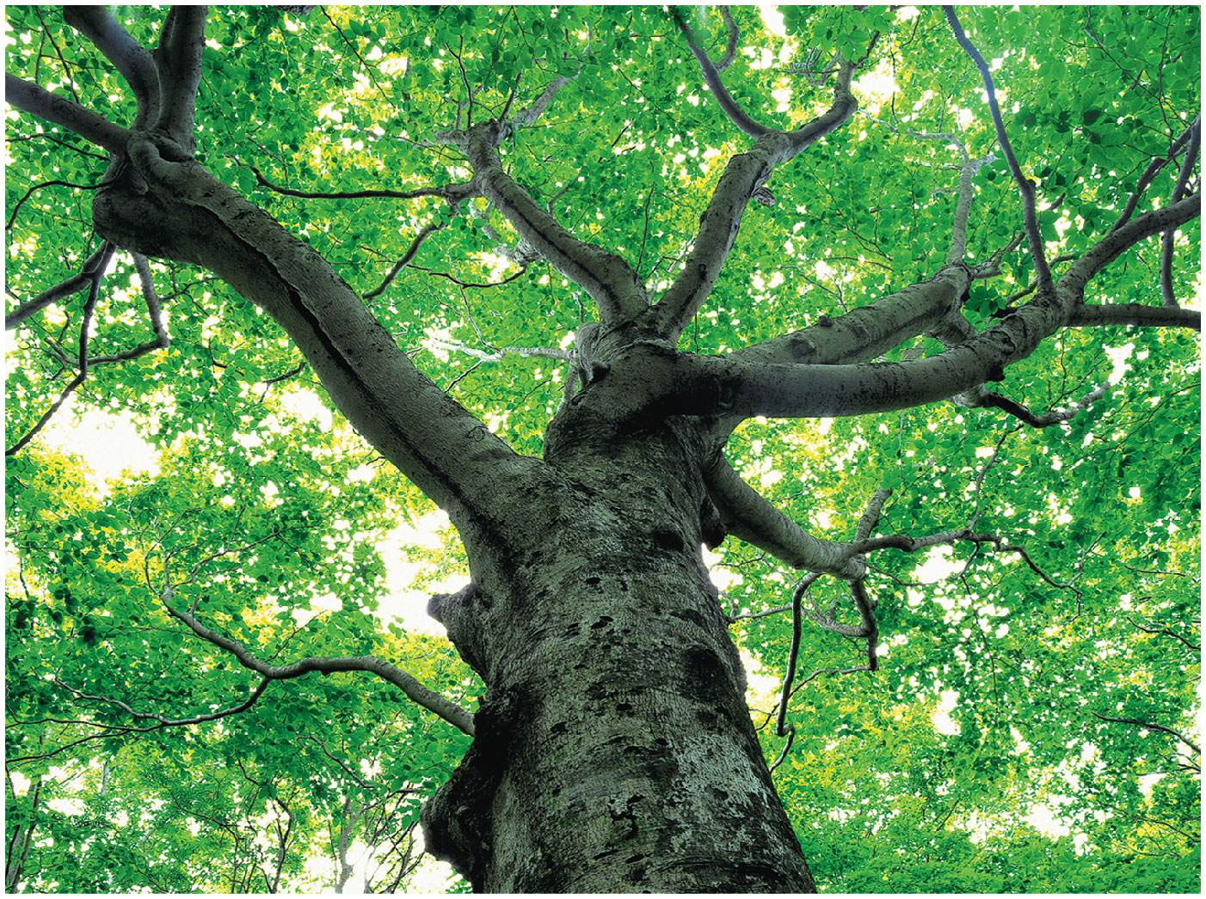
Where did the carbon found throughout the body of a plant originate?
soil
water
air
organic fertilizer
(manure, detritus)
light
Notes:
4
Answer: C. See Concepts 8.1 and 8.3. The carbon in a plant, no matter what part contains it, originated from the carbon in carbon dioxide in the atmosphere around the plant.

Slide 5
Where did the carbon found throughout the body of a plant originate?
soil
water
air
organic fertilizer
(manure, detritus)
light
Notes:
5

Slide 6
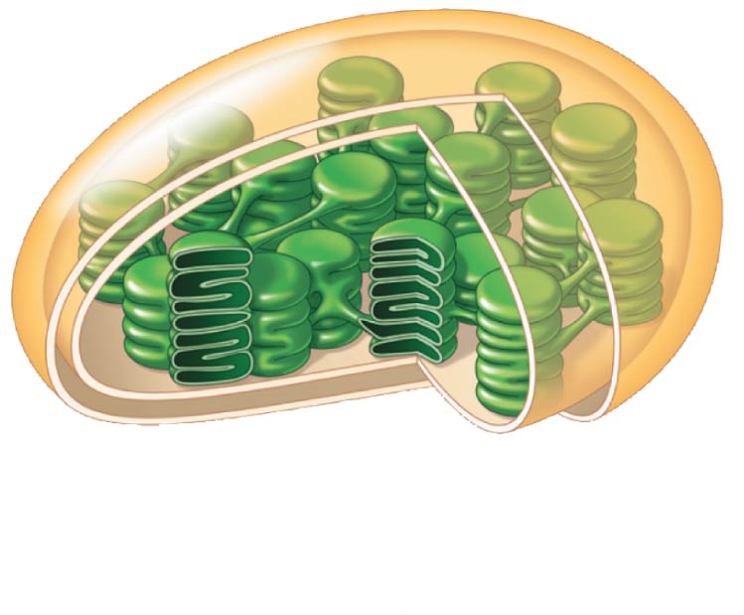
The light reactions, which involve the very hydrophobic chlorophyll, are located where in the chloroplast?
B.
E.
C.
(lumen)
A.
D.
Notes:
6
Answer: B. The light reactions occur in the thylakoid membranes, which are green due to the concentrated chlorophyll found there. See Concept 8.2.

Slide 7
The light reactions, which involve the very hydrophobic chlorophyll, are located where in the chloroplast?
B.
E.
C.
(lumen)
A.
D.
Notes:
7

Slide 8
The Calvin cycle reactions are located where in the chloroplast?
B.
E.
C.
(lumen)
A.
D.
Notes:
8
Answer: A. The stroma hosts the enzymes to fix carbon dioxide, using the energy gained by the light reactions in the thylakoid. Discuss what form that energy takes.

Slide 9
The Calvin cycle reactions are located where in the chloroplast?
B.
E.
C.
(lumen)
A.
D.
Notes:
9

Slide 10
What color(s) of light will drive photosynthesis by green plants most efficiently?
red only
yellow only
green only
blue only
red and blue
Notes:
10
Answer: E. See Concept 8.2. Chlorophylls absorb by far the greatest amount of light in the red and blue regions of the visible spectrum.

Slide 11
What color(s) of light will drive photosynthesis by green plants most efficiently?
red only
yellow only
green only
blue only
red and blue
Notes:
11

Slide 12
How are the light reactions and the Calvin cycle connected?
The light reactions provide ATP to the Calvin cycle, and the Calvin cycle provides NADPH for the light reactions.
The light reactions provide ATP and NADPH to the
Calvin cycle, and the Calvin cycle returns ADP, phosphate, and NADP⁺ to the light reactions.
The light reactions provide ATP and NADPH to the Calvin cycle, and the Calvin cycle returns reduced sugars to the light reactions.
The light reactions provide NADPH to the Calvin cycle, and the Calvin cycle provides RuBP to the light reactions.
The light reactions provide RuBP to the Calvin cycle, and the Calvin cycle returns G3P to the light reactions.
Notes:
12
Answer: B. See Concepts 8.2 and 8.3. The light reactions power the Calvin cycle, in a sense reversing the effects of the various parts of cellular respiration. Discuss an analogy with a rechargeable battery powering a machine to make donuts.

Slide 13
How are the light reactions and the Calvin cycle connected?
The light reactions provide ATP to the Calvin cycle, and the Calvin cycle provides NADPH for the light reactions.
The light reactions provide ATP and NADPH to the
Calvin cycle, and the Calvin cycle returns ADP, phosphate, and NADP⁺ to the light reactions.
The light reactions provide ATP and NADPH to the Calvin cycle, and the Calvin cycle returns reduced sugars to the light reactions.
The light reactions provide NADPH to the Calvin cycle, and the Calvin cycle provides RuBP to the light reactions.
The light reactions provide RuBP to the Calvin cycle, and the Calvin cycle returns G3P to the light reactions.
Notes:
13

Slide 14
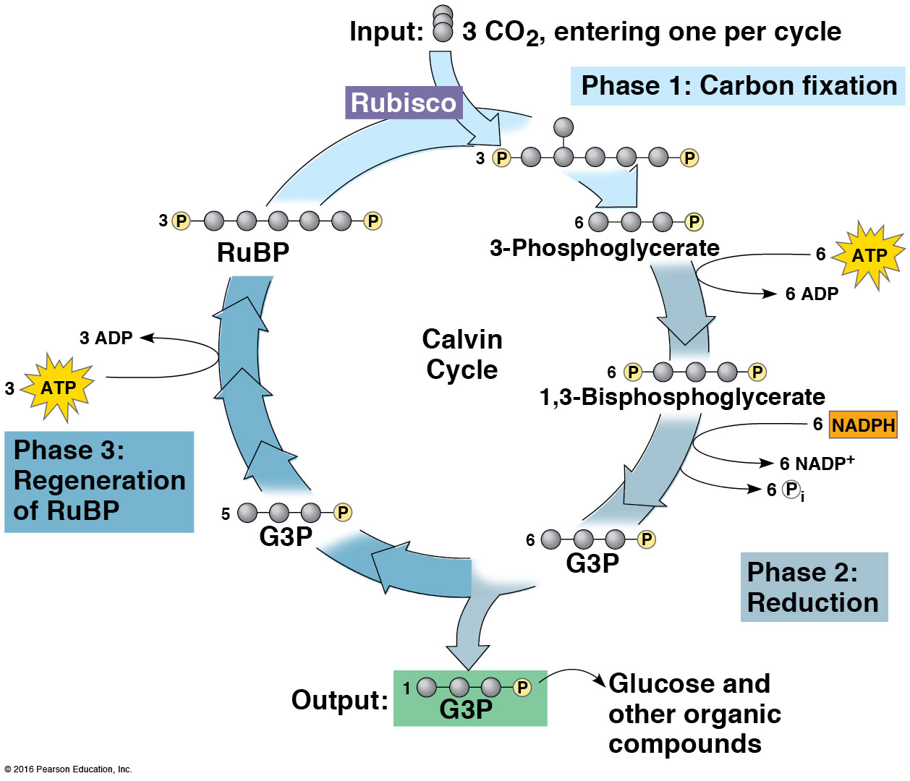
In this diagram, compound X is the CO₂ acceptor. If light is cut off, then
X and phosphoglycerate will both increase.
X will increase and phosphoglycerate will decrease.
X will decrease and
phosphoglycerate
will increase.
X and phosphoglycerate
will both decrease.
Compound X
Notes:
14
Answer: C. This question relates to Concept 8.3. Calvin and Benson identified the CO₂ acceptor compound partly based on its behavior when the Calvin cycle was manipulated by cutting off CO₂ or light. RuBP accumulated in the absence of carbon dioxide and was depleted in the dark.

Slide 15
In this diagram, compound X is the CO₂ acceptor. If light is cut off, then
X and phosphoglycerate will both increase.
X will increase and phosphoglycerate will decrease.
X will decrease and
phosphoglycerate
will increase.
X and phosphoglycerate
will both decrease.
Compound X
Notes:
15

Slide 16
Photorespiration occurs because
rubisco can use oxygen as a substrate when
CO₂ levels are low and oxygen levels are high.
linear electron flow cannot provide the Calvin cycle with enough ATP.
leaf cells use photorespiration to make ATP for cellular work outside the chloroplasts.
C₄ plants operate a CO₂ shuttle at a cost of extra ATP, provided by photorespiration.
plants need a way to consume the oxygen they produce.
Notes:
16
Answer: A. See Concept 8.3. Rubisco acts in some ways like a glacier, which advances and retreats, but which shows net retreat or advance over a period of years. Discuss that analogy more fully.

Slide 17
Photorespiration occurs because
rubisco can use oxygen as a substrate when
CO₂ levels are low and oxygen levels are high.
linear electron flow cannot provide the Calvin cycle with enough ATP.
leaf cells use photorespiration to make ATP for cellular work outside the chloroplasts.
C₄ plants operate a CO₂ shuttle at a cost of extra ATP, provided by photorespiration.
plants need a way to consume the oxygen they produce.
Notes:
17

Slide 18
A flask of duckweed in water is placed under a bank of lights on a 12-hour light, 12-hour dark cycle, next to a control flask containing only water. Assuming no change in water temperature, which flask will have the lowest dissolved oxygen (DO) concentration, at what time?
DO will always be the same in the two flasks.
DO will always be higher in the flask with duckweed than in the control.
DO will always be lower in the flask with duckweed than in the control.
The flask with duckweed will have the lowest DO at
the end of the dark cycle and the highest DO at the end of the light cycle.
Notes:
18
Answer: D. In the dark, plants respire (consume oxygen) but generate no oxygen. In the light, they generate more oxygen than they consume. See Concepts 8.2 and 8.3.

Slide 19
A flask of duckweed in water is placed under a bank of lights on a 12-hour light, 12-hour dark cycle, next to a control flask containing only water. Assuming no change in water temperature, which flask will have the lowest dissolved oxygen (DO) concentration, at what time?
DO will always be the same in the two flasks.
DO will always be higher in the flask with duckweed than in the control.
DO will always be lower in the flask with duckweed than in the control.
The flask with duckweed will have the lowest DO at
the end of the dark cycle and the highest DO at the end of the light cycle.
Notes:
19

Slide 20
How will increasing atmospheric CO₂ levels affect growth of terrestrial plants?
All plants will grow faster.
Most plants will be adversely affected.
C₃ plants will grow faster, with no effect on C₄ plants.
C₄ plants will thrive, while C₃ plants will suffer.
It depends on changes in the local climate.
Notes:
20
Answer: E. This question relates to Concept 8.3. The answer depends on resulting changes in the local environment—desertification will favor C₄ plants, whereas C₃ plants may benefit in certain situations. In reality, plant growth is rarely limited by carbon dioxide; growth is more often limited by scarcity of water, organic nitrogen, or minerals such as phosphate.

Slide 21
How will increasing atmospheric CO₂ levels affect growth of terrestrial plants?
All plants will grow faster.
Most plants will be adversely affected.
C₃ plants will grow faster, with no effect on C₄ plants.
C₄ plants will thrive, while C₃ plants will suffer.
It depends on changes in the local climate.
Notes:
21

Slide 22
Where might you find oxygen-producing, chlorophyll- based photosynthesis?
an ocean shore where seaweeds grow
a pond full of cyanobacteria
a farm field full of lettuce plant
a chloroplast
All of the choices are correct.
Notes:
Answer: E. All of these examples involve the oxygen-producing form of photosynthesis. Contrast with the form used by purple sulfur bacteria, which do not produce oxygen, and where that can be found. See Concept 8.1.

Slide 23
Where might you find oxygen-producing, chlorophyll- based photosynthesis?
an ocean shore where seaweeds grow
a pond full of cyanobacteria
a farm field full of lettuce plant
a chloroplast
All of the choices are correct.

Slide 24
If you wanted to design a very specific chemical to target the light reactions of photosynthesis, where should that chemical be designed to go, most specifically?
stomata
thylakoids
mesophyll
stroma
chloroplasts
Notes:
Answer: B. The thylakoids are the exact site of the light reactions and thus the most specific location, even though all of the other options have some connection to photosynthesis. Discuss why each of the other answer choices is either wrong or less specific. See Concept 8.1.

Slide 25
If you wanted to design a very specific chemical to target the light reactions of photosynthesis, where should that chemical be designed to go, most specifically?
stomata
thylakoids
mesophyll
stroma
chloroplasts

Slide 26
If you placed a leaf in a chamber filled with helium gas and shone light on it, ____ would decline in concentration over time inside the leaf and ____ would increase.
glucose; carbon dioxide
ATP; carbon dioxide
carbon dioxide; oxygen
water; oxygen
oxygen; ATP
Notes:
Answer: C. Oxygen would be produced while enough carbon dioxide was present for photosynthesis to proceed, and carbon dioxide would decline in concentration as it was fixed into glucose. See Concept 8.1.

Slide 27
If you placed a leaf in a chamber filled with helium gas and shone light on it, ____ would decline in concentration over time inside the leaf and ____ would increase.
glucose; carbon dioxide
ATP; carbon dioxide
carbon dioxide; oxygen
water; oxygen
oxygen; ATP

Slide 28
Which term is most closely associated with the use of NADPH during photosynthesis?
mesophyll
thylakoid
light reactions
ATP
Calvin cycle
Notes:
Answer: E. The Calvin cycle uses the energy-rich compounds produced by the light reactions to turn carbon dioxide into glucose. See Concepts 8.1 and 8.3.

Slide 29
Which term is most closely associated with the use of NADPH during photosynthesis?
mesophyll
thylakoid
light reactions
ATP
Calvin cycle

Slide 30
Which is least necessary for most photosynthesis on Earth?
water
oxygen
hydrogen sulfide
ATP
chlorophyll
Notes:
Answer: C. Most photosynthesis on Earth is the oxygen-producing kind; hydrogen sulfide is more critical for the kind of photosynthesis performed by some bacteria. See Concept 8.1.

Slide 31
Which is least necessary for most photosynthesis on Earth?
water
oxygen
hydrogen sulfide
ATP
chlorophyll

Slide 32
Which light bulb would be least useful for growing plants indoors?
a white light bulb
a green light bulb
a red light bulb
a blue light bulb
A and B
Notes:
Answer: B. Green light is either reflected or transmitted by leaves, not absorbed by the photosynthetic pigments. See Concept 8.2.

Slide 33
Which light bulb would be least useful for growing plants indoors?
a white light bulb
a green light bulb
a red light bulb
a blue light bulb
A and B

Slide 34
Which of the following accurately describes an action spectrum?
the set of wavelengths that lead to frogs hibernating in the fall
the set of wavelengths that lead to oxygen production during photosynthesis
the set of wavelengths that cause microbes to swim toward a light
the set of wavelengths that lead to starch production
All of the answer choices are correct.
Notes:
Answer: E. An action spectrum is the set of wavelengths that lead to some measurable response by an organism. Discuss how a traffic light can be used as an analogy for this. See Concept 8.2.

Slide 35
Which of the following accurately describes an action spectrum?
the set of wavelengths that lead to frogs hibernating in the fall
the set of wavelengths that lead to oxygen production during photosynthesis
the set of wavelengths that cause microbes to swim toward a light
the set of wavelengths that lead to starch production
All of the answer choices are correct.

Slide 36
If you wanted to describe, using specific data, how a leaf uses the energy of absorbed photons, which of the following would you measure?
fluorescence
photosynthetic production
heat production
A and B
A–C
Notes:
Answer: E. The energy absorbed by a leaf is not all put into the chemical bonds in glucose. Some is lost as heat and some is lost as fluoresced photons. See Concept 8.2.

Slide 37
If you wanted to describe, using specific data, how a leaf uses the energy of absorbed photons, which of the following would you measure?
fluorescence
photosynthetic production
heat production
A and B
A–C

Slide 38
If you were studying a chloroplast and found a photosystem floating in the stroma, and this photosystem included chlorophylls a and b as well as protein, why would be unusual?
Photosystems usually contain one chlorophyll or the other, but not both.
Photosystems are found in the cytoplasm, not chloroplasts.
Photosystems are found in the thylakoid
membranes, not the stroma.
Photosystems usually do not include protein, just chlorophyll.
None of the choices is correct.
Notes:
Answer: C. Photosystems are inserted in the thylakoid membrane and contain a mix of proteins and pigments. See Concept 8.2.

Slide 39
If you were studying a chloroplast and found a photosystem floating in the stroma, and this photosystem included chlorophylls a and b as well as protein, why would be unusual?
Photosystems usually contain one chlorophyll or the other, but not both.
Photosystems are found in the cytoplasm, not chloroplasts.
Photosystems are found in the thylakoid membranes, not the stroma.
Photosystems usually do not include protein, just chlorophyll.
None of the choices is correct.

Slide 40
If you were studying the biochemistry of photosynthesis and found that GTP and NADH were produced after chlorophyll absorbed red and blue light in the thylakoid membranes, what would be unusual about this process?
Photosyntheis produces ATP and NADPH.
Photosynthesis uses green light—that’s why chloroplasts are green.
Chlorophyll fluoresces light, not absorbs it.
Chlorophyll is found in the stroma, not the thylakoids.
None of the choices is correct.
Notes:
Answer: A. Photosynthesis produces ATP and NADPH for powering the Calvin cycle. See Concept 8.2.

Slide 41
If you were studying the biochemistry of photosynthesis and found that GTP and NADH were produced after chlorophyll absorbed red and blue light in the thylakoid membranes, what would be unusual about this process?
Photosyntheis produces ATP and NADPH.
Photosynthesis uses green light—that’s why chloroplasts are green.
Chlorophyll fluoresces light, not absorbs it.
Chlorophyll is found in the stroma, not the thylakoids.
None of the choices is correct.

Slide 42
Place the steps of the Calvin cycle in the correct order:
fixation, regeneration, reduction
reduction, regeneration, fixation
fixation, reduction, regeneration
regeneration, reduction, fixation
regeneration, fixation, reduction
Notes:
Answer: C. Carbon dioxide is added to RuBP, then energy is used to chemically reduce the resulting compound before RuBP is regenerated. See Concept 8.3.

Slide 43
Place the steps of the Calvin cycle in the correct order:
fixation, regeneration, reduction
reduction, regeneration, fixation
fixation, reduction, regeneration
regeneration, reduction, fixation
regeneration, fixation, reduction

Slide 44
If you were walking in the desert and saw a rounded, spiny plant, what kind of photosynthesis might be occurring in the plant?
C₃
C₄
CAM
A or B, depending on how recently rain fell
Not enough information is provided to guess.
Notes:
Answer: C. The plant sounds like a cactus, which would use CAM photosynthesis. Discuss how some plants can switch between C₃ and one of the more drought-tolerant forms of photosynthesis. See Concept 8.3.

Slide 45
If you were walking in the desert and saw a rounded, spiny plant, what kind of photosynthesis might be occurring in the plant?
C₃
C₄
CAM
A or B, depending on how recently rain fell
Not enough information is provided to guess.

Slide 46
If you were walking past a pond in Minnesota and saw a waterlily in the pond, what kind of photosynthesis might be occurring in the plant?
C₃
C₄
CAM
A or C, depending on how recently rain fell
Not enough information is provided to guess.
Notes:
Answer: A. Plants with abundant water supplies generally use the energetically cheaper C₃ form of photosynthesis. There are exceptions, such as aquatic isoetes, which can use CAM. See Concept 8.3.

Slide 47
If you were walking past a pond in Minnesota and saw a waterlily in the pond, what kind of photosynthesis might be occurring in the plant?
C₃
C₄
CAM
A or C, depending on how recently rain fell
Not enough information is provided to guess.

Slide 48
When studying a plant which, based on oxygen production, is actively photosynthesizing, you find very little glucose. Where did it all go?
cell walls
starch grains
to make other sugars
for cellular respiration
All of the answers are correct.
Notes:
Answer: E. The glucose made in photosynthesis is quickly used for building various other structures and is also broken down via cellular respiration to provide needed ATP. See Concept 8.3.

Slide 49
When studying a plant which, based on oxygen production, is actively photosynthesizing, you find very little glucose. Where did it all go?
cell walls
starch grains
to make other sugars
for cellular respiration
All of the answers are correct.

Slide 50
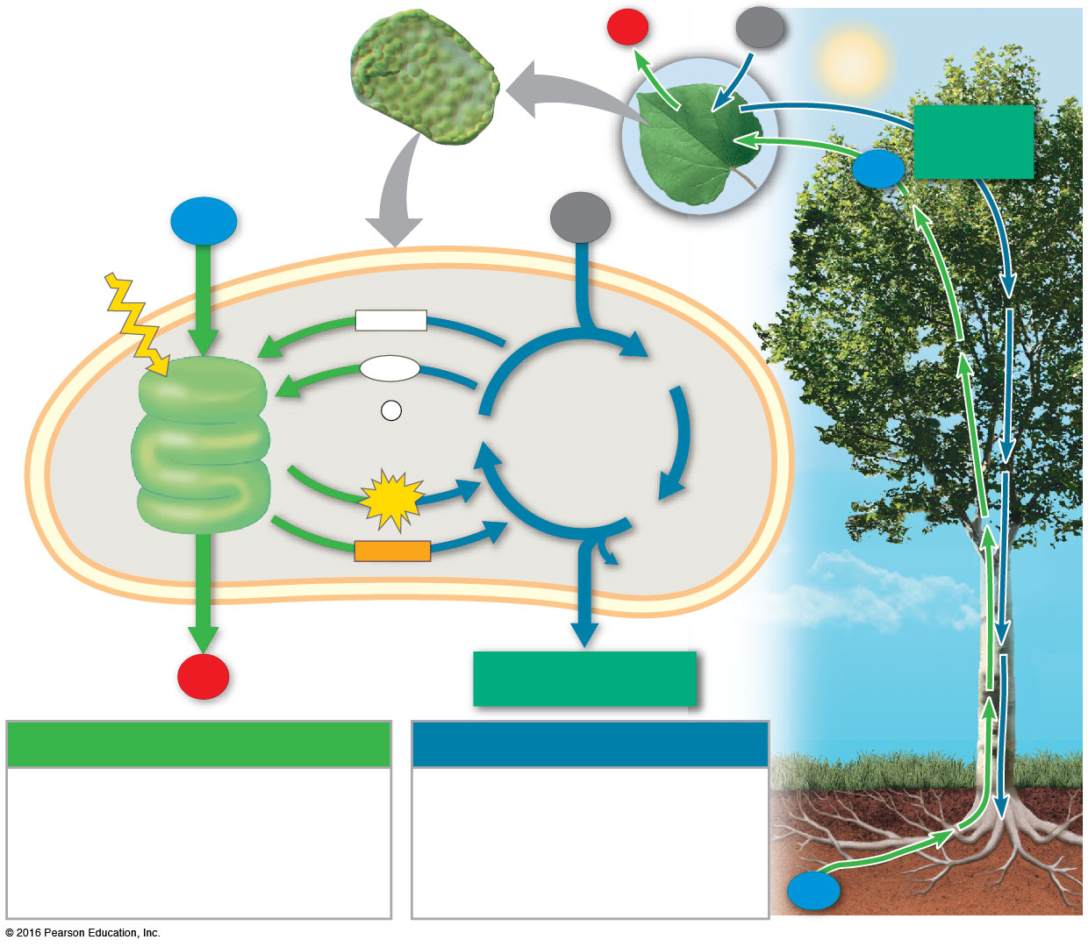
Which item(s) are provided to you by photosynthesis?
oxygen in your latest breath
starch in the toast you ate for breakfast
chitin in fungal cell walls in the
steak sandwich you ate
for lunch
paper in your textbook
A, B, and D
Notes:
Answer: E. Oxygen gas, starch, and wood (used for making paper) are all the results, directly or indirectly, of photosynthesis, while chitin from fungal walls must be derived from sources other than plant material. Fungi do not photosynthesize. See Concept 8.3.

Slide 51
Which item(s) are provided to you by photosynthesis?
oxygen in your latest breath
starch in the toast you ate for breakfast
chitin in fungal cell walls in the
steak sandwich you ate
for lunch
paper in your textbook
A, B, and D

