Slide 1
2
The Chemical Context of Life

Slide 2
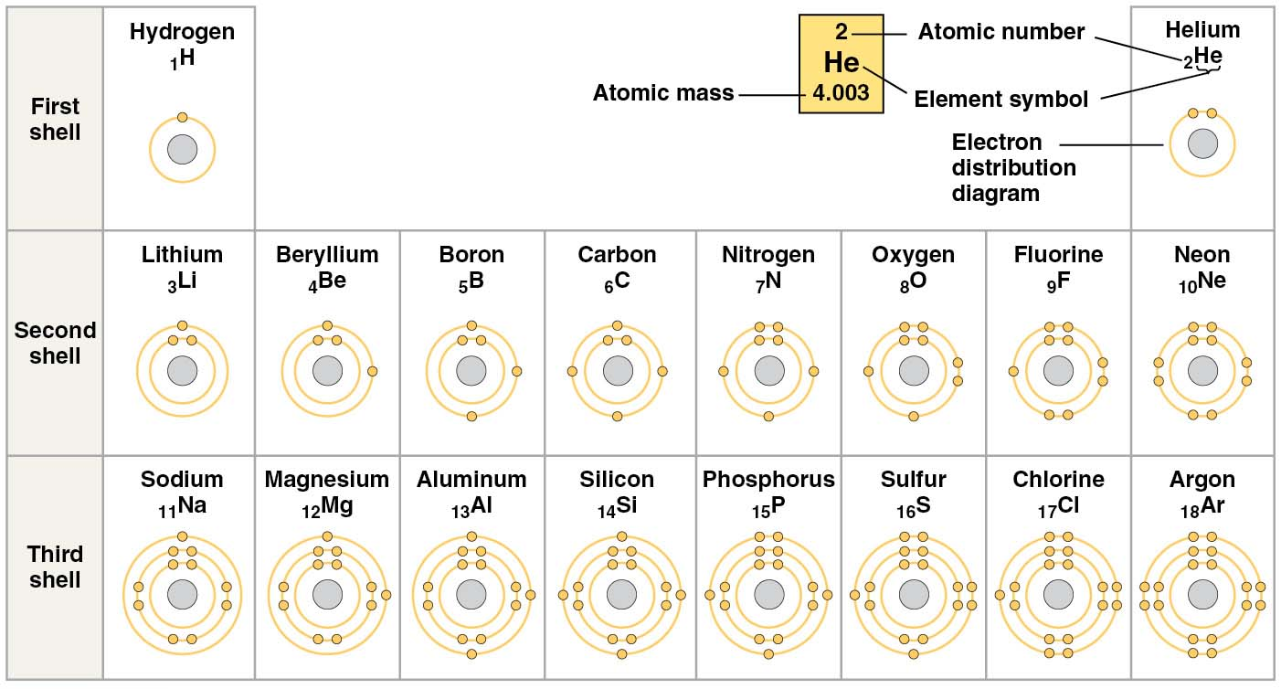
Based on the periodic table shown here, which elements will most likely form an ionic bond?
Na and Cl
C and O
N and O
Si and Cl
all of the above
Notes:
Answer: A is the best choice because the elements are in columns (in the abbreviated periodic table shown) that readily gain and lose one electron each. Other options are in more interior columns and do not easily ionize in this way.
This question is aimed at Concept 2.3. It should lead to a discussion of the basic concepts of electronegativity and types of bonds. *This continues in the next slide, so be sure to discuss covalent bonds now and to follow up with the next Clicker slide.*

Slide 3
Based on the periodic table shown here, which elements will most likely form an ionic bond?
Na and Cl
C and O
N and O
Si and Cl
all of the above
Notes:
3

Slide 4
Based on the periodic table shown here, which elements will most likely form a covalent bond?
Na and Cl
C and O
N and O
Si and Cl
H and H
Notes:
4
Answer: E is the best choice since these two will readily share electrons, having the same electronegativity. Discuss how other pairs differ from them in these characteristics.
This question is aimed at Concept 2.3. It should lead to a discussion of the basic concepts of electronegativity and types of bonds. One way to change this question would be to add C and H as a choice. This could be used to lead into a more detailed discussion. *Also, discuss the kinds of bonds that these pairs do form in living systems, such as the double bonds between oxygen and carbon seen in sugars.*

Slide 5
Based on the periodic table shown here, which elements will most likely form a covalent bond?
Na and Cl
C and O
N and O
Si and Cl
H and H
Notes:
5

Slide 6
What do elements with atomic numbers 6, 14, and 22 have in common?
same number of electrons
same atomic mass
same valence and will form the same number of covalent bonds
all of the above
none of the above
Notes:
6
Answer: C. This question focuses on Concept 2.2. It highlights the fact that these elements have the same basic structures and therefore the same basic properties. Suggest that students look at the periodic table in their textbook (Fig. 2.6).

Slide 7
What do elements with atomic numbers 6, 14, and 22 have in common?
same number of electrons
same atomic mass
same valence and will form the same number of covalent bonds
all of the above
none of the above
Notes:
7

Slide 8
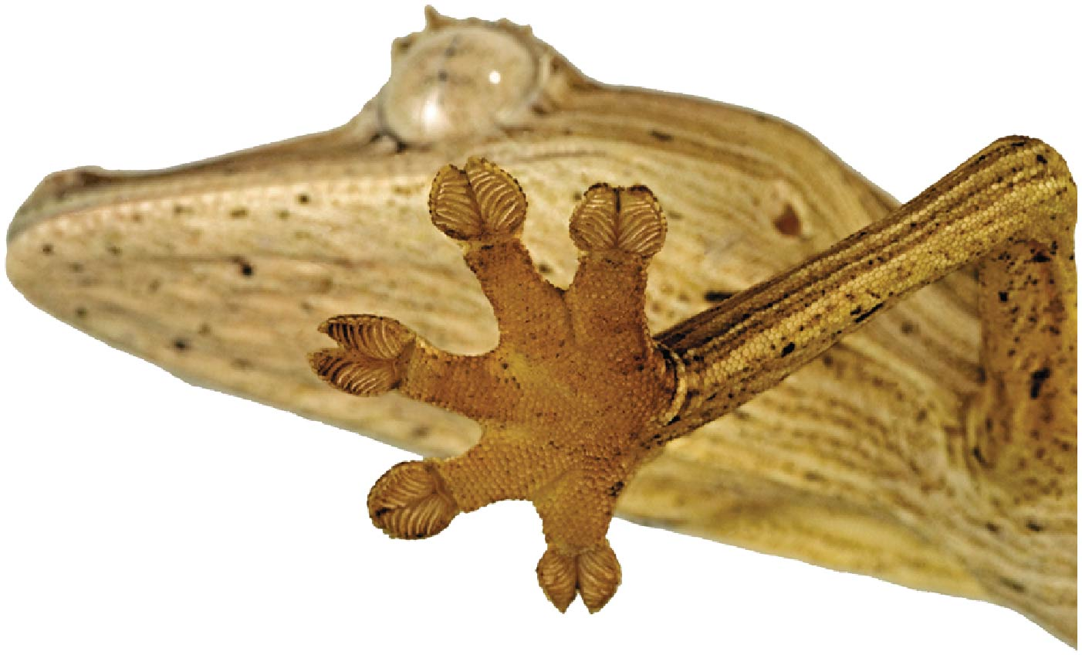
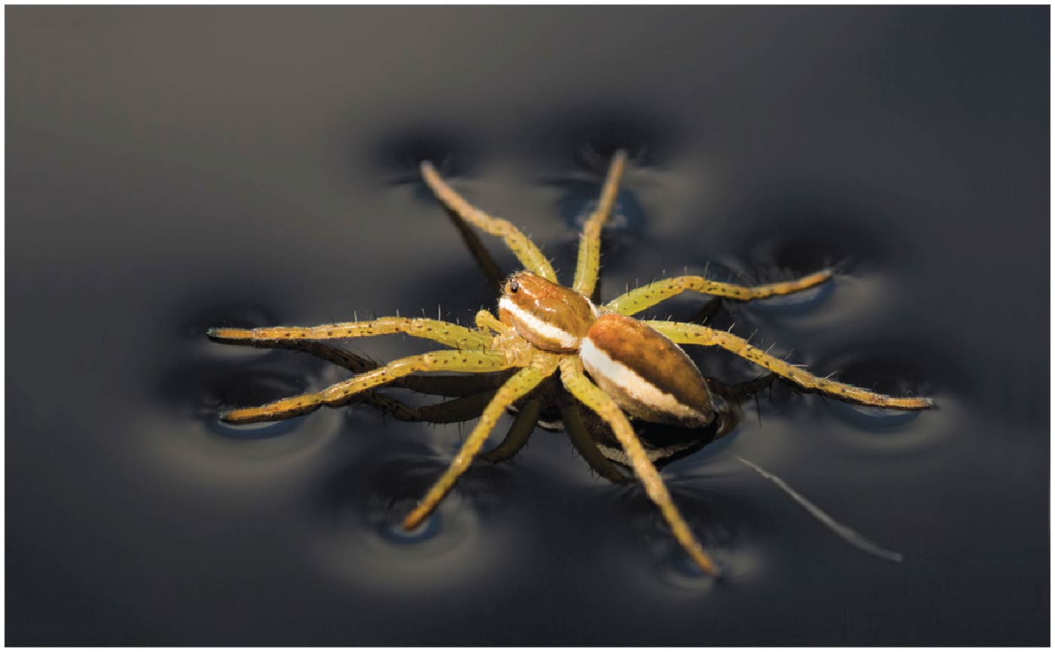
The gecko can climb smooth walls due to one type of bond or interaction, while a spider can walk on water due to a different kind. Identify each type of bond.
polar covalent, van der Waals
nonpolar covalent, polar covalent
strong ionic bond, hydrogen bond
weak ionic bond, polar covalent
van der Waals, hydrogen bond
Notes:
8
Answer: E. The gecko uses weak van der Waals interactions on many, many hairs to climb a wall, while the hydrogen bonds in water form a sheet that the light spider can walk across.
*This question relates to Concept 2.3, and a discussion of bonds types and strengths is appropriate. For example, why can the spider walk on water, but not a human? Also, bring in the new artificial adhesive based on the gecko’s climbing mechanism, which is discussed in the text.*

Slide 9
The gecko can climb smooth walls due to one type of bond or interaction, while a spider can walk on water due to a different kind. Identify each type of bond.
polar covalent, van der Waals
nonpolar covalent, polar covalent
strong ionic bond, hydrogen bond
weak ionic bond, polar covalent
van der Waals, hydrogen bond
Notes:
9

Slide 10
Buffers will bind to one of the chemicals shown in the reaction below. How will that change this reversible reaction?
H₂CO₃ HCO₃⁻ + H⁺
The reaction will stop.
HCO₃⁻ will release carbonate ions.
H₂CO₃ will precipitate from solution.
H₂CO₃ concentration will not change.
HCO₃⁻ concentration will increase.
Notes:
10
Answer: E. This topic is covered in Concepts 2.4 and 2.5. To connect to later/other material, briefly discuss either the bicarbonate buffering of blood pH or carbonic anhydrase, the world’s fastest enzyme, critical in both plants and animals for gas exchange.

Slide 11
Buffers will bind to one of the chemicals shown in the reaction below. How will that change this reversible reaction?
H₂CO₃ HCO₃⁻ + H⁺
The reaction will stop.
HCO₃⁻ will release carbonate ions.
H₂CO₃ will precipitate from solution.
H₂CO₃ concentration will not change.
HCO₃⁻ concentration will increase.
Notes:
11

Slide 12
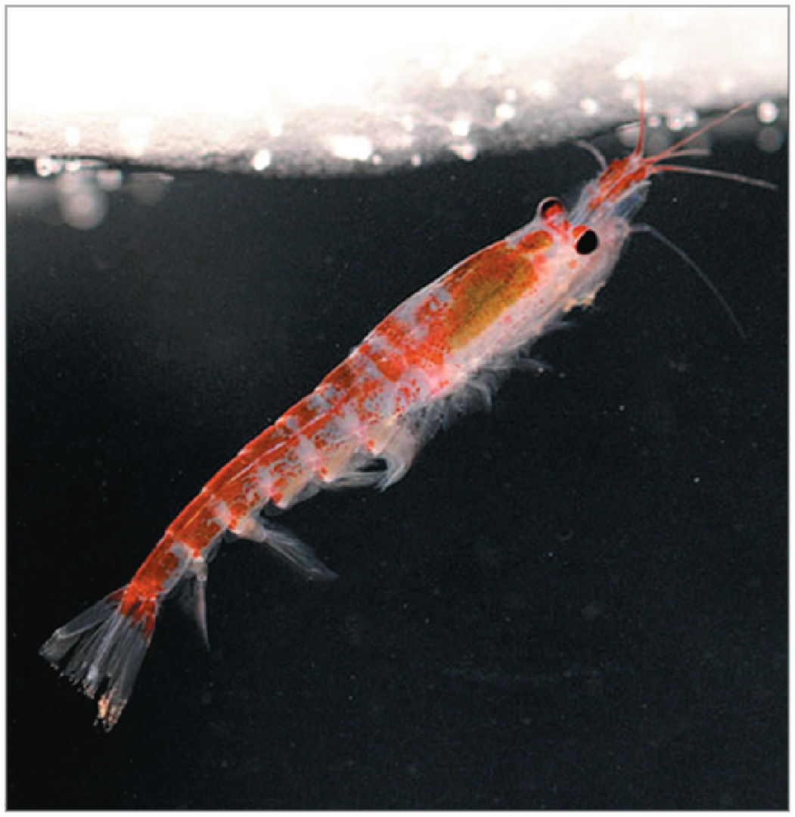
Water has special properties, including high cohesion, high surface tension, and the ability to absorb large amounts of heat. What kind of bond between water molecules gives water these special properties?
strong ionic bonds
nonpolar covalent bonds
polar covalent bonds
hydrogen bonds
weak ionic bonds
Notes:
12
Answer: D. This question emphasizes that the unique nature of water is due to extensive hydrogen bonding and deals with Concept 2.5.

Slide 13
Water has special properties, including high cohesion, high surface tension, and the ability to absorb large amounts of heat. What kind of bond between water molecules gives water these special properties?
strong ionic bonds
nonpolar covalent bonds
polar covalent bonds
hydrogen bonds
weak ionic bonds
Notes:
13

Slide 14
Which observation would determine whether geckos walk on vertical surfaces using (1) hydrogen bonding or (2) van der Waals interactions?
Geckos can walk up dry surfaces, and glass and plastic are normally dry.
Geckos can walk up smooth glass surfaces, and glass is a polar, hydrophilic compound.
Geckos can walk up smooth plastic surfaces, and plastics are hydrophobic.
Notes:
14
Answer: B. This deals with Concepts 2.3 and 2.5. Introduce the idea that A does not allow one to differentiate between either option. Review the nature of hydrogen bonds and van der Waals interactions.

Slide 15
Which observation would determine whether geckos walk on vertical surfaces using (1) hydrogen bonding or (2) van der Waals interactions?
Geckos can walk up dry surfaces, and glass and plastic are normally dry.
Geckos can walk up smooth glass surfaces, and glass is a polar, hydrophilic compound.
Geckos can walk up smooth plastic surfaces, and plastics are hydrophobic.
Notes:
15

Slide 16
What are the four emergent properties of water that are important for life?
cohesion, expansion upon freezing, high heat of evaporation, capillarity
cohesion, moderation of temperature, expansion upon freezing, solvent properties
moderation of temperature, solvent properties, high surface tension, capillarity
heat of vaporization, high specific heat, high surface tension, capillarity
polarity, hydrogen bonding, high specific heat, high surface tension
Notes:
16
Answer: B. This relates to Concept 2.5. Discuss briefly an example of each property used by living things or affecting living things.

Slide 17
What are the four emergent properties of water that are important for life?
cohesion, expansion upon freezing, high heat of evaporation, capillarity
cohesion, moderation of temperature, expansion upon freezing, solvent properties
moderation of temperature, solvent properties, high surface tension, capillarity
heat of vaporization, high specific heat, high surface tension, capillarity
polarity, hydrogen bonding, high specific heat, high surface tension
Notes:
17

Slide 18
Water has an unusually high specific heat. This is directly related to which of the following?
At its boiling point, water changes from liquid to vapor.
More heat is required to raise the temperature of water.
Ice floats in liquid water.
Salt water freezes at a lower temperature than pure water.
Floating ice can insulate bodies of water.
Notes:
18
Answer: B. This comes from Concept 2.5. Discuss the relationship of this property to the value of sweating in animals or transpiration in plants on a hot day.

Slide 19
Water has an unusually high specific heat. This is directly related to which of the following?
At its boiling point, water changes from liquid to vapor.
More heat is required to raise the temperature of water.
Ice floats in liquid water.
Salt water freezes at a lower temperature than pure water.
Floating ice can insulate bodies of water.
Notes:
19

Slide 20
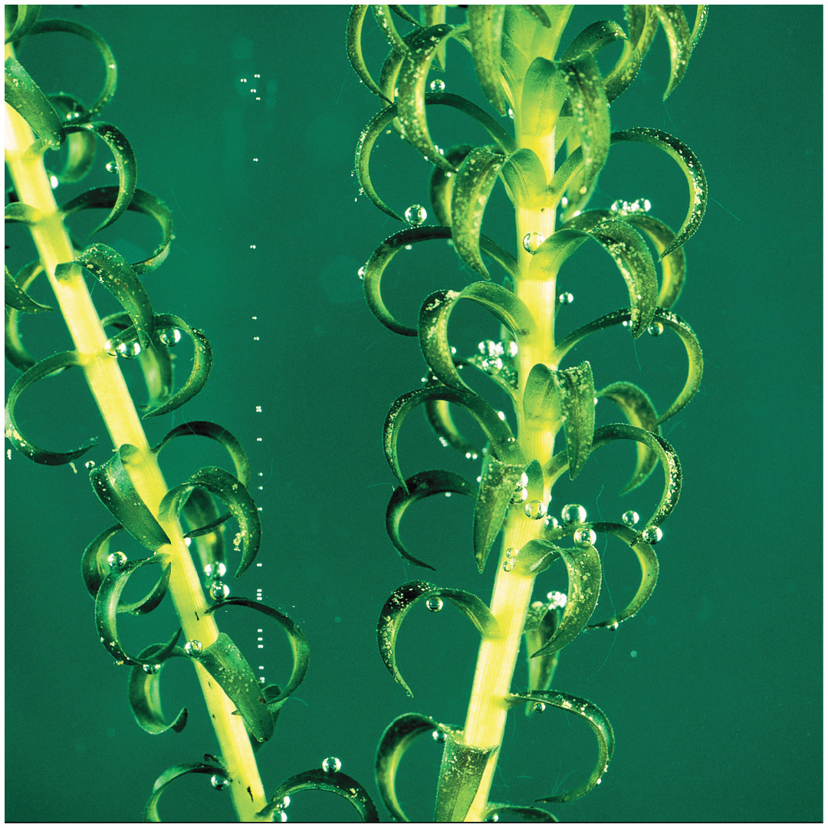
Which of the following will result when water is treated with chemicals to reduce its surface tension?
Surfactant-treated water droplets will form a thin film instead of beading on a waxed surface.
Surfactant-treated water will form smaller droplets when dripping from a sink.
Water striders will sink.
All of the above will occur.
Only A and C will occur.
Notes:
20
Answer: D. This connects to Concept 2.5. Using the figure showing gas bubbles escaping from an aquatic plant, relate the formation of those bubbles due to surface tension to the surface tension-derived phenomena in A–C.

Slide 21
Which of the following will result when water is treated with chemicals to reduce its surface tension?
Surfactant-treated water droplets will form a thin film instead of beading on a waxed surface.
Surfactant-treated water will form smaller droplets when dripping from a sink.
Water striders will sink.
All of the above will occur.
Only A and C will occur.
Notes:
21

Slide 22
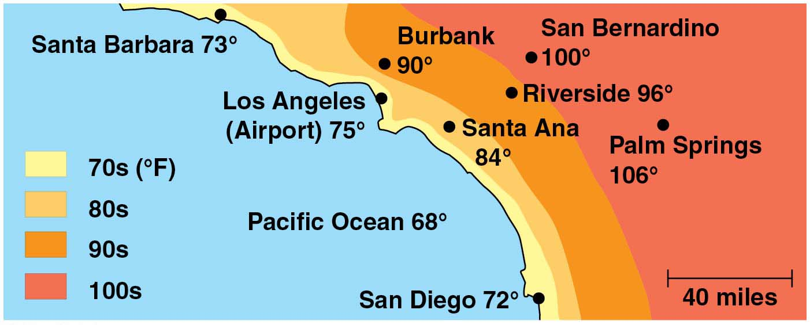
Temperatures depend on local geographic conditions. Why is the temperature much cooler in Los Angeles than in San Bernardino?
The cool ocean water buffers temperatures by cooling winds moving inland.
The high specific heat of water helps keep ocean water cooler than land.
Los Angeles is closer to the ocean than San Bernardino.
A and B
A–C
Notes:
Answer: E. Ocean water stays cooler due to the higher specific heat of water, and winds moving from the ocean to land are cooler. However, these winds warm as they pass over more and more land, providing less and less cooling. This relates to Concept 2.5.

Slide 23
Temperatures depend on local geographic conditions. Why is the temperature much cooler in Los Angeles than in San Bernardino?
The cool ocean water buffers temperatures by cooling winds moving inland.
The high specific heat of water helps keep ocean water cooler than land.
Los Angeles is closer to the ocean than San Bernardino.
A and B
A–C

Slide 24
Which is a compound?
gold
nitrogen
carbon
phosphorus
none of the above
Notes:
Answer: E. All of the options given are chemical elements, which can make compounds, but are not compounds themselves. Please see Concept 2.1.

Slide 25
Which is a compound?
gold
nitrogen
carbon
phosphorus
none of the above

Slide 26
You are asked whether a sample came from a living thing. Chemical analysis shows that it consists mostly of calcium and sulfur, so you say that
it did, since living things contain calcium and sulfur.
it did not, since living things contain calcium, but not sulfur.
it did, since living things usually contain mostly phosphorus.
it did not, since sulfur is toxic.
it did not, since living things contain more carbon and oxygen than most other elements.
Notes:
Answer: E. The four most abundant chemical elements in living things are carbon, hydrogen, oxygen, and nitrogen. Please see Concept 2.1.

Slide 27
You are asked whether a sample came from a living thing. Chemical analysis shows that it consists mostly of calcium and sulfur, so you say that
it did, since living things contain calcium and sulfur.
it did not, since living things contain calcium, but not sulfur.
it did, since living things usually contain mostly phosphorus.
it did not, since sulfur is toxic.
it did not, since living things contain more carbon and oxygen than most other elements.

Slide 28
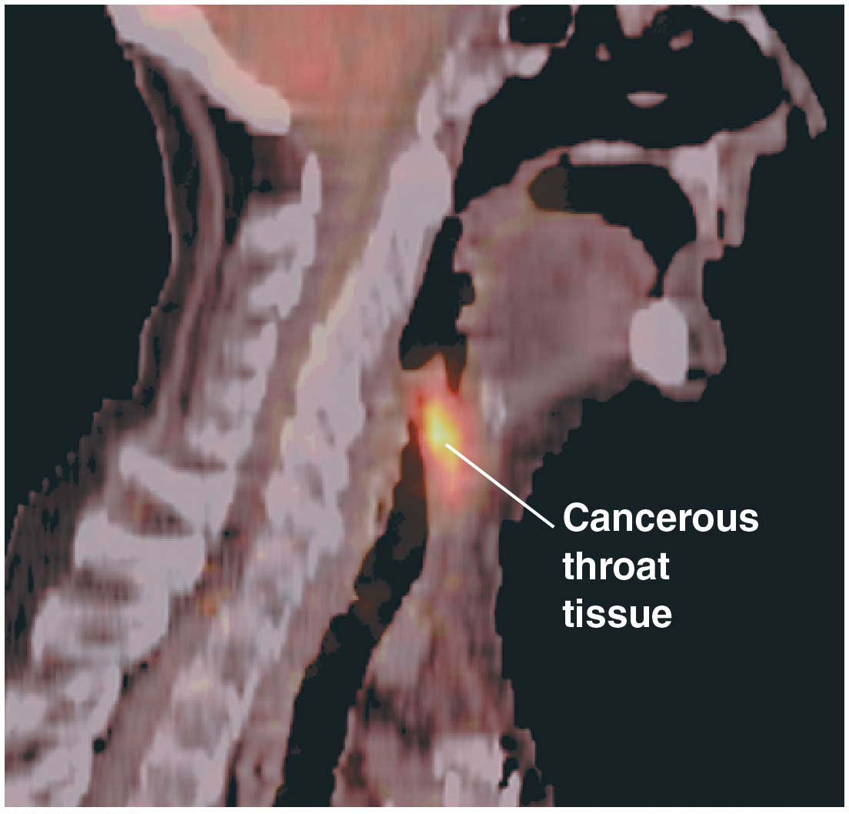
If you see radioactive isotopes in a laboratory that deals with biological samples, what could you be sure is not the reason for their presence?
medical imaging
tracing movements in cells
dating fossils
disinfecting wounds
B and C
Notes:
Answer: D. Radioactive isotopes can be very dangerous and so would not be used for cleaning wounds. Concept 2.2 discusses different forms of chemical elements.

Slide 29
If you see radioactive isotopes in a laboratory that deals with biological samples, what could you be sure is not the reason for their presence?
medical imaging
tracing movements in cells
dating fossils
disinfecting wounds
B and C

Slide 30
Complete the analogy: covalent bonds are to ionic bonds as a wooden board is to
paper.
egg shells.
a tree trunk.
a mosquito.
a leaf.
Notes:
Answer: A. Chemical bonds, as discussed in Concept 2.3, are made using electrons, and covalent bonds are stronger than ionic bonds. Boards and paper are made using material from trees, and boards are stronger than paper.

Slide 31
Complete the analogy: covalent bonds are to ionic bonds as a wooden board is to
paper.
egg shells.
a tree trunk.
a mosquito.
a leaf.

Slide 32
Correct the following statement: “A double ionic bond can occur if the valence shells of the two participants allow for sharing two electrons.”
“A double hydrogen bond can occur if the valence shells of the two participants allow for sharing two electrons.”
“A double covalent bond can occur if the valence shells of the two participants allow for sharing two electrons.”
“A double ionic bond can occur if the valence shells of the two participants allow for sharing three electrons.”
“A double covalent bond can occur if the valence shells of the two participants allow for sharing four electrons.”
“A double ionic bond can occur if the valence shells of the two participants allow for sharing four electrons.”
Notes:
Answer: D. Double bonds are covalent bonds, and a double bond involves four shared electrons. Please see Concept 2.3.

Slide 33
Correct the following statement: “A double ionic bond can occur if the valence shells of the two participants allow for sharing two electrons.”
“A double hydrogen bond can occur if the valence shells of the two participants allow for sharing two electrons.”
“A double covalent bond can occur if the valence shells of the two participants allow for sharing two electrons.”
“A double ionic bond can occur if the valence shells of the two participants allow for sharing three electrons.”
“A double covalent bond can occur if the valence shells of the two participants allow for sharing four electrons.”
“A double ionic bond can occur if the valence shells of the two participants allow for sharing four electrons.”

Slide 34
Which of the following is a nonpolar covalent bond?
Na—Na
Ca—Ca
C—C
C—H
Ca—C
Notes:
Answer: C, because a nonpolar bond should have two atoms of the same element, and Na and Ca form ionic bonds, as described in Concepts 2.1 and 2.3.

Slide 35
Which of the following is a nonpolar covalent bond?
Na—Na
Ca—Ca
C—C
C—H
Ca—C

Slide 36
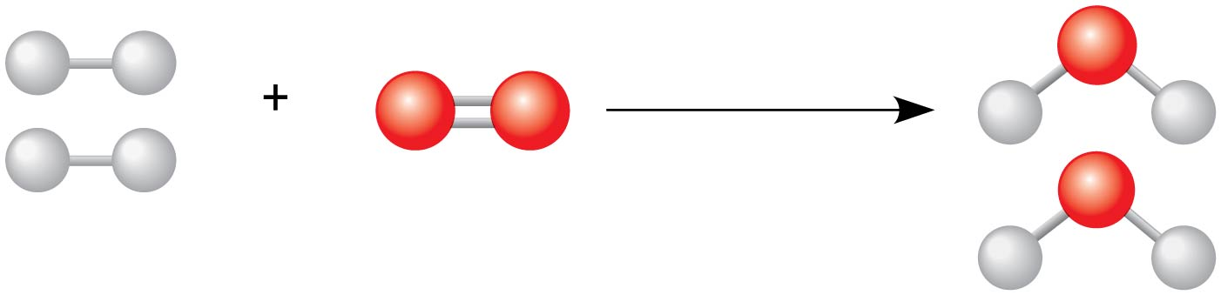
The chemicals on the left are ______, the arrow shows the ______, and the chemical on the right is the _______.
products, reaction, reactant
reactants, progress, product
reactants, reaction, product
products, reaction, reactant
None of the choices is correct.
Notes:
Answer: C. The reactants combine to produce the product, which is water in this example from Concept 2.4.

Slide 37
The chemicals on the left are ______, the arrow shows the ______, and the chemical on the right is the _______.
products, reaction, reactant
reactants, progress, product
reactants, reaction, product
products, reaction, reactant
None of the choices is correct.

Slide 38
What do the bubbles shown on these leaves indicate?
formation of covalent bonds
formation of ionic bonds
formation of radioactive isotopes
formation of new elements
formation of ice crystals
Notes:
Answer: A. Photosynthesis, which produces the oxygen in the bubbles, creates covalent bonds in carbohydrates.

Slide 39
What do the bubbles shown on these leaves indicate?
formation of covalent bonds
formation of ionic bonds
formation of radioactive isotopes
formation of new elements
formation of ice crystals

Slide 40
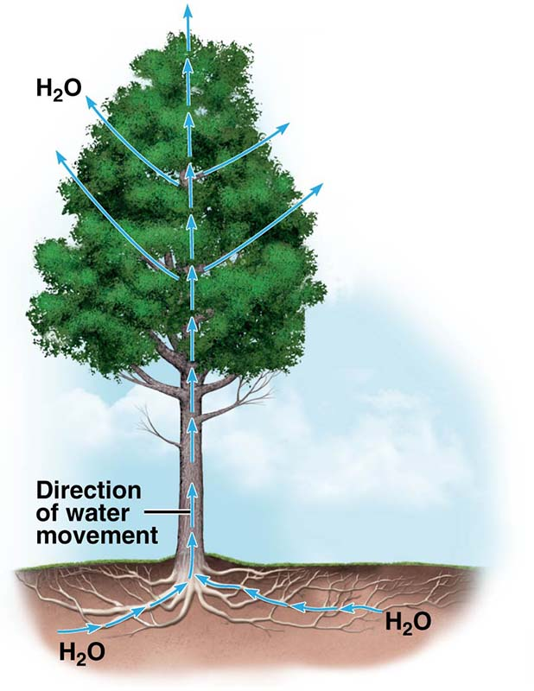
Which properties of water are most important for the movement of water up the tree?
cohesion and specific heat
cohesion and adhesion
adhesion and specific heat
adhesion and heat of vaporization
heat of vaporization and specific heat
Notes:
Answer: B. Adhesion helps support water columns moving up the tree as water binds to cell walls, and cohesion allows the driving force for movement to be transmitted from water molecule to water molecule, as described in Concept 2.5.

Slide 41
Which properties of water are most important for the movement of water up the tree?
cohesion and specific heat
cohesion and adhesion
adhesion and specific heat
adhesion and heat of vaporization
heat of vaporization and specific heat

Slide 42
If you observed an extraterrestrial organism that was mostly composed of water, and you saw that it gradually lost water during warmer weather, you would guess that the function of the water loss was to
reduce temperature.
eliminate waste.
transmit signals.
reduce weight.
attract prey.
Notes:
Answer: A. On Earth, both plants and animals release small amounts of water to reduce temperature, based on water’s high heat of vaporization. Please see Concept 2.5.

Slide 43
If you observed an extraterrestrial organism that was mostly composed of water, and you saw that it gradually lost water during warmer weather, you would guess that the function of the water loss was to
reduce temperature.
eliminate waste.
transmit signals.
reduce weight.
attract prey.

Slide 44
If you were a fish in Minnesota, for which property of water would you be most grateful?
specific heat
heat of vaporization
adhesion
low density when frozen
odorlessness
Notes:
Answer: D. A fish in Minnesota would face being crushed by ice each winter if water ice were more dense than liquid water, which would lead a layer of water ice to sink to the bottom of a pond. Please see Concept 2.5.

Slide 45
If you were a fish in Minnesota, for which property of water would you be most grateful?
specific heat
heat of vaporization
adhesion
low density when frozen
odorlessness

Slide 46
Water becomes less dense when it freezes due to
hydrogen bonds.
polar covalent bonds.
ionic bonds.
nonpolar covalent bonds.
double bonds.
Notes:
Answer: A. The hydrogen bonds between water molecules lead to a less-dense, open structure when water freezes, as described in Concept 2.5.

Slide 47
Water becomes less dense when it freezes due to
hydrogen bonds.
polar covalent bonds.
ionic bonds.
nonpolar covalent bonds.
double bonds.

Slide 48
Imagine that you are examining the structure of an extraterrestrial organism’s cells. You separate various components, finding one that mixes poorly with water. This is probably from the organism’s
membranes.
cell wall.
DNA.
reserve of salts.
skeleton.
Notes:
Answer: A. Membranes consist of hydrophobic materials, which do not mix well with water. Please see Concept 2.5.

Slide 49
Imagine that you are examining the structure of an extraterrestrial organism’s cells. You separate various components, finding one that mixes poorly with water. This is probably from the organism’s
membranes.
cell wall.
DNA.
reserve of salts.
skeleton.

