Slide 1
4
A Tour of the Cell

Slide 2
Which cellular structure is common to all three domains of life?
nucleus
endoplasmic reticulum
mitochondria
ribosomes
endocytotic vesicles
Notes:
Answer: D. Ribosomes, though not the same size in eukaryotes and prokaryotes, are essential for protein synthesis, which is required for life. Discuss examples of essential proteins. Please see Concept 4.2.

Slide 3
Which cellular structure is common to all three domains of life?
nucleus
endoplasmic reticulum
mitochondria
ribosomes
endocytotic vesicles
Notes:
3

Slide 4
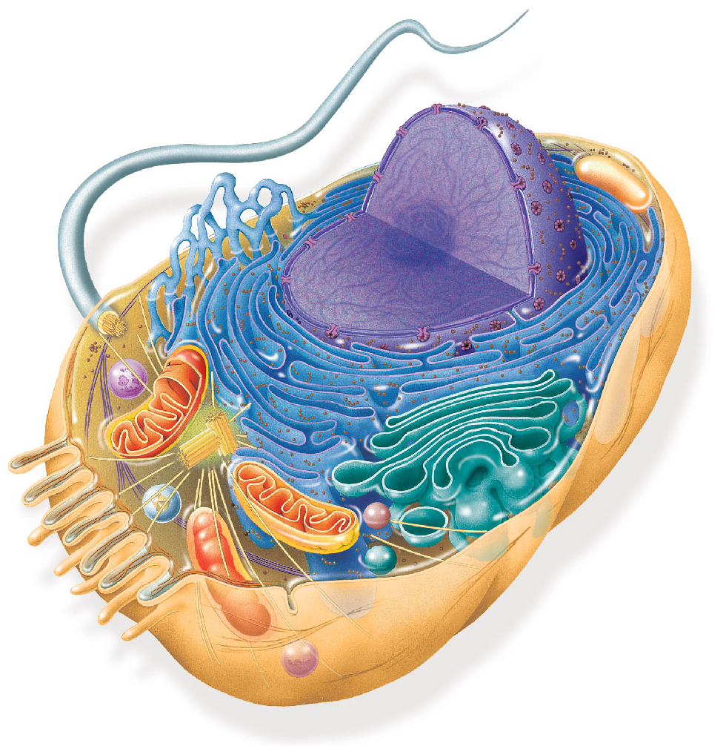
Enzymes responsible for biosynthesis of membrane lipids would be located in what part of the cell?
endoplasmic reticulum
nucleus
lysosomes
Golgi
plasma membrane
Notes:
4
Answer: A . This question focuses on Concepts 4.2 and 4.4. The endoplasmic reticulum produces membrane lipids and sends them throughout the cell.

Slide 5
Enzymes responsible for biosynthesis of membrane lipids would be located in what part of the cell?
endoplasmic reticulum
nucleus
lysosomes
Golgi
plasma membrane
Notes:
5

Slide 6
Which of the following is not an argument for the theory that mitochondria and chloroplasts evolved from prokaryotic endosymbionts?
Mitochondria and chloroplasts have double membranes.
Mitochondria and chloroplasts have their own ribosomes.
Mitochondria and chloroplasts have their own DNA.
The mitochondrial and chloroplast genomes are circular.
All of the above support the endosymbiotic theory.
Notes:
6
Answer: E. This question focuses on Concept 4.5. Discuss from what groups of prokaryotes the mitochondria and chloroplasts are thought to have come.

Slide 7
Which of the following is not an argument for the theory that mitochondria and chloroplasts evolved from prokaryotic endosymbionts?
Mitochondria and chloroplasts have double membranes.
Mitochondria and chloroplasts have their own ribosomes.
Mitochondria and chloroplasts have their own DNA.
The mitochondrial and chloroplast genomes are circular.
All of the above support the endosymbiotic theory.
Notes:
7

Slide 8
Autophagy removes old, damaged organelles like mitochondria. Which organelle is most critical for autophagy?
smooth ER
peroxisomes
rough ER
lysosomes
Golgi apparatus
Notes:
8
Answer: D. Lysosomes perform the digestion that is part of autophagy, as described in Concept 4.4.

Slide 9
Autophagy removes old, damaged organelles like mitochondria. Which organelle is most critical for autophagy?
smooth ER
peroxisomes
rough ER
lysosomes
Golgi apparatus
Notes:
9

Slide 10
What protein(s) is (are) not made at the rough ER?
insulin
digestive enzymes of the gut
antibodies in the blood
enzymes found within the peroxisome organelle
collagen (an extracellular matrix protein)
Notes:
10
Answer: D. Concept 4.4 discusses how the rough ER produces proteins that are sent outside the cell by exocytosis.

Slide 11
What protein(s) is (are) not made at the rough ER?
insulin
digestive enzymes of the gut
antibodies in the blood
enzymes found within the peroxisome organelle
collagen (an extracellular matrix protein)
Notes:
11

Slide 12
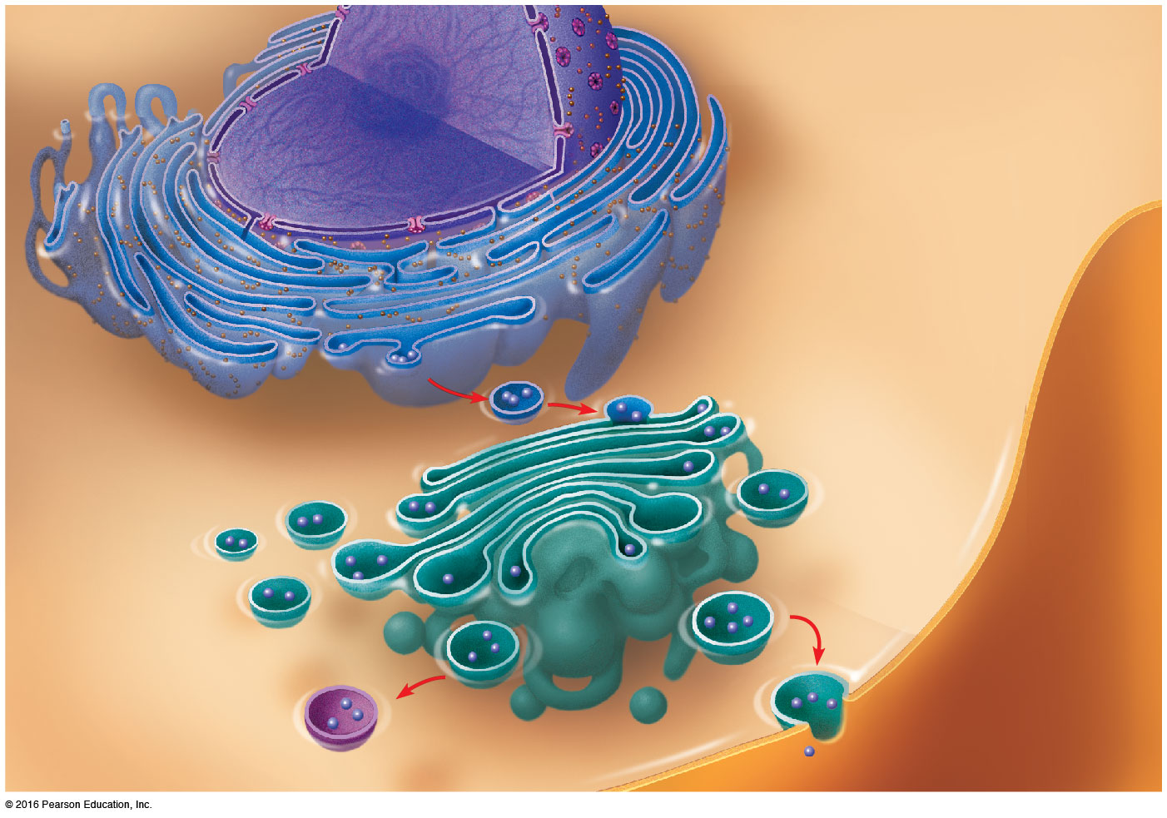
What is the correct order for secretion?
rough ER, endosome, Golgi, smooth ER
rough ER, Golgi, smooth ER, exocytosis
smooth ER, rough ER, exocytosis, Golgi
rough ER, Golgi, transport vesicle, exocytosis
rough ER, Golgi, endosome, exocytosis, transport vesicle
Notes:
12
Answer: D. Secreted proteins, as shown in Concept 4.4, pass through several parts of the endomembrane system.

Slide 13
What is the correct order for secretion?
rough ER, endosome, Golgi, smooth ER
rough ER, Golgi, smooth ER, exocytosis
smooth ER, rough ER, exocytosis, Golgi
rough ER, Golgi, transport vesicle, exocytosis
rough ER, Golgi, endosome, exocytosis, transport vesicle
Notes:
13

Slide 14
Brefeldin A disrupts transport from the ER to the Golgi apparatus. What other structures would be affected by Brefeldin A?
lysosomes, transport vesicles, plasma membrane
mitochondria, peroxisomes, plasma membrane
vacuoles, mitochondria, plasma membrane
lysosomes, transport vesicles, nuclear membrane
all intracellular organelles and membranes
Notes:
14
Answer: A . This question corresponds with Concept 4.4. The connection being made is with the various parts of the endomembrane system.

Slide 15
Brefeldin A disrupts transport from the ER to the Golgi apparatus. What other structures would be affected by Brefeldin A?
lysosomes, transport vesicles, plasma membrane
mitochondria, peroxisomes, plasma membrane
vacuoles, mitochondria, plasma membrane
lysosomes, transport vesicles, nuclear membrane
all intracellular organelles and membranes
Notes:
15

Slide 16
Since alcohol is destroyed in the cell by the removal of hydrogen atoms, where does this occur?
lysosome
smooth ER
peroxisome
rough ER
Golgi apparatus
Notes:
16
Answer: C. The text discusses the reactions that destroy peroxides, and students should see a parallel in alcohol and its destruction. Please see Concept 4.5.

Slide 17
Since alcohol is destroyed in the cell by the removal of hydrogen atoms, where does this occur?
lysosome
smooth ER
peroxisome
rough ER
Golgi apparatus
Notes:
17

Slide 18
Taxol, which is used in fighting breast cancer, prevents depolymerization of microtubules. What cellular function might taxol interfere with most in fighting cancer?
maintaining cell shape
cell motility (cilia or flagella)
chromosome movements in cell division
cell division (cleavage furrow formation)
cytoplasmic streaming
Notes:
18
Answer: C. Please see Concept 4.6. Microtubules are critical for the cell divisions that allow cancer to grow and spread. Discuss how microtubules act during cell division.

Slide 19
Taxol, which is used in fighting breast cancer, prevents depolymerization of microtubules. What cellular function might taxol interfere with most in fighting cancer?
maintaining cell shape
cell motility (cilia or flagella)
chromosome movements in cell division
cell division (cleavage furrow formation)
cytoplasmic streaming
Notes:
19

Slide 20
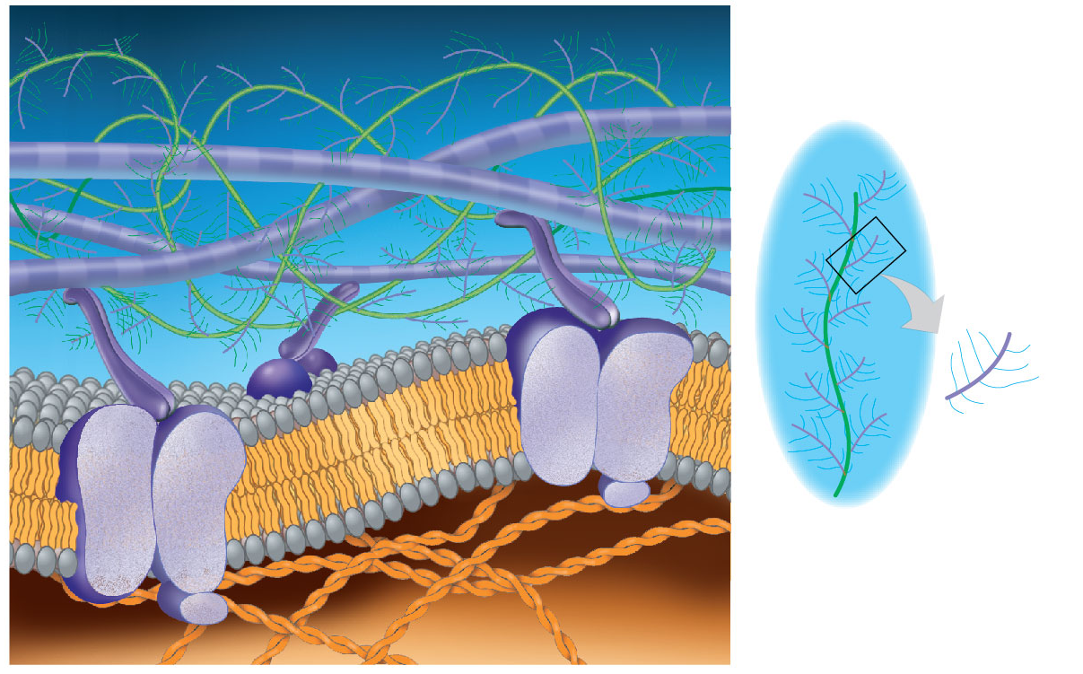
What role do integrins play in cells?
speed cell division
link extracellular matrix and cell interior
maintain numbers of mitochondria
act as ion channels
connect parts of the endomembrane system
Notes:
Answer: B. Integrins are integral membrane proteins that provide a connection across the plasma membrane. Discuss examples where this is critical for life.

Slide 21
What role do integrins play in cells?
speed cell division
link extracellular matrix and cell interior
maintain numbers of mitochondria
act as ion channels
connect parts of the endomembrane system

Slide 22
Which kind of cells make plasmodesmata?
plant cells
animal cells
bacterial cells
A–C
B and C
Notes:
Answer: A. Plasmodesmata are hollow channels through the plant cell wall. Please see Concept 4.7.

Slide 23
Which kind of cells make plasmodesmata?
plant cells
animal cells
bacterial cells
A–C
B and C

Slide 24
Which kind of cells make tight junctions?
plant cells
animal cells
bacterial cells
A–C
A and C
Notes:
Answer: B. Tight junctions help to prevent movement of material from one side of an animal cell to the other via the extracellular matrix. Discuss how this is important in the small intestine. Please see Concept 4.7.

Slide 25
Which kind of cells make tight junctions?
plant cells
animal cells
bacterial cells
A–C
A and C

Slide 26
If you were studying frog eggs, what would be most useful for visualizing them?
unaided eye
light microscope
electron microscope
A and B
A and C
Notes:
Answer: D. Frog eggs are fairly large cells and so can easily be viewed using both the unaided human eye and the light microscope. Please see Concept 4.1.

Slide 27
If you were studying frog eggs, what would be most useful for visualizing them?
unaided eye
light microscope
electron microscope
A and B
A and C

Slide 28
If you were studying typical bacteria, what would be most useful for visualizing them?
unaided eye
light microscope
electron microscope
A and B
B and C
Notes:
Answer: E. Most bacteria are too small to detect with the unaided eye, but some detail can be seen with the light microscope and much more using the electron microscope. Please see Concept 4.1.

Slide 29
If you were studying typical bacteria, what would be most useful for visualizing them?
unaided eye
light microscope
electron microscope
A and B
B and C

Slide 30
If you were asked to use a light microscope to locate specific molecules in a cell, what would be the best form of light microscopy to use?
Nomarski
phase-contrast
brightfield, unstained
brightfield, stained
fluorescence
Notes:
Answer: E. Fluorescence microscopy gives highly specific data on the location of molecules. Discuss how it could be used to locate nuclei in cells. Please see Concept 4.1.

Slide 31
If you were asked to use a light microscope to locate specific molecules in a cell, what would be the best form of light microscopy to use?
Nomarski
phase-contrast
brightfield, unstained
brightfield, stained
fluorescence

Slide 32
Which is not part of a prokaryotic cell?
nucleoid
chloroplast
ribosome
plasma membrane
cell wall
Notes:
Answer: B. Chloroplasts are descended from prokaryotic cells, but they are found on eukaryotes. Please see Concept 4.2.

Slide 33
Which is not part of a prokaryotic cell?
nucleoid
chloroplast
ribosome
plasma membrane
cell wall

Slide 34
Which is not part of a eukaryotic cell?
nucleoid
chloroplast
ribosome
plasma membrane
peroxisome
Notes:
Answer: A. The eukaryotes keep most of their DNA in a membrane-enclosed nucleus, not a nucleoid. Please see Concept 4.2.

Slide 35
Which is not part of a eukaryotic cell?
nucleoid
chloroplast
ribosome
plasma membrane
peroxisome

Slide 36
If you fluorescently labeled a protein and found it ended up in the nucleus, through what must it have passed?
pore complex
nucleolus
chromatin
endoplasmic reticulum
not necessarily any of these
Notes:
Answer: A. Pore complexes are the gateways into the nucleus. Please see Concept 4.3.

Slide 37
If you fluorescently labeled a protein and found it ended up in the nucleus, through what must it have passed?
pore complex
nucleolus
chromatin
endoplasmic reticulum
not necessarily any of these

Slide 38
Where would you place an arrow on a diagram of a cell if the arrow was to point to the place where cytoplasmic proteins are made?
rough ER
smooth ER
free ribosomes
peroxisome
mitochondrion
Notes:
Answer: C. Soluble proteins found in the cytoplasm are made by ribosomes, which float freely in the cytoplasm, not attached to any organelle. Please see Concept 4.3.

Slide 39
Where would you place an arrow on a diagram of a cell if the arrow was to point to the place where cytoplasmic proteins are made?
rough ER
smooth ER
free ribosomes
peroxisome
mitochondrion

Slide 40
If you placed fluorescently labeled protein outside an animal cell, after uptake for digestion, where would it be?
rough ER
smooth ER
lysosome
peroxisome
mitochondrion
Notes:
Answer: C. Lysosomes digest at the cellular level. Discuss what lysosomal diseases might cause in a human being. Please see Concept 4.4.

Slide 41
If you placed fluorescently labeled protein outside an animal cell, after uptake for digestion, where would it be?
rough ER
smooth ER
lysosome
peroxisome
mitochondrion

Slide 42
If you were examining a plant cell, what kind of vacuole would you find?
contractile
central
food
A–C
A and C
Notes:
Answer: B. Plant cells have a proportionally large central vacuole that can perform a number of different functions, depending on the state of the plant cell. Please see Concept 4.4.

Slide 43
If you were examining a plant cell, what kind of vacuole would you find?
contractile
central
food
A–C
A and C

Slide 44
If you were working in a cave and discovered an unusual carnivorous plant, what might this plant lack at the cellular level yet still be able to survive using carnivory?
ER
nucleus
mitochondrion
chloroplast
peroxisome
Notes:
Answer: D. Chloroplasts would be useless in a lightless cave, though the other cellular parts would be needed for daily life. Discuss what parts of a plant cell are most critical for normal plant carnivory. Please see Concept 4.5.

Slide 45
If you were working in a cave and discovered an unusual carnivorous plant, what might this plant lack at the cellular level yet still be able to survive using carnivory?
ER
nucleus
mitochondrion
chloroplast
peroxisome

Slide 46
If you applied a drug to block mitochondrial function, what would an affected cell lack most?
protein
ATP
enzymes
vesicles
membranes
Notes:
Answer: B. The mitochondrion is the powerhouse of the cell and provides vitally important supplies of ATP. Please see Concept 4.5.

Slide 47
If you applied a drug to block mitochondrial function, what would an affected cell lack most?
protein
ATP
enzymes
vesicles
membranes

Slide 48
A drug that blocks muscular contraction might have disrupted what?
nucleus
intermediate filaments
microtubules
ribosomes
microfilaments
Notes:
Answer: E. Actin microfilaments work with myosin to produce muscular contraction. Please see Concept 4.6.

Slide 49
A drug that blocks muscular contraction might have disrupted what?
nucleus
intermediate filaments
microtubules
ribosomes
microfilaments

