Slide 1
27
The Rise
of Animal Diversity

Slide 2
What should animals with radial symmetry be better able to do than those with bilateral symmetry?
move quickly in one direction
detect threats from above and below equally well
deal effectively with food distributed homogeneously in 360°
focus attention in a single direction
Notes:
Answer: C. This question is aimed at Concept 27.3. This question focuses on student misconceptions about radial and bilateral symmetry, one of which is that radial symmetry is always inferior to bilateral symmetry.

Slide 3
What should animals with radial symmetry be better able to do than those with bilateral symmetry?
move quickly in one direction
detect threats from above and below equally well
deal effectively with food distributed homogeneously in 360°
focus attention in a single direction
Notes:
3

Slide 4
Which of these genetic changes is thought to have led to the increasing complexity of the arthropod body plan?
increased number of Hox genes for body segmentation
changes in regulation of Hox genes for body segmentation
increased number of Hox genes for appendages
changes in regulation of Hox genes for appendages
increased complexity in genes for exoskeleton arrangements
Notes:
4
Answer: B. This question relates to Concept 27.3.

Slide 5
Which of these genetic changes is thought to have led to the increasing complexity of the arthropod body plan?
increased number of Hox genes for body segmentation
changes in regulation of Hox genes for body segmentation
increased number of Hox genes for appendages
changes in regulation of Hox genes for appendages
increased complexity in genes for exoskeleton arrangements
Notes:
5

Slide 6
Which of the following phyla have a water vascular system?
molluscs
echinoderms
cnidarians
annelids
arthropods
Notes:
6
Answer: B. Echinoderms are equipped with a water vascular system that can power their tube feet as well as distribute oxygen and nutrients throughout the organism.

Slide 7
Which of the following phyla have a water vascular system?
molluscs
echinoderms
cnidarians
annelids
arthropods
Notes:
7

Slide 8
Which of the following traits is shared by all vertebrates, at least in some developmental stages, except the lampreys?
notochord
vertebrae
cartilaginous skeleton
cranium (head)
mouth with jaws
Notes:
8
Answer: E. This question relates to Concept 27.3. Lampreys are jawless fishes, but they have the four other vertebrate features.

Slide 9
Which of the following traits is shared by all vertebrates, at least in some developmental stages, except the lampreys?
notochord
vertebrae
cartilaginous skeleton
cranium (head)
mouth with jaws
Notes:
9

Slide 10
Which of these correctly describes phylogenetic relationships among birds, mammals, and reptiles?
Birds share the closest common ancestor with dinosaurs.
Reptiles and birds, but not mammals, are amniotes.
Mammals evolved from therapsid reptiles after the fall of the dinosaurs.
Birds and mammals are more closely related to each other than either group is to crocodilian reptiles.
Among living species in the group we call reptiles, turtles and snakes are most closely related to each other.
Notes:
10
Answer: A. This question relates to Concept 27.4. Mammals diverged from stem reptiles early in amniote evolution. Amniotes include reptiles, birds, and mammals. Options D and E do not correctly describe phylogenetic relationships within amniotes.

Slide 11
Which of these correctly describes phylogenetic relationships among birds, mammals, and reptiles?
Birds share the closest common ancestor with dinosaurs.
Reptiles and birds, but not mammals, are amniotes.
Mammals evolved from therapsid reptiles after the fall of the dinosaurs.
Birds and mammals are more closely related to each other than either group is to crocodilian reptiles.
Among living species in the group we call reptiles, turtles and snakes are most closely related to each other.
Notes:
11

Slide 12
Which of the following groups soon outcompeted amphibians on land due to their watertight skin and watertight eggs?
birds
mammals
reptiles
none of the above
Notes:
12
Answer: C. Reptiles have dry, scaly, watertight skin and watertight eggs, which greatly reduced their dependence on water compared to amphibians.

Slide 13
Which of the following groups soon outcompeted amphibians on land due to their watertight skin and watertight eggs?
birds
mammals
reptiles
none of the above
Notes:
13

Slide 14
Which of the following chordate groups has all four key chordate characteristics as an adult?
lancelets
tunicates
frogs
humans
Notes:
14
Answer: A. Lancelets have a notochord, a dorsal nerve cord, pharyngeal slits, and a post-anal tail in their larval as well as adult form.

Slide 15
Which of the following chordate groups has all four key chordate characteristics as an adult?
lancelets
tunicates
frogs
humans
Notes:
15

Slide 16
The Ediacaran biota are
early fossil evidence of human ancestors discovered in Olduvai Gorge, Tanzania.
closely related to living animals and algae.
members of an early group of soft-bodied multicellular eukaryotes.
fossils dating from about 770 million years ago.
Notes:
16
Answer: C. The Ediacaran biota were an early group of soft-bodied, multicellular eukaryotes. Their fossils were found 560 million years ago in the Ediacara Hills of Australia.

Slide 17
The Ediacaran biota are
early fossil evidence of human ancestors discovered in Olduvai Gorge, Tanzania.
closely related to living animals and algae.
members of an early group of soft-bodied multicellular eukaryotes.
fossils dating from about 770 million years ago.
Notes:
17

Slide 18
Which of the following is an incorrect statement about sponges (phylum Porifera)?
Current phylogenetic studies indicate that they are monophyletic.
They are eumetazoans.
They lack true tissues.
Their collar cells engulf bacteria and food particles by phagocytosis.
They were formerly mistaken for plants since they are sedentary.
Notes:
18
Answer: B. Sponges are metazoans.

Slide 19
Which of the following is an incorrect statement about sponges (phylum Porifera)?
Current phylogenetic studies indicate that they are monophyletic.
They are eumetazoans.
They lack true tissues.
Their collar cells engulf bacteria and food particles by phagocytosis.
They were formerly mistaken for plants since they are sedentary.
Notes:
19

Slide 20
Ediacaran life-forms declined during the Cambrian explosion for all of the following reasons except
genetic changes affecting the regulation of developmental genes facilitated the evolution of new body forms.
there were novel adaptations in locomotion of predators.
prey species acquired protective shells.
natural selection led to the rise of bilaterian phyla.
a decrease in atmospheric oxygen allowed species with lower metabolic rates to thrive.
Notes:
20
Answer: E. The increase in atmospheric oxygen that preceded the Cambrian explosion enabled animals with higher metabolic rates and larger body sizes to thrive while potentially harming other species.

Slide 21
Ediacaran life-forms declined during the Cambrian explosion for all of the following reasons except
genetic changes affecting the regulation of developmental genes facilitated the evolution of new body forms.
there were novel adaptations in locomotion of predators.
prey species acquired protective shells.
natural selection led to the rise of bilaterian phyla.
a decrease in atmospheric oxygen allowed species with lower metabolic rates to thrive.
Notes:
21

Slide 22
Which of the following is not an embryonic germ layer?
ectoderm
endoderm
periderm
mesoderm
Notes:
22
Answer: C. The embryonic germ layers are ectoderm, mesoderm, and endoderm (from outside to inside.) Periderm is a secondary covering in plants.

Slide 23
Which of the following is not an embryonic germ layer?
ectoderm
endoderm
periderm
mesoderm
Notes:
23

Slide 24
The functions of a coelom in bilaterians include all of the following except
keeping heartbeat or intestinal movement from affecting body surface
providing a hydrostatic skeleton
digesting food
cushioning organs
Notes:
24
Answer: C. The coelomic cavity functions in providing a fluid that cushions suspended organs, in earthworms providing a noncompressible fluid that acts as a skeleton against which muscles work, and allowing internal organs to grow and move independently of the body wall.

Slide 25
The functions of a coelom in bilaterians include all of the following except
keeping heartbeat or intestinal movement from affecting body surface
providing a hydrostatic skeleton
digesting food
cushioning organs
Notes:
25

Slide 26
Which is the most species-rich of all the animal groups?
Bacteria
Crustacea
Chordata
Arthropoda
amniotes
Notes:
26
Answer: D. Arthropoda is the most species-rich of all animal groups, and its members were among the first animals to colonize land. Crustaceans are types of arthropods, Bacteria are not animals, amniotes are animals that lay eggs with shells, and Chordata are a phylum within vertebrata.

Slide 27
Which is the most species-rich of all the animal groups?
Bacteria
Crustacea
Chordata
Arthropoda
amniotes
Notes:
27

Slide 28
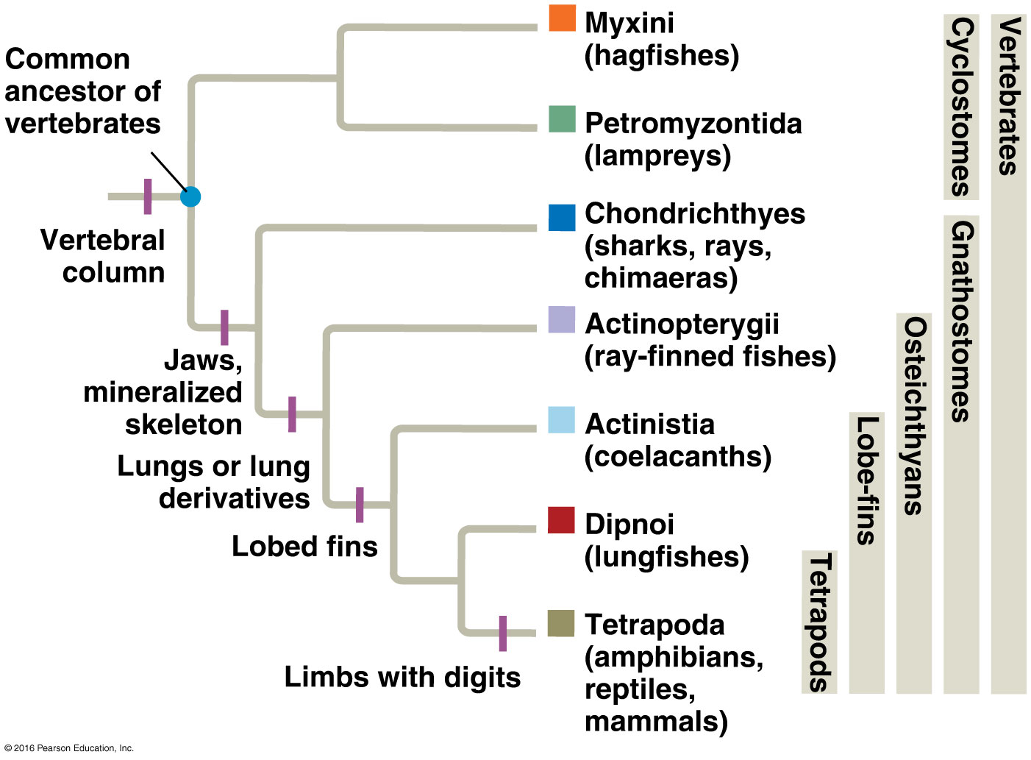
Based on the phylogeny in the figure, which vertebrate group would have jaws and a mineralized skeleton, lungs or lung derivatives, and lobed fins but no limbs with digits?
Actinistia
Dipnoi
Tetrapoda
Actinopterygii
Chondrichthyes
Notes:
28
Answer: B. Dipnoi (lungfishes) have a vertebral column, jaws and a mineralized skeleton, lungs or lung derivatives, and lobed fins. They share a common ancestor with Tetrapoda (amphibians, reptiles, and mammals), which have all the above and limbs with digits.

Slide 29
Based on the phylogeny in the figure, which vertebrate group would have jaws and a mineralized skeleton, lungs or lung derivatives, and lobed fins but no limbs with digits?
Actinistia
Dipnoi
Tetrapoda
Actinopterygii
Chondrichthyes
Notes:
29

Slide 30
In comparing the plants, insects, and vertebrates that colonized land, which of the following is not true?
Roots, lignin, stems, vascular systems, cuticle, and stomata evolved after the split between the aquatic and terrestrial plants.
The evolutionary changes involved in the insect and vertebrate transition to terrestrial life were more extensive than those of plants.
Plants that colonized land bore little resemblance to their aquatic relatives
Plants have more derived characters than either insects or vertebrates.
Notes:
30
Answer: B. From Figure 27.21, plants colonizing land had many more adaptations that evolved since their lineages diverged from their aquatic relatives than either insects or vertebrates.

Slide 31
In comparing the plants, insects, and vertebrates that colonized land, which of the following is not true?
Roots, lignin, stems, vascular systems, cuticle, and stomata evolved after the split between the aquatic and terrestrial plants.
The evolutionary changes involved in the insect and vertebrate transition to terrestrial life were more extensive than those of plants.
Plants that colonized land bore little resemblance to their aquatic relatives
Plants have more derived characters than either insects or vertebrates.
Notes:
31

Slide 32
The “fishapod” Tiktaalik had fins, gills, and lungs and was covered with scales, but also possessed tetrapod traits like a wrist, ribs, neck, and front fin bones with the same basic pattern as all limbed animals, suggesting that
it was mostly fish.
it was mostly tetrapod.
it predated the oldest known tetrapod.
it was able to walk on land.
further studies may provide details on how the tetrapod body did not evolve from nowhere, but was modified from a preexisting body plan.
Notes:
32
Answer: E. Tiktaalik exhibits both fish and tetrapod characters, suggesting that the tetrapod body plan did not evolve from out of nowhere, but was a modification of preexisting structures.

Slide 33
The “fishapod” Tiktaalik had fins, gills, and lungs and was covered with scales, but also possessed tetrapod traits like a wrist, ribs, neck, and front fin bones with the same basic pattern as all limbed animals, suggesting that
it was mostly fish.
it was mostly tetrapod.
it predated the oldest known tetrapod.
it was able to walk on land.
further studies may provide details on how the tetrapod body did not evolve from nowhere, but was modified from a preexisting body plan.
Notes:
33

Slide 34
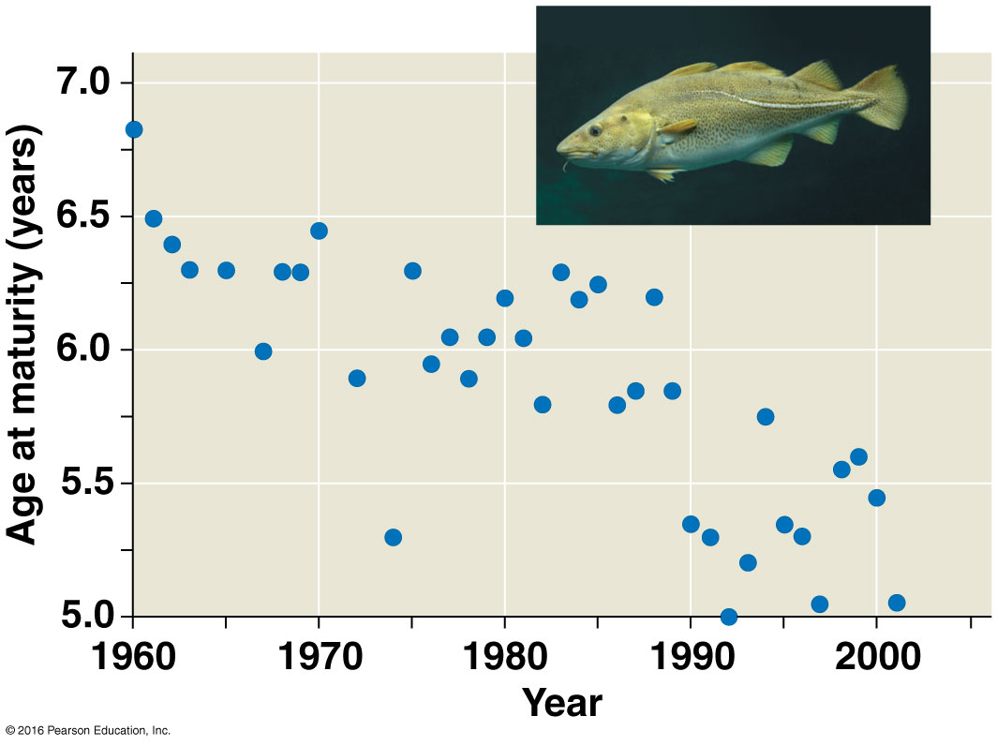
Study the graph. How does the fact that some northern cod species reach sexual maturity at an earlier age illustrate a human impact on cod evolution?
A smaller animal is more likely to become extinct than a larger one.
Fish that reproduce when younger have fewer offspring and are likely to become extinct.
Fish that are smaller are less attractive to other fish, don’t reproduce, and may become extinct.
Since fisheries target large fish, natural selection favors smaller fish that mature earlier since they are more likely to reproduce before they are caught.
Notes:
34
Answer: D. Commercial fishing operations are affecting cod evolution by targeting larger and older fish, and natural selection is favoring smaller and younger fish that are more likely to reproduce before being caught.

Slide 35
Study the graph. How does the fact that some northern cod species reach sexual maturity at an earlier age illustrate a human impact on cod evolution?
A smaller animal is more likely to become extinct than a larger one.
Fish that reproduce when younger have fewer offspring and are likely to become extinct.
Fish that are smaller are less attractive to other fish, don’t reproduce, and may become extinct.
Since fisheries target large fish, natural selection favors smaller fish that mature earlier since they are more likely to reproduce before they are caught.
Notes:
35

