Slide 1
26
The Colonization of Land

Slide 2
Which of the following are the closest algal relatives of land plants?
psilophytes
charophytes
chrysophytes
bacillariophytes
rhodophytes
Notes:
Answer: B.

Slide 3
Which of the following are the closest algal relatives of land plants?
psilophytes
charophytes
chrysophytes
bacillariophytes
rhodophytes
Notes:
3

Slide 4
The relationship between a gametophyte and a sporophyte in a liverwort is like the relationship between
a brother and a sister.
a grandparent and a grandchild.
an uncle and a nephew.
a parent and a child.
two cousins.
Notes:
4
Answer: D.

Slide 5
The relationship between a gametophyte and a sporophyte in a liverwort is like the relationship between
a brother and a sister.
a grandparent and a grandchild.
an uncle and a nephew.
a parent and a child.
two cousins.
Notes:
5

Slide 6
Plants that evolved vascular tissue are more advanced than plants without vascular tissue. One of the consequences is that vascular tissue enabled plants to
reproduce via spores.
store water.
grow taller.
develop stomata.
support large gametophytes.
Notes:
6
Answer: C.

Slide 7
Plants that evolved vascular tissue are more advanced than plants without vascular tissue. One of the consequences is that vascular tissue enabled plants to
reproduce via spores.
store water.
grow taller.
develop stomata.
support large gametophytes.
Notes:
7

Slide 8
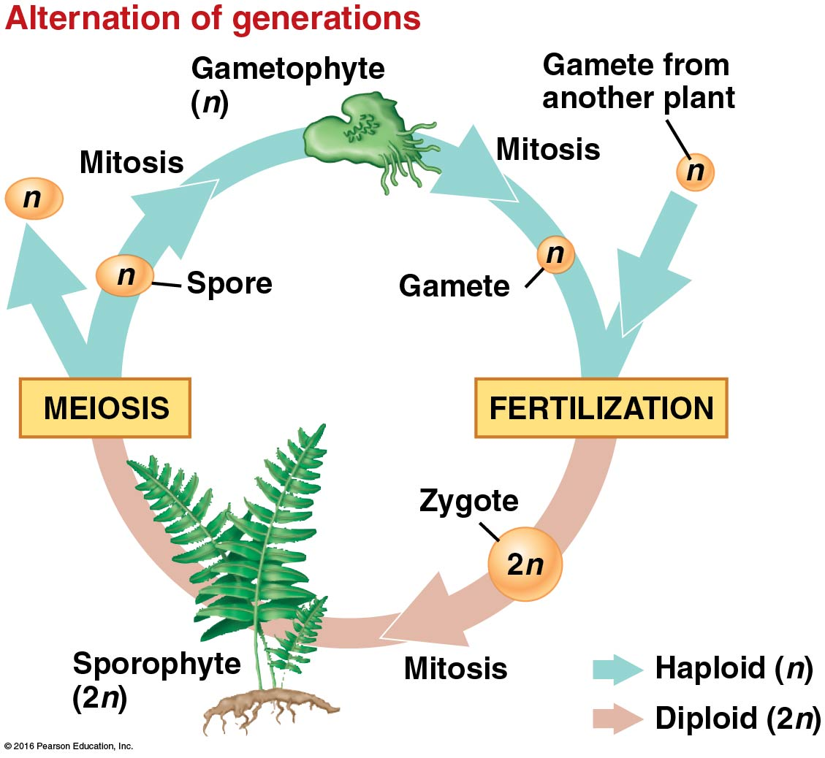
One thing you should be able to conclude from this figure is that
gametophytes have fewer chromosomes than sporophytes do.
gametophytes evolved before sporophytes.
gametophytes grow from sporophytes.
gametophyte cells come about by mitosis; sporophyte cells come about by meiosis.
Notes:
8
Answer: A. Gametophytes, being haploid, have half as many chromosomes as diploid sporophytes do.

Slide 9
One thing you should be able to conclude from this figure is that
gametophytes have fewer chromosomes than sporophytes do.
gametophytes evolved before sporophytes.
gametophytes grow from sporophytes.
gametophyte cells come about by mitosis; sporophyte cells come about by meiosis.
Notes:
9

Slide 10
Stomata are found in every group of sporophyte plants except the liverworts. According to the hypothesis that stomata evolved only once among the bryophytes, this is evidence that
liverworts resemble the most primitive plants.
liverworts don’t need to exchange gases with the atmosphere.
liverworts have lost the ability to make stomata.
liverworts are able to fix nitrogen.
gametophytes are more important in liverworts.
Notes:
10
Answer: A.

Slide 11
Stomata are found in every group of sporophyte plants except the liverworts. According to the hypothesis that stomata evolved only once among the bryophytes, this is evidence that
liverworts resemble the most primitive plants.
liverworts don’t need to exchange gases with the atmosphere.
liverworts have lost the ability to make stomata.
liverworts are able to fix nitrogen.
gametophytes are more important in liverworts.
Notes:
11

Slide 12
Which of the following plants have a sporophyte that is nutritionally dependent on the photosynthetic gametophyte?
ferns
mosses
whisk ferns
horsetails
Notes:
12
Answer: B. The moss life cycle involves the growth of a brown, nutritionally dependent sporophyte out of the top of the photosynthetic gametophyte.

Slide 13
Which of the following plants have a sporophyte that is nutritionally dependent on the photosynthetic gametophyte?
ferns
mosses
whisk ferns
horsetails
Notes:
13

Slide 14
Which of the following evolutionary innovations of seed plants enabled them to outcompete ferns and other seedless plants that dominated through the end of the Carboniferous period?
heterospory
reduced, dependent gametophytes
vascular systems
flowers
Notes:
14
Answer: B.

Slide 15
Which of the following evolutionary innovations of seed plants enabled them to outcompete ferns and other seedless plants that dominated through the end of the Carboniferous period?
heterospory
reduced, dependent gametophytes
vascular systems
flowers
Notes:
15

Slide 16
You are presented with several single-celled organisms, including one thought to belong to the kingdom Fungi. What unique feature helps you identify the fungus?
presence of mitochondria
absence of chloroplasts
presence of nuclei
presence of chitinous cell walls
Notes:
16
Answer: D. Chitinous cell walls are a distinguishing trait of fungal cells. This question relates to Concept 26.2.

Slide 17
You are presented with several single-celled organisms, including one thought to belong to the kingdom Fungi. What unique feature helps you identify the fungus?
presence of mitochondria
absence of chloroplasts
presence of nuclei
presence of chitinous cell walls
Notes:
17

Slide 18
You are given a fungus to identify. It has a fruiting body that contains many structures with eight haploid spores lined up in a row. What kind of fungus is this?
zygomycete
chytrid
deuteromycete
ascomycete
Notes:
18
Answer: D.

Slide 19
You are given a fungus to identify. It has a fruiting body that contains many structures with eight haploid spores lined up in a row. What kind of fungus is this?
zygomycete
chytrid
deuteromycete
ascomycete
Notes:
19

Slide 20
Many fungi produce antibiotics, for example, penicillin, that are effective at stopping bacterial growth. Which of the following is the evolutionary advantage to the fungus of secreting antibacterial chemicals?
defense: preventing bacteria from infecting the fungus
defense: preventing bacteria from killing fungal spores
symbiosis: attracting helpful bacteria
competition: destroying bacteria that compete for their food
predation: eventually consuming the bacteria
Notes:
20
Answer: D. Antibiotics kill bacteria so they can no longer compete with fungi for resources. This question relates to Concept 26.2.

Slide 21
Many fungi produce antibiotics, for example, penicillin, that are effective at stopping bacterial growth. Which of the following is the evolutionary advantage to the fungus of secreting antibacterial chemicals?
defense: preventing bacteria from infecting the fungus
defense: preventing bacteria from killing fungal spores
symbiosis: attracting helpful bacteria
competition: destroying bacteria that compete for their food
predation: eventually consuming the bacteria
Notes:
21

Slide 22
Which of the following phyla includes aquatic, flagellated fungi?
Ascomycota
Basidiomycota
Chytridiomycota
Zygomycota
Notes:
22
Answer: C.

Slide 23
Which of the following phyla includes aquatic, flagellated fungi?
Ascomycota
Basidiomycota
Chytridiomycota
Zygomycota
Notes:
23

Slide 24
Which of the following correctly describes sporopollenin?
an adaptation that enabled plants to move to land
a circular ring of proteins embedded in plants’ plasma membranes
a durable polymer that prevents exposed zygotes from drying out
A and C
Notes:
24
Answer: D. Sporopollenin, present in charophytes, enables individual algae to survive when they are not exposed to water. It is also found in the walls encasing the spores of plants.

Slide 25
Which of the following correctly describes sporopollenin?
an adaptation that enabled plants to move to land
a circular ring of proteins embedded in plants’ plasma membranes
a durable polymer that prevents exposed zygotes from drying out
A and C
Notes:
25

Slide 26
Which of the following is not a derived trait of plants?
alternation of generations
apical meristems
cuticle
stomata
flagellated sperm
Notes:
26
Answer: E.

Slide 27
Which of the following is not a derived trait of plants?
alternation of generations
apical meristems
cuticle
stomata
flagellated sperm
Notes:
27

Slide 28
Which of the following correctly describes the difference between fertilization and meiosis in land plants?
In fertilization, haploid gametes unite to form a diploid zygote; in meiosis, the diploid sporophyte produces haploid spores.
In fertilization, the diploid sporophyte produces haploid spores; in meiosis, haploid gametes unite to form a diploid zygote.
In fertilization, multicellular haploid gametophytes are produced from spores; in meiosis, the gametophyte divides, producing diploid gametes.
A mature diploid sporophyte produces diploid spores by meiosis; fertilization produces multicellular haploid gametophytes.
Notes:
28
Answer: A.

Slide 29
Which of the following correctly describes the difference between fertilization and meiosis in land plants?
In fertilization, haploid gametes unite to form a diploid zygote; in meiosis, the diploid sporophyte produces haploid spores.
In fertilization, the diploid sporophyte produces haploid spores; in meiosis, haploid gametes unite to form a diploid zygote.
In fertilization, multicellular haploid gametophytes are produced from spores; in meiosis, the gametophyte divides, producing diploid gametes.
A mature diploid sporophyte produces diploid spores by meiosis; fertilization produces multicellular haploid gametophytes.
Notes:
29

Slide 30
The fossil record shows that early plants, such as Aglaophyton (Figure 26.10), were less than 20 cm tall. What feature did these early plants have that enabled their bodies to increase in complexity?
life cycles with dominant sporophytes
roots and leaves
dichotomous branching
bacterial symbionts
seeds
Notes:
30
Answer: C.

Slide 31
The fossil record shows that early plants, such as Aglaophyton (Figure 26.10), were less than 20 cm tall. What feature did these early plants have that enabled their bodies to increase in complexity?
life cycles with dominant sporophytes
roots and leaves
dichotomous branching
bacterial symbionts
seeds
Notes:
31

Slide 32
Fungi are
multicellular in origin.
heterotrophic.
more closely related to plants than they are to animals or most other eukaryotes.
autotrophic.
Notes:
32
Answer: B.

Slide 33
Fungi are
multicellular in origin.
heterotrophic.
more closely related to plants than they are to animals or most other eukaryotes.
autotrophic.
Notes:
33

Slide 34
Fungal hyphae form an interwoven mass called a(n)
arbuscule.
microvillus.
nucleariid.
mycorrhizae.
mycelium.
Notes:
34
Answer: E.

Slide 35
Fungal hyphae form an interwoven mass called a(n)
arbuscule.
microvillus.
nucleariid.
mycorrhizae.
mycelium.
Notes:
35

Slide 36
Researchers have found that the expression of plant genes called sym genes is essential for all of the following except
the establishment of symbiotic relationships between plants and fungi.
the formation of arbuscules.
plasmogamy.
the formation of mycorrhizae in flowering plants.
Notes:
36
Answer: C. Plasmogamy is the fusion of two parent mycelia, the first part of the sexual portion of the fungal life cycle.

Slide 37
Researchers have found that the expression of plant genes called sym genes is essential for all of the following except
the establishment of symbiotic relationships between plants and fungi.
the formation of arbuscules.
plasmogamy.
the formation of mycorrhizae in flowering plants.
Notes:
37

