Slide 1
6
An Introduction to Metabolism

Slide 2
How do living organisms create macromolecules, organelles, cells, tissues, and complex higher-order structures?
The laws of thermodynamics do not apply to living organisms.
Living organisms create order by using energy from the sun.
Living organisms create order locally, but the energy transformations generate waste heat that increases the entropy of the universe.
Notes:
2
Answer: C. This question relates to Concept 6.1. Discuss examples of how creating local order leads to waste heat, such as cutting and stacking firewood leading to the worker sweating.

Slide 3
How do living organisms create macromolecules, organelles, cells, tissues, and complex higher-order structures?
The laws of thermodynamics do not apply to living organisms.
Living organisms create order by using energy from the sun.
Living organisms create order locally, but the energy transformations generate waste heat that increases the entropy of the universe.
Notes:
3

Slide 4
Entropy can drive a chemical reaction; for example,
A → B + C.
B + C → A + D.
A + B + C → D.
A + B + C → D + E + F.
A → B.
Notes:
4
Answer: A. See Concept 6.1. Entropy involves an increase in disorder, such as an increase in the number of chemicals from reactants to products. Discuss other examples of high entropy, such as increasingly messy desks.

Slide 5
Entropy can drive a chemical reaction; for example,
A → B + C.
B + C → A + D.
A + B + C → D.
A + B + C → D + E + F.
A → B.
Notes:
5

Slide 6
Are most chemical reactions at equilibrium in living cells?
yes
no
only the exergonic reactions
all reactions except those powered by ATP hydrolysis
None of the options is correct.
Notes:
6
Answer: B. This question relates to Concept 6.2. At equilibrium, the free-energy change is zero, and no work can be done. A cell at equilibrium is dead!

Slide 7
Are most chemical reactions at equilibrium in living cells?
yes
no
only the exergonic reactions
all reactions except those powered by ATP hydrolysis
None of the options is correct.
Notes:
7

Slide 8
A reaction has a ΔG of −5.6 kcal/mol. Which would most likely be true?
The reaction could be coupled to power an endergonic reaction with a ΔG of +8.8 kcal/mol.
The reaction is nonspontaneous.
To take place, the reaction would need to couple to ATP hydrolysis.
The reaction would result in products with a greater free-energy content than in the initial reactants.
The reaction would proceed by itself but might be very slow.
Notes:
8
Answer: E. This question relates to Concepts 6.2 and 6.3. The free-energy change in a reaction tells if it will occur, but not the velocity with which it will occur.

Slide 9
A reaction has a ΔG of −5.6 kcal/mol. Which would most likely be true?
The reaction could be coupled to power an endergonic reaction with a ΔG of +8.8 kcal/mol.
The reaction is nonspontaneous.
To take place, the reaction would need to couple to ATP hydrolysis.
The reaction would result in products with a greater free-energy content than in the initial reactants.
The reaction would proceed by itself but might be very slow.
Notes:
9

Slide 10
Is it true that the breakdown of food molecules in the gut does not require coupling of ATP hydrolysis, but enzymes are required to speed up the spontaneous reaction?
true, because food contains abundant energy to be released
false, because enzymes change the ΔG to a negative value
false, because enzymes are not required, as breakdown is spontaneous and spontaneous reactions always occur very rapidly
true, because ADP is used, not ATP
None of the answer choices is correct.
Notes:
10
Answer: A. See Concept 6.2. The abundant energy in food can be released, leading to a large, negative ΔG to provide the driving force for the breakdown reactions.

Slide 11
Is it true that the breakdown of food molecules in the gut does not require coupling of ATP hydrolysis, but enzymes are required to speed up the spontaneous reaction?
true, because food contains abundant energy to be released
false, because enzymes change the ΔG to a negative value
false, because enzymes are not required, as breakdown is spontaneous and spontaneous reactions always occur very rapidly
true, because ADP is used, not ATP
None of the answer choices is correct.
Notes:
11

Slide 12
The oxidation of glucose to CO₂ and H₂O is highly exergonic: ΔG = −636 kcal/mole. This is spontaneous, but why might it be very slow outside living cells?
Few glucose molecules have the activation energy at room temperature.
There is too much CO₂ in the air.
CO₂ has higher energy than glucose.
The formation of six CO₂ molecules from one glucose molecule decreases entropy.
The water molecules quench the reaction.
Notes:
12
Answer: A. Discuss what would happen if the reaction was fast outside living cells, such as in a sugar bowl (that is, sucrose), but also oxidized slowly without enzymes, for instance, or in the blood. See Concept 6.2.

Slide 13
The oxidation of glucose to CO₂ and H₂O is highly exergonic: ΔG = −636 kcal/mole. This is spontaneous, but why might it be very slow outside living cells?
Few glucose molecules have the activation energy at room temperature.
There is too much CO₂ in the air.
CO₂ has higher energy than glucose.
The formation of six CO₂ molecules from one glucose molecule decreases entropy.
The water molecules quench the reaction.
Notes:
13

Slide 14
Firefly luciferase catalyzes the following reaction: luciferin + ATP ↔ adenyl-luciferin + pyrophosphate Then the next reaction occurs spontaneously: adenyl-luciferin + O₂ → oxyluciferin + H₂O + CO₂ + AMP + light What is the role of luciferase?
Luciferase makes the ΔG of the reaction more negative.
Luciferase lowers the energy of the transition state of the reaction.
Luciferase alters the equilibrium point of the reaction.
Luciferase makes the reaction irreversible.
All of the above are true.
Notes:
14
Answer: B. Enzymes speed reactions by making transition states appear at lower temperatures. Even a very spontaneous reaction might be slow without some catalyst, such as an enzyme, to help it move faster. See Concept 6.4.

Slide 15
Firefly luciferase catalyzes the following reaction: luciferin + ATP ↔ adenyl-luciferin + pyrophosphate Then the next reaction occurs spontaneously: adenyl-luciferin + O₂ → oxyluciferin + H₂O + CO₂ + AMP + light What is the role of luciferase?
Luciferase makes the ΔG of the reaction more negative.
Luciferase lowers the energy of the transition state of the reaction.
Luciferase alters the equilibrium point of the reaction.
Luciferase makes the reaction irreversible.
All of the above are true.
Notes:
15

Slide 16
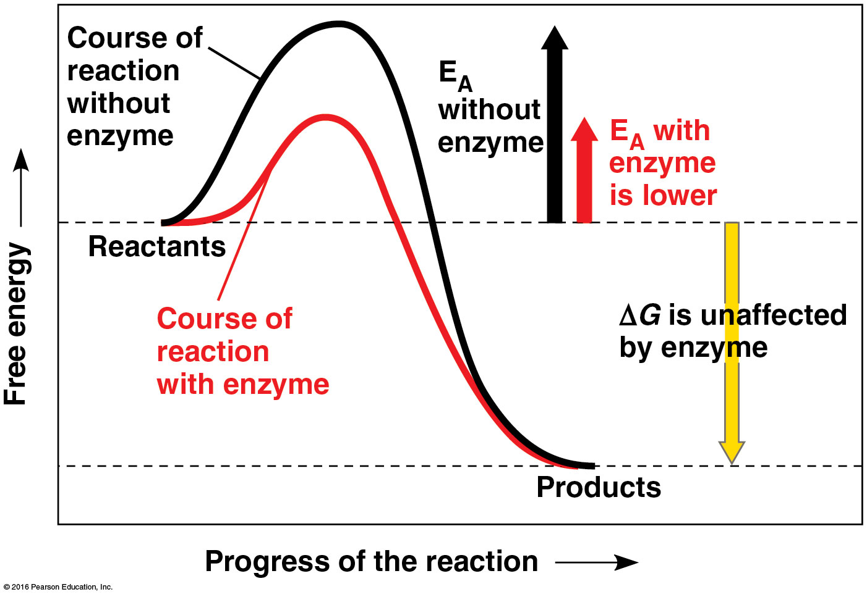
In the energy diagram below, which of the energy changes would be the same in both the enzyme-catalyzed and uncatalyzed reactions?
a
b
c
d
e
Notes:
16
Answer: C. The energetic difference between reactants and products does not change with the presence of a catalyst, as described in Concept 6.4. Discuss examples of important energy-releasing biological reactions.

Slide 17
In the energy diagram below, which of the energy changes would be the same in both the enzyme-catalyzed and uncatalyzed reactions?
a
b
c
d
e
Notes:
17

Slide 18
Vioxx and other prescription nonsteroidal anti-inflammatory drugs (NSAIDs) are potent inhibitors of the cyclooxygenase-2 (COX-2) enzyme. High substrate concentrations reduce the efficacy of inhibition by these drugs. These drugs are
competitive inhibitors.
noncompetitive inhibitors.
allosteric regulators.
prosthetic groups.
feedback inhibitors.
Notes:
18
Answer: A. Competitive inhibitors keep the real substrate from entering the active site, as discussed in Concept 6.4. Discuss an analogy in which a cab is an enzyme, you are a substrate, and another traveller is an inhibitor.
Copeland et al. Mechanism of selective inhibition of the inducible isoform of prostaglandin G/H synthase, Proceedings of the National Academy of Sciences 91:11202–11206 (1994).

Slide 19
Vioxx and other prescription nonsteroidal anti-inflammatory drugs (NSAIDs) are potent inhibitors of the cyclooxygenase-2 (COX-2) enzyme. High substrate concentrations reduce the efficacy of inhibition by these drugs. These drugs are
competitive inhibitors.
noncompetitive inhibitors.
allosteric regulators.
prosthetic groups.
feedback inhibitors.
Notes:
19
Copeland et al. Mechanism of selective inhibition of the inducible isoform of prostaglandin G/H synthase, Proceedings of the National Academy of Sciences 91:11202–11206 (1994).

Slide 20
If you were very cold, what kind of energy would be most immediately useful?
kinetic energy
thermal energy
potential energy
chemical energy
All of the above could help immediately.
Notes:
Answer: B. Thermal energy is heat energy and would counteract the cold. The other forms of energy could be useful, but not as immediately as thermal energy. Compare with the answer if the question were “If you were being chased by a cheetah… .” See Concept 6.1.

Slide 21
If you were very cold, what kind of energy would be most immediately useful?
kinetic energy
thermal energy
potential energy
chemical energy
All of the above could help immediately.

Slide 22
In an analogy between a building and a living body, is the crew installing plumbing in the building acting in catabolism or anabolism? Is their work exergonic or endergonic?
catabolism; exergonic
anabolism; endergonic
catabolism; endergonic
anabolism; exergonic
It depends on what floor of the building is being built.
Notes:
Answer: B. The workers are using energy to build something up. See Concept 6.3.

Slide 23
In an analogy between a building and a living body, is the crew installing plumbing in the building acting in catabolism or anabolism? Is their work exergonic or endergonic?
catabolism; exergonic
anabolism; endergonic
catabolism; endergonic
anabolism; exergonic
It depends on what floor of the building is being built.

Slide 24
A tree capturing energy from the sun and making sugars is an example of what law, and why?
first law of thermodynamics, because it is changing the form of energy
second law of thermodynamics, because some energy is lost as heat
first law of thermodynamics, because matter is being turned into energy
second law of thermodynamics, because the synthesis of sugar is spontaneous
A and B
Notes:
Answer: E. Discuss what forms of energy are involved. See Concept 6.1.

Slide 25
A tree capturing energy from the sun and making sugars is an example of what law, and why?
first law of thermodynamics, because it is changing the form of energy
second law of thermodynamics, because some energy is lost as heat
first law of thermodynamics, because matter is being turned into energy
second law of thermodynamics, because the synthesis of sugar is spontaneous
A and B

Slide 26
If you were studying a new kind of fungus, and you wanted to know how much energy was immediately available to power metabolism in the fungus, you would measure the concentration of what molecule?
sucrose
glucose
ATP
lipids
DNA
Notes:
Answer: C. ATP powers almost all reactions in cells for which energy is input at some point. See Concept 6.3.

Slide 27
If you were studying a new kind of fungus, and you wanted to know how much energy was immediately available to power metabolism in the fungus, you would measure the concentration of what molecule?
sucrose
glucose
ATP
lipids
DNA
Notes:
Answer: C. ATP powers almost all reactions in cells for which energy is input at some point. See Concept 6.3.

Slide 28
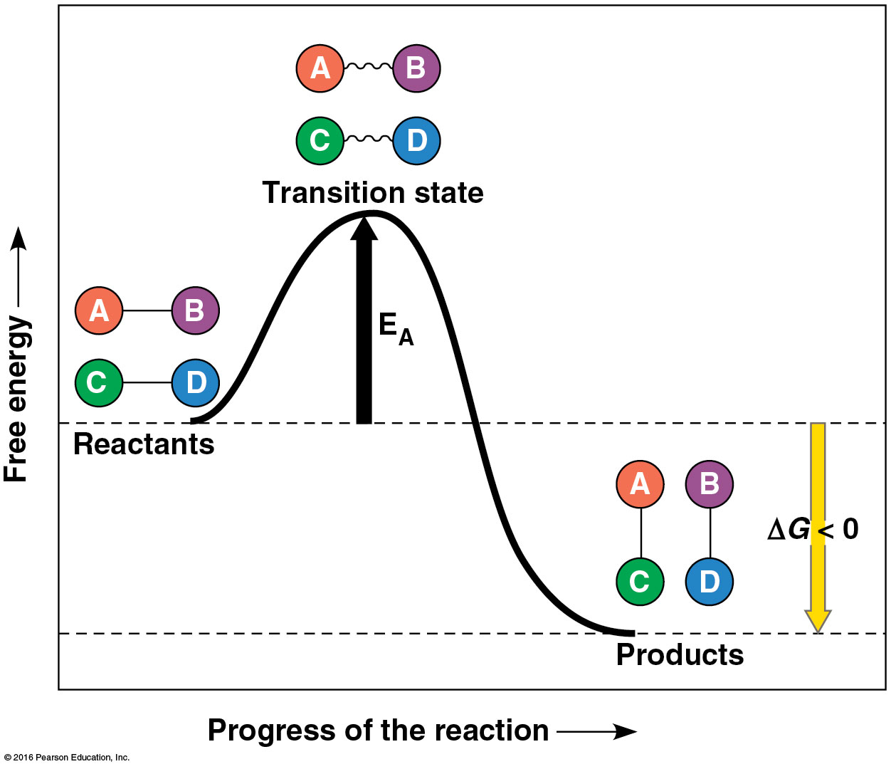
What kind of method would you need to study transition states?
one involving organic solvents, since reactions happen in membranes
one that is repeated, since transition states form many times before reactions can proceed
one involving cold, to reduce thermal noise in the data
one that is fast, since transition states only last a short time
None of the answers is true.
Notes:
Answer: D. As shown in Concept 6.4, transition states are very short lived, involving higher-energy, strained versions of reactants.

Slide 29
What kind of method would you need to study transition states?
one involving organic solvents, since reactions happen in membranes
one that is repeated, since transition states form many times before reactions can proceed
one involving cold, to reduce thermal noise in the data
one that is fast, since transition states only last a short time
None of the answers is true.

Slide 30
If you were designing an organism, and a critical chemical reaction occurred too slowly at the organism’s body temperature, what would you need to add to the design?
an enzyme
a catalyst
a molecule that enables transition states to be reached with lower energy requirements
A, B, and C
A and C
Notes:
Answer: D. As discussed in Concept 6.4, enzymes are catalysts that help reactants reach the transition state with less thermal energy.

Slide 31
If you were designing an organism, and a critical chemical reaction occurred too slowly at the organism’s body temperature, what would you need to add to the design?
an enzyme
a catalyst
a molecule that enables transition states to be reached with lower energy requirements
A, B, and C
A and C

Slide 32
If you took a bacterium living in a stream with 20°C water and placed it in a hot spring with 50°C water, what might happen?
It would thrive, with more thermal energy to speed reactions.
It would die because its enzymes would malfunction at high temperature.
It would grow as usual, since temperature has little effect on bacteria.
It would die because faster reactions would deplete cellular ATP.
B and D
Notes:
Answer: B. As discussed in Concept 6.4, enzymes must maintain their shape to function, and that proper shape is lost at nonoptimal temperatures. Discuss using a house key before and after melting it as an analogy.

Slide 33
If you took a bacterium living in a stream with 20°C water and placed it in a hot spring with 50°C water, what might happen?
It would thrive, with more thermal energy to speed reactions.
It would die because its enzymes would malfunction at high temperature.
It would grow as usual, since temperature has little effect on bacteria.
It would die because faster reactions would deplete cellular ATP.
B and D

Slide 34
Invented by the ancient Inca, ceviche is a seafood dish cooked by applying acid, such as citrus juice, to raw fish. How does this work?
by denaturing protein with lowered pH
by raising the temperature of the fish as the acid enters its cells
by releasing stored enzymes
by breaking down ATP
by speeding growth of acid-loving bacteria
Notes:
Answer: A. See Concept 6.4. Proteins, including enzymes, work well at a particular pH, and lose their shape and function away from that pH.

Slide 35
Invented by the ancient Inca, ceviche is a seafood dish cooked by applying acid, such as citrus juice, to raw fish. How does this work?
by denaturing protein with lowered pH
by raising the temperature of the fish as the acid enters its cells
by releasing stored enzymes
by breaking down ATP
by speeding growth of acid-loving bacteria

Slide 36
You have discovered an enzyme consisting of four identical units, each of which catalyzes the same reaction. What might this structure do to the reaction rate in a cell?
slow it down as the four subunits compete for substrate
speed it up due to cooperativity
slow it down as the subunits can block one another physically
leave the rate unchanged
There is not enough information to make a prediction.
Notes:
Answer: A. See Concept 6.5. Cooperativity occurs when enzymes with multiple identical subunits work faster per subunit when all are binding substrate. Discuss how hemoglobin, though not an enzyme, also displays this property.

Slide 37
You have discovered an enzyme consisting of four identical units, each of which catalyzes the same reaction. What might this structure do to the reaction rate in a cell?
slow it down as the four subunits compete for substrate
speed it up due to cooperativity
slow it down as the subunits can block one another physically
leave the rate unchanged
There is not enough information to make a prediction.

Slide 38
If a mechanic tries to change as many tires as possible in a short time by bringing car after car into the garage before previously repaired cars can be removed, eventually no more work can be done until the fixed cars are removed. What enzyme function is this like?
cooperativity
denaturation
optimal temperature
feedback inhibition
noncompetitive inhibition
Notes:
Answer: D. See Concept 6.5. Feedback inhibition occurs when a product inhibits the enzyme that produced it to prevent excessive concentrations of the product from building up.

Slide 39
If a mechanic tries to change as many tires as possible in a short time by bringing car after car into the garage before previously repaired cars can be removed, eventually no more work can be done until the fixed cars are removed. What enzyme function is this like?
cooperativity
denaturation
optimal temperature
feedback inhibition
noncompetitive inhibition

Slide 40
Imagine that you have discovered a new enzyme, but when you isolate it for further study, it does not work properly. What might have been lost?
a cofactor
a coenzyme
bound reactant
A and B
A, B, and C
Notes:
Answer: D. See Concepts 6.4 and 6.5. Cofactors and coenzymes work with an enzyme as part of its functional structure to make it fully functional. Use an analogy of a car with and without its ignition key to help explain.

Slide 41
Imagine that you have discovered a new enzyme, but when you isolate it for further study, it does not work properly. What might have been lost?
a cofactor
a coenzyme
bound reactant
A and B
A, B, and C

Slide 42
If normal human body temperature is 37ºC, what temperature would be optimal for many human enzymes?
2°C
7°C
17°C
27°C
37°C
Notes:
Answer: E. See Concepts 6.4. The optimal temperature for an enzyme is generally close to the temperature at which it normally works.

Slide 43
If normal human body temperature is 37ºC, what temperature would be optimal for many human enzymes?
2°C
7°C
17°C
27°C
37°C

Slide 44
What is a good analogy for the induced fit of a substrate into an enzyme’s active site?
a pencil in a sharpener
two hands shaking
solid tires turning on a road
teeth biting an apple
All of the choices are correct.
Notes:
Answer: B. See Concepts 6.4. When two hands shake, the shape of the hands alters for better fit.

Slide 45
What is a good analogy for the induced fit of a substrate into an enzyme’s active site?
a pencil in a sharpener
two hands shaking
solid tires turning on a road
teeth biting an apple
All of the choices are correct.

Slide 46
Which example best demonstrates the second law of thermodynamics?
eggs neatly placed in a carton
two hands shaking
a broken pencil in two pieces
a tree with leaves of all the same basic shape
four puppies with the same coat color
Notes:
Answer: C. See Concept 6.1. While generating order (A, B, D, E.) creates disorder someplace else, C most clearly shows disorder.

Slide 47
Which example best demonstrates the second law of thermodynamics?
eggs neatly placed in a carton
two hands shaking
a broken pencil in two pieces
a tree with leaves of all the same basic shape
four puppies with the same coat color

Slide 48
Why is the breakdown of ATP useful for powering cellular processes?
It is an endergonic reaction that can be coupled with other reactions.
As an exergonic reaction, it releases energy to spare.
It takes up excess free energy that interferes with metabolism.
It helps warm cells and speed metabolism.
It generates ADP for the synthesis of RNA.
Notes:
Answer: B. See Concepts 6.2 and 6.3. ATP is coupled to nonspontaneous reactions to make the reactions move forward for the life of the cell.

Slide 49
Why is the breakdown of ATP useful for powering cellular processes?
It is an endergonic reaction that can be coupled with other reactions.
As an exergonic reaction, it releases energy to spare.
It takes up excess free energy that interferes with metabolism.
It helps warm cells and speed metabolism.
It generates ADP for the synthesis of RNA.

Slide 50
If you observed a chemical reaction proceed spontaneously in a cell, which of the following would be true?
The reaction was exergonic.
The reactants had more free energy than the products.
The products included ATP.
A and B
A and C
Notes:
Answer: D. See Concepts 6.2 and 6.3. Exergonic reactions are spontaneous because they release free energy and increase entropy. ATP production could be the result of such a process, but not in most cases.

Slide 51
If you observed a chemical reaction proceed spontaneously in a cell, which of the following would be true?
The reaction was exergonic.
The reactants had more free energy than the products.
The products included ATP.
A and B
A and C

