Slide 1
31
Plant Responses to Internal and External Signals

Slide 2
According to the acid growth hypothesis, what is the correct sequence in which the following events occur, leading to auxin-induced cell elongation?
Crosslinks between cellulose microfibrils and polysaccharides of the cell wall are enzymatically broken.
Increased turgor pressure of cell cytoplasm expands the cell.
Proton pumps move H⁺ into the cell wall.
1, 2, 3
1, 3, 2
2, 3, 1
3, 2, 1
3, 1, 2
Notes:
Answer: E.

Slide 3
According to the acid growth hypothesis, what is the correct sequence in which the following events occur, leading to auxin-induced cell elongation?
Crosslinks between cellulose microfibrils and polysaccharides of the cell wall are enzymatically broken.
Increased turgor pressure of cell cytoplasm expands the cell.
Proton pumps move H⁺ into the cell wall.
1, 2, 3
1, 3, 2
2, 3, 1
3, 2, 1
3, 1, 2

Slide 4
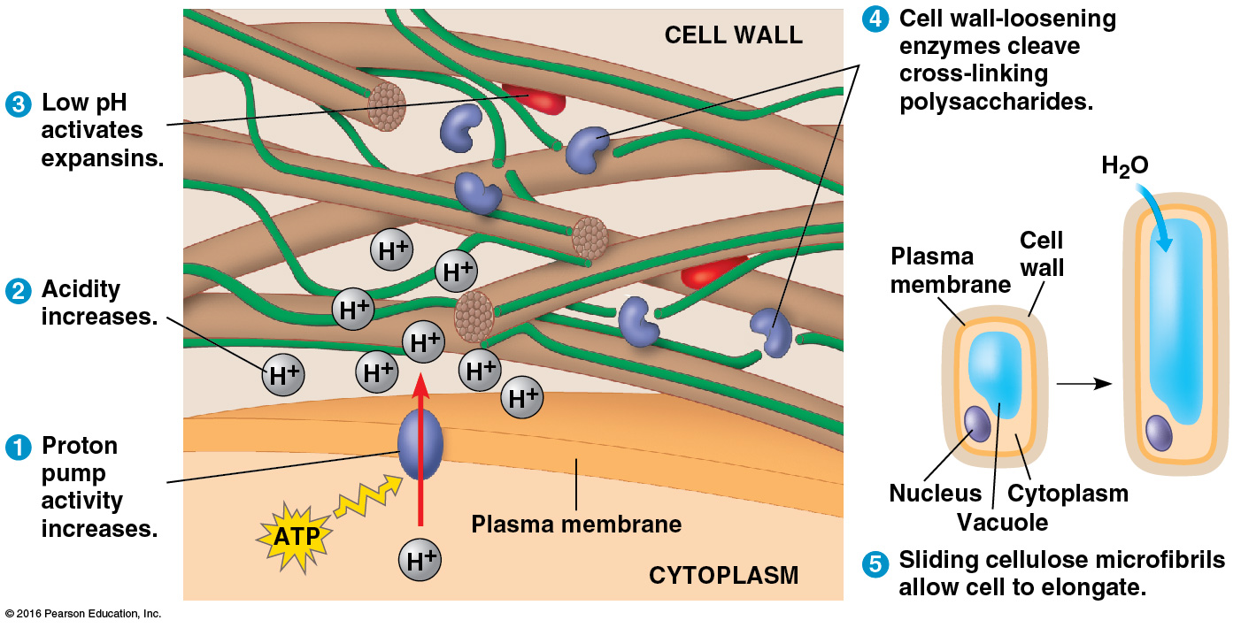
Which of these could explain the auxin-induced cell elongation, as pictured in the figure? (NOTE: The cell does NOT increase in size in all dimensions.)
Proton pumps, homogeneously distributed in the plasma membrane, are all equally active.
Active proton pumps are limited to the portion of the plasma membrane that is parallel to the axis of elongation.
Expansins and/or cell wall–loosening enzymes are homogeneously distributed outside of the plasma membrane.
Expansins and/or cell wall–loosening enzymes are limited to the exterior of the cell on the side that is perpendicular to the axis of elongation.
1 only
2 only
1 or 3
1 or 4
2 and 4
Notes:
4
Answer: B.

Slide 5
Which of these could explain the auxin-induced cell elongation, as pictured in the figure? (NOTE: The cell does NOT increase in size in all dimensions.)
Proton pumps, homogeneously distributed in the plasma membrane, are all equally active.
Active proton pumps are limited to the portion of the plasma membrane that is parallel to the axis of elongation.
Expansins and/or cell wall–loosening enzymes are homogeneously distributed outside of the plasma membrane.
Expansins and/or cell wall–loosening enzymes are limited to the exterior of the cell on the side that is perpendicular to the axis of elongation.
1 only
2 only
1 or 3
1 or 4
2 and 4
Notes:
5

Slide 6
Plant hormones are essential in plant growth and development. Almost each hormone has _____ effect(s) depending on _____.
a single; the site of action and its concentration
a single; the growth and development
multiple; the site of action and the growth and development
multiple; the site of action, its concentration, and the plant growth and development
Notes:
Answer: D.

Slide 7
Plant hormones are essential in plant growth and development. Almost each hormone has _____ effect(s) depending on _____.
a single; the site of action and its concentration
a single; the growth and development
multiple; the site of action and the growth and development
multiple; the site of action, its concentration, and the plant growth and development

Slide 8
Which of the following hormones is mismatched with its function?
auxin—regulates development of fruit
gibberellins—stimulates stem elongation
abscisic acid—regulates cell division
ethylene—promotes ripening of many fruits
Notes:
Answer: C.

Slide 9
Which of the following hormones is mismatched with its function?
auxin—regulates development of fruit
gibberellins—stimulates stem elongation
abscisic acid—regulates cell division
ethylene—promotes ripening of many fruits

Slide 10
Which of the following hormones is correctly matched with its major site of production?
cytokinins—roots
auxins—shoot meristem and young leaves
gibberellins—meristem of apical buds and roots
all the above
Notes:
Answer: D.

Slide 11
Which of the following hormones is correctly matched with its major site of production?
cytokinins—roots
auxins—shoot meristem and young leaves
gibberellins—meristem of apical buds and roots
all the above

Slide 12
Which of these is most directly involved in causing the leaves of deciduous trees to fall in autumn?
cytokinins
gibberellins
abscisic acid
ethylene
brassinosteroids
Notes:
12
Answer: D.

Slide 13
Which of these is most directly involved in causing the leaves of deciduous trees to fall in autumn?
cytokinins
gibberellins
abscisic acid
ethylene
brassinosteroids
Notes:
13

Slide 14
A patch of soil contains ungerminated seeds. If this patch is covered by a newly laid concrete sidewalk, then which of these phenomena will the seedlings under the sidewalk exhibit if they germinate, and which hormone accounts for this phenomenon?
triple response; ethylene
seed dormancy; abscisic acid
anti-aging effects; cytokines
anti-aging effects; abscisic acid
triple response; brassinosteroids
Notes:
14
Answer: A.

Slide 15
A patch of soil contains ungerminated seeds. If this patch is covered by a newly laid concrete sidewalk, then which of these phenomena will the seedlings under the sidewalk exhibit if they germinate, and which hormone accounts for this phenomenon?
triple response; ethylene
seed dormancy; abscisic acid
anti-aging effects; cytokines
anti-aging effects; abscisic acid
triple response; brassinosteroids
Notes:
15

Slide 16
The role(s) of auxin in plant development is/are _____.
the development of a plant
the size of the plant
the phyllotaxy on the stem
to increase the activity of proton pumps
all the above
Notes:
Answer: E.

Slide 17
The role(s) of auxin in plant development is/are _____.
the development of a plant
the size of the plant
the phyllotaxy on the stem
to increase the activity of proton pumps
all the above

Slide 18
Which of the following plant hormones has a significant impact on bolting?
cytokinins
gibberellins
ethylene
indoleacetic acid (IAA)
Notes:
Answer: B.

Slide 19
Which of the following plant hormones has a significant impact on bolting?
cytokinins
gibberellins
ethylene
indoleacetic acid (IAA)

Slide 20
Circadian rhythms, seasonal rhythms, and seedling germination are most strongly influenced by a molecular switching mechanism that involves a phytochrome sensitive to both
violet light and ultraviolet light.
infrared radiation and red light.
red light and far-red light.
blue light and red light.
geomagnetism and cosmic radiation.
Notes:
20
Answer: C.

Slide 21
Circadian rhythms, seasonal rhythms, and seedling germination are most strongly influenced by a molecular switching mechanism that involves a phytochrome sensitive to both
violet light and ultraviolet light.
infrared radiation and red light.
red light and far-red light.
blue light and red light.
geomagnetism and cosmic radiation.
Notes:
21

Slide 22
Which of the following plant hormones has an effective triple response to a mechanical stress caused during seed germination?
cytokinins
gibberellins
ethylene
indoleacetic acid (IAA)
Notes:
Answer: C.

Slide 23
Which of the following plant hormones has an effective triple response to a mechanical stress caused during seed germination?
cytokinins
gibberellins
ethylene
indoleacetic acid (IAA)

Slide 24
If one experimentally wants to get a long-day (short-night) plant to flower at a time when nights are longer than the critical night length, the best way would be to interrupt their
days with a few minutes of complete darkness during their exposure to light.
nights with a few minutes of exposure to blue light.
nights with a few minutes of exposure to far-red light.
nights with a few minutes of exposure to red light.
nights with a few minutes of exposure to any color of light.
Notes:
24
Answer: D.

Slide 25
If one experimentally wants to get a long-day (short-night) plant to flower at a time when nights are longer than the critical night length, the best way would be to interrupt their
days with a few minutes of complete darkness during their exposure to light.
nights with a few minutes of exposure to blue light.
nights with a few minutes of exposure to far-red light.
nights with a few minutes of exposure to red light.
nights with a few minutes of exposure to any color of light.
Notes:
25

Slide 26
The morphological adaptation of a plant for growing in the dark is referred to as etiolation. Which of the following is not a part of etiolation?
a higher rate of evaporation
an extensive root system
leaves that are not mature
allocation of maximum energy to elongate the stem
Notes:
Answer: A.

Slide 27
The morphological adaptation of a plant for growing in the dark is referred to as etiolation. Which of the following is not a part of etiolation?
a higher rate of evaporation
an extensive root system
leaves that are not mature
allocation of maximum energy to elongate the stem

Slide 28
In animals, signaling chemicals may move from cell to cell via gap junctions. In plants, which structures are analogous to gap junctions, and which plant hormone moves from leaves to shoot apical meristems through these structures?
nuclear pores; florigens
tight junctions; cytokinins
tight junctions; auxins
plasmodesmata; auxins
plasmodesmata; florigens
Notes:
28
Answer: E.

Slide 29
In animals, signaling chemicals may move from cell to cell via gap junctions. In plants, which structures are analogous to gap junctions, and which plant hormone moves from leaves to shoot apical meristems through these structures?
nuclear pores; florigens
tight junctions; cytokinins
tight junctions; auxins
plasmodesmata; auxins
plasmodesmata; florigens
Notes:
29

Slide 30
In plants, which organelles are sensitive to gravity, and what do these organelles exhibit in a gravitational field?
otoliths; positive gravitropism
statoliths; positive gravitropism
statoliths; negative gravitropism
statocysts; negative gravitropism
statocysts; positive gravitropism
Notes:
30
Answer: B.

Slide 31
In plants, which organelles are sensitive to gravity, and what do these organelles exhibit in a gravitational field?
otoliths; positive gravitropism
statoliths; positive gravitropism
statoliths; negative gravitropism
statocysts; negative gravitropism
statocysts; positive gravitropism
Notes:
31

Slide 32
In response to temperature extremes, plants may synthesize either heat-shock proteins or antifreeze proteins, proteins that help protect against which dangers, respectively?
protein denaturation, ice-crystal formation
wilting, inability to synthesize hormones
permanent closure of stomata, evapotranspiration
leaf abscission, protein denaturation
evapotranspiration, inability to perform motor activities
Notes:
32
Answer: A.

Slide 33
In response to temperature extremes, plants may synthesize either heat-shock proteins or antifreeze proteins, proteins that help protect against which dangers, respectively?
protein denaturation, ice-crystal formation
wilting, inability to synthesize hormones
permanent closure of stomata, evapotranspiration
leaf abscission, protein denaturation
evapotranspiration, inability to perform motor activities
Notes:
33

Slide 34
Plant cells can do all of the following in response to attack by an avirulent pathogen except
kill themselves.
synthesize chemicals that inhibit the pathogen.
limit the spread of the pathogen to other cells.
secrete chemicals that signal the presence of pathogens to other parts of the plant.
engulf the pathogen by phagocytosis.
Notes:
34
Answer: E.

Slide 35
Plant cells can do all of the following in response to attack by an avirulent pathogen except
kill themselves.
synthesize chemicals that inhibit the pathogen.
limit the spread of the pathogen to other cells.
secrete chemicals that signal the presence of pathogens to other parts of the plant.
engulf the pathogen by phagocytosis.
Notes:
35

Slide 36
Which color of light inhibits the seed germination of a lettuce plant?
blue
far-red
violet
red
yellow
Notes:
Answer: B.

Slide 37
Which color of light inhibits the seed germination of a lettuce plant?
blue
far-red
violet
red
yellow

Slide 38
What is the correct sequence in which these events in systemic acquired resistance occur?
Phloem transports chemical signal to plant parts distant from the site of attack.
Damaged tissues secrete methylsalicylic acid.
Salicylic acid induces production of PR proteins.
Methylsalicylic acid is converted to salicylic acid in healthy cells.
1, 2, 4, 3
1, 3, 4, 2
2, 4, 1, 3
2, 1, 4, 3
2, 4, 3, 1
Notes:
38
Answer: D.

Slide 39
What is the correct sequence in which these events in systemic acquired resistance occur?
Phloem transports chemical signal to plant parts distant from the site of attack.
Damaged tissues secrete methylsalicylic acid.
Salicylic acid induces production of PR proteins.
Methylsalicylic acid is converted to salicylic acid in healthy cells.
1, 2, 4, 3
1, 3, 4, 2
2, 4, 1, 3
2, 1, 4, 3
2, 4, 3, 1
Notes:
39

