Slide 1
20
Phylogeny

Slide 2
Which of the following taxonomic categories includes the fewest number of species?
Animalia
Panthera
Felidae
Carnivora
Mammalia
Notes:
Answer: B. This question focuses on Concept 20.1 (specifically, “Hierarchical Classification”).

Slide 3
Which of the following taxonomic categories includes the fewest number of species?
Animalia
Panthera
Felidae
Carnivora
Mammalia

Slide 4
Different animals that possess homologous structures probably _____.
evolved from the same ancestor
are headed for extinction
by chance had similar mutations in the past
are not related
have increased genetic diversity
Notes:
4
Answer: A.

Slide 5
Different animals that possess homologous structures probably _____.
evolved from the same ancestor
are headed for extinction
by chance had similar mutations in the past
are not related
have increased genetic diversity
Notes:
5

Slide 6
Which of the following pairs are homologous?
struts in dragonfly wing and bones in penguin flipper
struts in dragonfly wing and bones in bat wing
bones in bat wing and bones in seal flipper
seal flipper and penguin flipper
bones in penguin flipper and bones in bat wing
Notes:
6
Answer: E. Neither analogous nor homologous: A; analogous: B, C, and D; homologous: E. Seal flippers and penguin flippers are both derived from vertebrate forelimbs (the bones are homologous), but the forelimbs evolved to the flipper shape independently (analogous).

Slide 7
Which of the following pairs are homologous?
struts in dragonfly wing and bones in penguin flipper
struts in dragonfly wing and bones in bat wing
bones in bat wing and bones in seal flipper
seal flipper and penguin flipper
bones in penguin flipper and bones in bat wing
Notes:
7

Slide 8
Which of the following would make the most suitable outgroup species for a cladogram relative to all the other species?
frog
tuna
snake
penguin
bat
Notes:
8
Answer: B. The other choices are descended from terrestrial vertebrates.

Slide 9
Which of the following would make the most suitable outgroup species for a cladogram relative to all the other species?
frog
tuna
snake
penguin
bat
Notes:
9

Slide 10
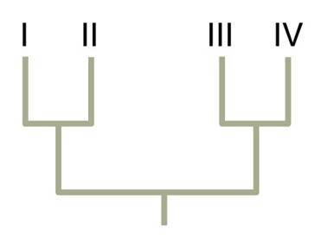
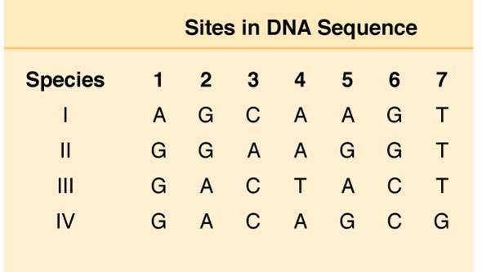
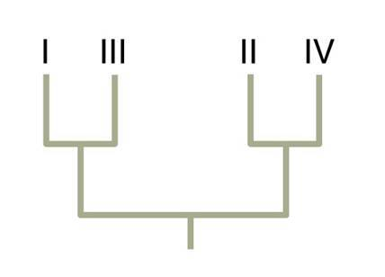
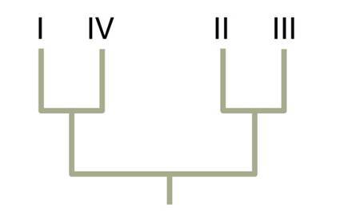
Given the DNA sequence data in the table, which phylogenetic tree is the most parsimonious?
Notes:
10
Answer: A.

Slide 11
Given the DNA sequence data in the table, which phylogenetic tree is the most parsimonious?
Notes:
11

Slide 12
Which of the following is the correct way to write the scientific name for humans?
Homo sapiens
homo sapiens
Homo sapiens
homo sapiens
Notes:
12
Answer: C. The name should be written in italics with the genus capitalized and the species lowercase.

Slide 13
Which of the following is the correct way to write the scientific name for humans?
Homo sapiens
homo sapiens
Homo sapiens
homo sapiens
Notes:
13

Slide 14
When describing a group of animals, you speak about an ancestral species and some, but not all, of its descendants. This is an example of a
monophyletic group.
polyphyletic group.
paraphyletic group.
Notes:
14
Answer: C. A monophyletic group is an ancestor and all of its descendants, and a polyphyletic group is a group that has multiple ancestors.

Slide 15
When describing a group of animals, you speak about an ancestral species and some, but not all, of its descendants. This is an example of a
monophyletic group.
polyphyletic group.
paraphyletic group.
Notes:
15

Slide 16
Hair on mammals when compared to other invertebrates is an example of a
shared derived character.
shared ancestral character.
paraphyletic character.
polyphyletic character.
Notes:
16
Answer: A. Hair is something that only mammals share, and it is not found in their ancestors. If it were, then we would call it a shared ancestral character.

Slide 17
Hair on mammals when compared to other invertebrates is an example of a
shared derived character.
shared ancestral character.
paraphyletic character.
polyphyletic character.
Notes:
17

Slide 18
Which of the following kingdoms is now obsolete?
Plantae
Fungi
Protista
Monera
Notes:
18
Answer: D. Monera, because scientists decided that Archaea and Bacteria were too different from one another to be included in the same kingdom.

Slide 19
Which of the following kingdoms is now obsolete?
Plantae
Fungi
Protista
Monera
Notes:
19

Slide 20
Biological classification is an inclusive hierarchical system (e.g., species, genus, family, class). Which of the following is also an inclusive hierarchical system?
music: classical, jazz, rock, hip-hop
class: first year, sophomore, junior, senior
military rank: private, corporal, major, colonel, etc.
address: street, city, state, nation, etc.
Notes:
Answer: D.

Slide 21
Biological classification is an inclusive hierarchical system (e.g., species, genus, family, class). Which of the following is also an inclusive hierarchical system?
music: classical, jazz, rock, hip-hop
class: first year, sophomore, junior, senior
military rank: private, corporal, major, colonel, etc.
address: street, city, state, nation, etc.

Slide 22
In a phylogenetic tree, the arrangement of branches depicts what about the taxa it contains?
their phenotypic similarity
their geographic distribution
their patterns of descent
their rates of evolutionary change
Notes:
Answer: C.

Slide 23
In a phylogenetic tree, the arrangement of branches depicts what about the taxa it contains?
their phenotypic similarity
their geographic distribution
their patterns of descent
their rates of evolutionary change

Slide 24
In the hypothetical phylogenetic tree shown, which groups, inclusive of any ancestors, are monophyletic?
Y + Z
U + V + W
U + V + W + X
W + X + Y + Z
U
V
W
X
Y
Z
Notes:
Answer: C. Only C is monophyletic.

Slide 25
In the hypothetical phylogenetic tree shown, which groups, inclusive of any ancestors, are monophyletic?
Y + Z
U + V + W
U + V + W + X
W + X + Y + Z
U
V
W
X
Y
Z

Slide 26
In the hypothetical phylogenetic tree shown, which taxon or taxa serve(s) as the best outgroup for analyzing taxon U + V?
U
Z
Y
W and/or X
V
V
W
X
Y
Z
Notes:
Answer: C.

Slide 27
In the hypothetical phylogenetic tree shown, which taxon or taxa serve(s) as the best outgroup for analyzing taxon U + V?
U
Z
Y
W and/or X
V
V
W
X
Y
Z

Slide 28
Considering the hypothetical phylogenetic tree shown, what piece of additional information could throw the tree into doubt?
U
W becomes extinct.
X is found to share new homoplasies with W.
A new subspecies of Y is discovered.
U is found to share new homologies with V.
V
W
X
Y
Z
Notes:
Answer: B.

Slide 29
Considering the hypothetical phylogenetic tree shown, what piece of additional information could throw the tree into doubt?
U
W becomes extinct.
X is found to share new homoplasies with W.
A new subspecies of Y is discovered.
U is found to share new homologies with V.
V
W
X
Y
Z

Slide 30
In terms of a molecular clock, histone genes “tick” almost imperceptibly slowly (0.01 amino acid substitutions per 10⁹ years), while fibrinopeptides evolve almost 1,000 times as fast. What accounts for these different clock rates?
Mutations occur much more frequently in fibrinopetides than in histones.
Mutations in fibrinopeptides are much less harmful than those in histones.
Fibrinopeptide genes are much larger than histone genes.
Fibrinopeptide genes are much more common than histone genes.
Notes:
Answer: B.

Slide 31
In terms of a molecular clock, histone genes “tick” almost imperceptibly slowly (0.01 amino acid substitutions per 10⁹ years), while fibrinopeptides evolve almost 1,000 times as fast. What accounts for these different clock rates?
Mutations occur much more frequently in fibrinopetides than in histones.
Mutations in fibrinopeptides are much less harmful than those in histones.
Fibrinopeptide genes are much larger than histone genes.
Fibrinopeptide genes are much more common than histone genes.

Slide 32
Of the roughly 20,000 genes in the human genome, approximately 145 are shown to have been acquired by horizontal gene transfer. Which of the following phylogenetic patterns is consistent with horizontal gene transfer?
Humans and all eukaryotes have histone genes.
Only vertebrates have the CCN gene family.
Only vertebrates and bacteria have the gene that confers ABO blood type.
The gene ARHGAP11B is found only in humans.
Notes:
Answer: C. A, B, and D provide no evidence of horizontal gene transfer—the groups listed are monophyletic and the shared genes likely come from common descent. C is a paraphyletic group, suggesting that genes may have transferred between the groups.

Slide 33
Of the roughly 20,000 genes in the human genome, approximately 145 are shown to have been acquired by horizontal gene transfer. Which of the following phylogenetic patterns is consistent with horizontal gene transfer?
Humans and all eukaryotes have histone genes.
Only vertebrates have the CCN gene family.
Only vertebrates and bacteria have the gene that confers ABO blood type.
The gene ARHGAP11B is found only in humans.

