Slide 1
32
The Internal Environment of Animals: Organization and Regulation

Slide 2
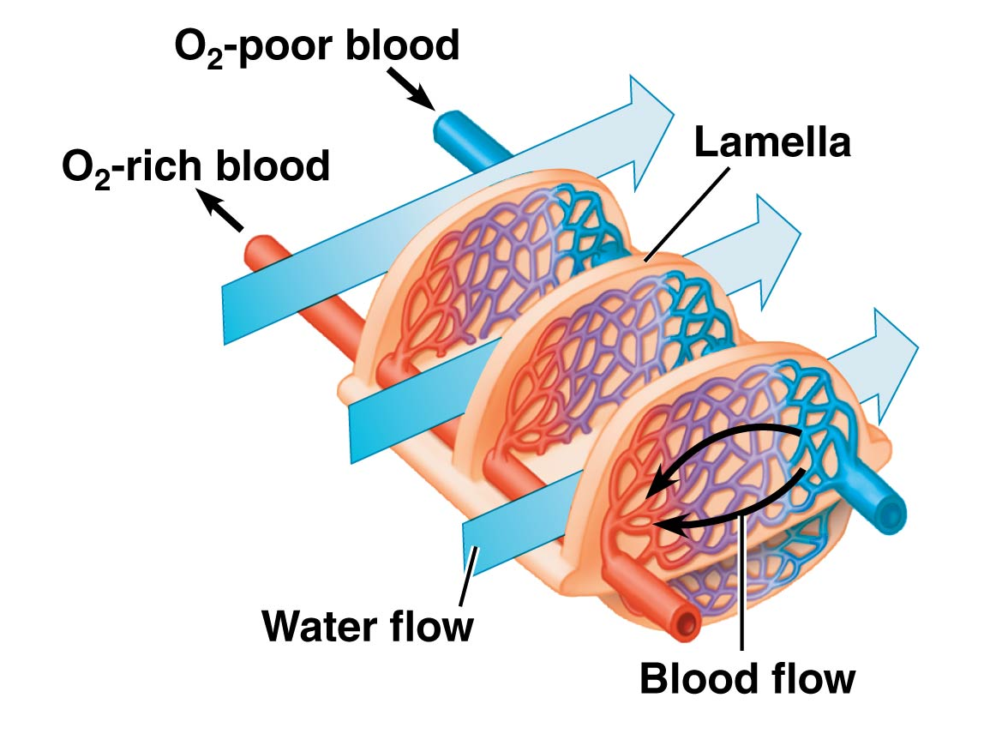
The direction of blood flow in fish gills is opposite the direction of water flow past the gills. Which of these should be expected if this structural relationship represents a countercurrent exchange mechanism for oxygen?
Net movement of oxygen from water into
blood occurs along the entire distance where blood and water are in close contact.
Net movement of oxygen from blood into water occurs along the entire distance where blood and water are in close contact.
Net movement of oxygen from water into blood occurs only in the first half of the distance where blood and water are in close contact.
Net movement of oxygen from water into blood occurs only in the second half of the distance where blood and water are in close contact.
Effective net movement of oxygen from blood into water occurs only in the first half of the distance where blood and water are in close contact.
Notes:
2
Answer: A.

Slide 3
The direction of blood flow in fish gills is opposite the direction of water flow past the gills. Which of these should be expected if this structural relationship represents a countercurrent exchange mechanism for oxygen?
Net movement of oxygen from water into
blood occurs along the entire distance where blood and water are in close contact.
Net movement of oxygen from blood into water occurs along the entire distance where blood and water are in close contact.
Net movement of oxygen from water into blood occurs only in the first half of the distance where blood and water are in close contact.
Net movement of oxygen from water into blood occurs only in the second half of the distance where blood and water are in close contact.
Effective net movement of oxygen from blood into water occurs only in the first half of the distance where blood and water are in close contact.
Notes:
3

Slide 4
The redness of the skin of a sunburned person is the result of vasodilation of the small arteries in the skin. The skin remains red when the sunburned person is not visibly sweating. At times when a sunburned person is not sweating, heat is being transferred from the person into the air mostly by which of the following? (Hint: Heat transfer is more effective by this means when the person is running or is in a strong breeze.)
radiation
convection
conduction
evaporation
absorption
Notes:
4
Answer: B.

Slide 5
The redness of the skin of a sunburned person is the result of vasodilation of the small arteries in the skin. The skin remains red when the sunburned person is not visibly sweating. At times when a sunburned person is not sweating, heat is being transferred from the person into the air mostly by which of the following? (Hint: Heat transfer is more effective by this means when the person is running or is in a strong breeze.)
radiation
convection
conduction
evaporation
absorption
Notes:
5

Slide 6
In human hormone cascades, what is the correct sequence in which these structures become involved, starting with the organ at the beginning of the cascade? (NOTE: Not all organs listed are included in all options.)
nonendocrine target
anterior pituitary gland
posterior pituitary gland
hypothalamus
specific endocrine gland
2, 3, 5, 1, 4
2, 4, 3, 1, 5
4, 2, 3, 5, 1
4, 3, 5, 1
4, 2, 5, 1
Notes:
6
Answer: E.

Slide 7
In human hormone cascades, what is the correct sequence in which these structures become involved, starting with the organ at the beginning of the cascade? (NOTE: Not all organs listed are included in all options.)
nonendocrine target
anterior pituitary gland
posterior pituitary gland
hypothalamus
specific endocrine gland
2, 3, 5, 1, 4
2, 4, 3, 1, 5
4, 2, 3, 5, 1
4, 3, 5, 1
4, 2, 5, 1
Notes:
7

Slide 8
Which of the following organ systems is incorrectly matched with its main function?
circulatory system—body defense
endocrine system—coordination of body activities
integumentary system—thermoregulation
excretory system—regulation of osmotic balance of blood
Notes:
Answer: A.

Slide 9
Which of the following organ systems is incorrectly matched with its main function?
circulatory system—body defense
endocrine system—coordination of body activities
integumentary system—thermoregulation
excretory system—regulation of osmotic balance of blood

Slide 10
Which of the following tissue types is incorrectly matched with its function?
epithelial tissue—covers the lines of organs and body cavities
muscle tissue—holds the tissue and organs
connective tissue—stores fat and provides flexibility
nervous tissue—processing and transmission of information
Notes:
Answer: B.

Slide 11
Which of the following tissue types is incorrectly matched with its function?
epithelial tissue—covers the lines of organs and body cavities
muscle tissue—holds the tissue and organs
connective tissue—stores fat and provides flexibility
nervous tissue—processing and transmission of information

Slide 12
Men who overuse synthetic testosterone (as in anabolic steroids) may experience testicular atrophy, reduced sperm count, and low levels of circulating FSH. The physiological explanation for these observations is
that synthetic testosterone is not as effective as natural testosterone.
negative feedback.
positive feedback.
that such men have inadequate numbers of FSH receptors.
that such men have inadequate numbers of testosterone receptors.
Notes:
12
Answer: B.

Slide 13
Men who overuse synthetic testosterone (as in anabolic steroids) may experience testicular atrophy, reduced sperm count, and low levels of circulating FSH. The physiological explanation for these observations is
that synthetic testosterone is not as effective as natural testosterone.
negative feedback.
positive feedback.
that such men have inadequate numbers of FSH receptors.
that such men have inadequate numbers of testosterone receptors.
Notes:
13

Slide 14
Which of the following help plants and animals connect to each other with light, hormones, metabolic energy, and organic compounds?
photoreceptors
growth and development
metabolism
anabolism and catabolism
all of the above
Notes:
Answer: E.

Slide 15
Which of the following help plants and animals connect to each other with light, hormones, metabolic energy, and organic compounds?
photoreceptors
growth and development
metabolism
anabolism and catabolism
all of the above

Slide 16
The adrenal medulla is stimulated to increase its secretion of adrenaline whenever there is an increased frequency of nervous impulses originating in the hypothalamus and arriving at the adrenal medulla. This best represents
a simple endocrine pathway.
a positive feedback loop.
a neuroendocrine pathway.
a hormone cascade pathway.
the way that one hormone can have different effects, depending on which type of receptor is present in the target.
Notes:
16
Answer: C.

Slide 17
The adrenal medulla is stimulated to increase its secretion of adrenaline whenever there is an increased frequency of nervous impulses originating in the hypothalamus and arriving at the adrenal medulla. This best represents
a simple endocrine pathway.
a positive feedback loop.
a neuroendocrine pathway.
a hormone cascade pathway.
the way that one hormone can have different effects, depending on which type of receptor is present in the target.
Notes:
17

Slide 18
Plants and animals have close connections and similarities (unity in diversity) in (1) gaseous exchange, (2) transportation of nutrients, (3) nourishment, and (4) absorption. Which of the following structures is/are incorrectly matched with these functions?
mesophyll and alveoli for gaseous exchange
seeds and milk generation in mammals for nourishment
vascular tissue and vessels for transportation
root hairs and villi for absorption
both B and C
Notes:
Answer: E.

Slide 19
Plants and animals have close connections and similarities (unity in diversity) in (1) gaseous exchange, (2) transportation of nutrients, (3) nourishment, and (4) absorption. Which of the following structures is/are incorrectly matched with these functions?
mesophyll and alveoli for gaseous exchange
seeds and milk generation in mammals for nourishment
vascular tissue and vessels for transportation
root hairs and villi for absorption
both B and C

Slide 20
Arrange the following steps in the correct order of a signaling process in the endocrine system: (1) stimulus, (2) signal travels everywhere via the bloodstream, (3) response, and (4) blood vessel.
1, 2, 3, 4
1, 2, 4, 3
1, 3, 2, 4
1, 4, 2, 3
Notes:
Answer: B.

Slide 21
Arrange the following steps in the correct order of a signaling process in the endocrine system: (1) stimulus, (2) signal travels everywhere via the bloodstream, (3) response, and (4) blood vessel.
1, 2, 3, 4
1, 2, 4, 3
1, 3, 2, 4
1, 4, 2, 3

Slide 22
Blood flukes are parasitic flatworms that live in the bloodstream of the host. The worm’s interstitial fluids are isoosmotic to the host’s blood, so which of these is/are true?
1. The worms lack flame bulbs or have nonfunctional flame bulbs.
2. The worms have flame bulbs that are mostly active in performing osmoregulation.
3. The worms have flame bulbs that eliminate nitrogenous wastes.
4. The worms have flame bulbs whose role is to eliminate excess water that enters the worm by osmosis.
1 only
3 only
2 and 3
2 and 4
3 and 4
Notes:
22
Answer: B.

Slide 23
Blood flukes are parasitic flatworms that live in the bloodstream of the host. The worm’s interstitial fluids are isoosmotic to the host’s blood, so which of these is/are true?
1. The worms lack flame bulbs or have nonfunctional flame bulbs.
2. The worms have flame bulbs that are mostly active in performing osmoregulation.
3. The worms have flame bulbs that eliminate nitrogenous wastes.
4. The worms have flame bulbs whose role is to eliminate excess water that enters the worm by osmosis.
1 only
3 only
2 and 3
2 and 4
3 and 4
Notes:
23

Slide 24
Which of the following are major systems in coordinating and controlling responses to stimuli in animals?
circulatory and nervous systems
endocrine and exocrine systems
nervous and endocrine systems
nervous and exocrine systems
none of the above
Notes:
Answer: C.

Slide 25
Which of the following are major systems in coordinating and controlling responses to stimuli in animals?
circulatory and nervous systems
endocrine and exocrine systems
nervous and endocrine systems
nervous and exocrine systems
none of the above

Slide 26
Under which circumstance should reabsorption of water from kidney filtrate back into the bloodstream be most effective?
if neither ADH nor aldosterone is present in circulation
if both ADH and aldosterone are present in circulation
if ADH, but not aldosterone, is present in circulation
if aldosterone, but not ADH, is present in circulation
if renin, angiotensin II, and aldosterone are present in circulation, but not ADH
Notes:
26
Answer: B.

Slide 27
Under which circumstance should reabsorption of water from kidney filtrate back into the bloodstream be most effective?
if neither ADH nor aldosterone is present in circulation
if both ADH and aldosterone are present in circulation
if ADH, but not aldosterone, is present in circulation
if aldosterone, but not ADH, is present in circulation
if renin, angiotensin II, and aldosterone are present in circulation, but not ADH
Notes:
27

Slide 28
The functions of epinephrine and norepinephrine produced by the adrenal medulla in the human body is
raising blood glucose level.
raising blood calcium level.
constricting and dilating blood vessels.
lowering blood calcium level.
both A and C
Notes:
Answer: E.

Slide 29
The functions of epinephrine and norepinephrine produced by the adrenal medulla in the human body is
raising blood glucose level.
raising blood calcium level.
constricting and dilating blood vessels.
lowering blood calcium level.
both A and C

Slide 30
The function of oxytocin produced by the posterior pituitary gland in the human body is
stimulating mammary cells.
promoting retention of water.
stimulating ovaries and testes.
stimulating the adrenal cortex.
Notes:
Answer: A.

Slide 31
The function of oxytocin produced by the posterior pituitary gland in the human body is
stimulating mammary cells.
promoting retention of water.
stimulating ovaries and testes.
stimulating the adrenal cortex.

Slide 32
Animals that can produce exceptionally concentrated urine should be expected to have nephrons with longer
1. descending limbs of the loops of Henle.
2. ascending limbs of the loops of Henle.
3. distal tubules.
4. proximal tubules.
1 only
3 only
1 and 2
1 and 4
all four of these
Notes:
32
Answer: C.

Slide 33
Animals that can produce exceptionally concentrated urine should be expected to have nephrons with longer
1. descending limbs of the loops of Henle.
2. ascending limbs of the loops of Henle.
3. distal tubules.
4. proximal tubules.
1 only
3 only
1 and 2
1 and 4
all four of these
Notes:
33

Slide 34
In frogs, the unique function of the thyroid hormone thyroxine (T₄) is
stimulating the eggs.
promoting retention of water.
stimulating the resorption of the tadpole’s tail.
both B and C
none of the above
Notes:
Answer: C.

Slide 35
In frogs, the unique function of the thyroid hormone thyroxine (T₄) is
stimulating the eggs.
promoting retention of water.
stimulating the resorption of the tadpole’s tail.
both B and C
none of the above

Slide 36
Heat exchange between an organism and its environment to maintain body temperature (thermoregulation) is achieved by _____.
radiation
conduction
convection
evaporation
all the above
Notes:
Answer: E.

Slide 37
Heat exchange between an organism and its environment to maintain body temperature (thermoregulation) is achieved by _____.
radiation
conduction
convection
evaporation
all the above

Slide 38
Which two solutes become more abundant in the kidney medulla’s interstitial fluid as one progresses deeper into the medulla, and what is the significance of these two gradients?
urea and NaCl; interstitial fluids there become isoosmotic to blood
NaCl and KCl; this promotes maximal chloride ion retention
HCO₃– and H⁺; this produces pH-neutral interstitial fluids
urea and KCl; less urea is actually excreted than is possible
urea and NaCl; this promotes better retention of water
Notes:
38
Answer: E.

Slide 39
Which two solutes become more abundant in the kidney medulla’s interstitial fluid as one progresses deeper into the medulla, and what is the significance of these two gradients?
urea and NaCl; interstitial fluids there become isoosmotic to blood
NaCl and KCl; this promotes maximal chloride ion retention
HCO₃– and H⁺; this produces pH-neutral interstitial fluids
urea and KCl; less urea is actually excreted than is possible
urea and NaCl; this promotes better retention of water
Notes:
39

Slide 40
In kidneys, which hormone is most effective at causing increased numbers of aquaporins to be present in collecting duct epithelia, and what is the source of this hormone?
ADH; posterior pituitary gland
aldosterone; adrenal medulla
renin; kidneys
aldosterone; adrenal cortex
ADH; kidneys
Notes:
40
Answer: A.

Slide 41
In kidneys, which hormone is most effective at causing increased numbers of aquaporins to be present in collecting duct epithelia, and what is the source of this hormone?
ADH; posterior pituitary gland
aldosterone; adrenal medulla
renin; kidneys
aldosterone; adrenal cortex
ADH; kidneys
Notes:
41

