Slide 1
39
Motor Mechanisms
and Behavior

Slide 2
Myasthenia gravis, which leads to skeletal muscle paralysis, might be most directly treated with a therapy that would
increase the movement of calcium ions into the sarcoplasmic reticulum.
increase the number of available acetylcholine receptors.
increase the amount and depth of myelin on motor neurons.
increase the synthesis and activity of ATP in the cytosol of skeletal muscles.
Notes:
Answer: B. Myasthenia gravis is an autoimmune disease in which the immune system destroys acetylcholine receptors at the neuromuscular junction. One way that it is treated is by decreasing the activity of acetylcholinesterase in the junction, thus increasing the persistence of acetylcholine at this location and increasing opportunities for acetylcholine to bind and open ionotropic channels at the junction. This question relates to Concept 39.1.

Slide 3
Myasthenia gravis, which leads to skeletal muscle paralysis, might be most directly treated with a therapy that would
increase the movement of calcium ions into the sarcoplasmic reticulum.
increase the number of available acetylcholine receptors.
increase the amount and depth of myelin on motor neurons.
increase the synthesis and activity of ATP in the cytosol of skeletal muscles.

Slide 4
Arrange the following structures of a skeletal muscle from the largest to the smallest in size.
1. Bundle of muscle fibers
2. Myofibril
3. Muscle
4. Simple muscle fiber
1, 2, 3, 4
4, 3, 2, 1
3, 1, 2, 4
3, 2, 4, 3
Notes:
Answer: C.

Slide 5
Arrange the following structures of a skeletal muscle from the largest to the smallest in size.
1. Bundle of muscle fibers
2. Myofibril
3. Muscle
4. Simple muscle fiber
1, 2, 3, 4
4, 3, 2, 1
3, 1, 2, 4
3, 2, 4, 3

Slide 6
What is the correct sequence of myosin-actin interaction in muscle fiber contraction?
1. The myosin head hydrolyzes ATP to ADP + P_{i}.
2. The myosin head is bound to ATP.
3. The myosin head binds to actin.
4. The myosin couples release of ADP and P_{i} to a power stroke.
2, 3, 1, 4
3, 4, 2, 1
1, 3, 2, 4
2, 1, 3, 4
Notes:
Answer: D.

Slide 7
What is the correct sequence of myosin-actin interaction in muscle fiber contraction?
1. The myosin head hydrolyzes ATP to ADP + P_{i}.
2. The myosin head is bound to ATP.
3. The myosin head binds to actin.
4. The myosin couples release of ADP and P_{i} to a power stroke.
2, 3, 1, 4
3, 4, 2, 1
1, 3, 2, 4
2, 1, 3, 4

Slide 8
An example of a ball-and-socket joint is found at the junction of the
femur with the pelvic girdle.
humerus with the radius and ulna.
femur with the tibia and fibula.
adjacent phalanges.
Notes:
8
Answer: A. See Figure 39.12. After revealing the correct answer, ask students to describe the type of joints at the other choices: B is hinge joint and pivot joint, C is hinge joint, and D is hinge joint.

Slide 9
An example of a ball-and-socket joint is found at the junction of the
femur with the pelvic girdle.
humerus with the radius and ulna.
femur with the tibia and fibula.
adjacent phalanges.
Notes:
9

Slide 10
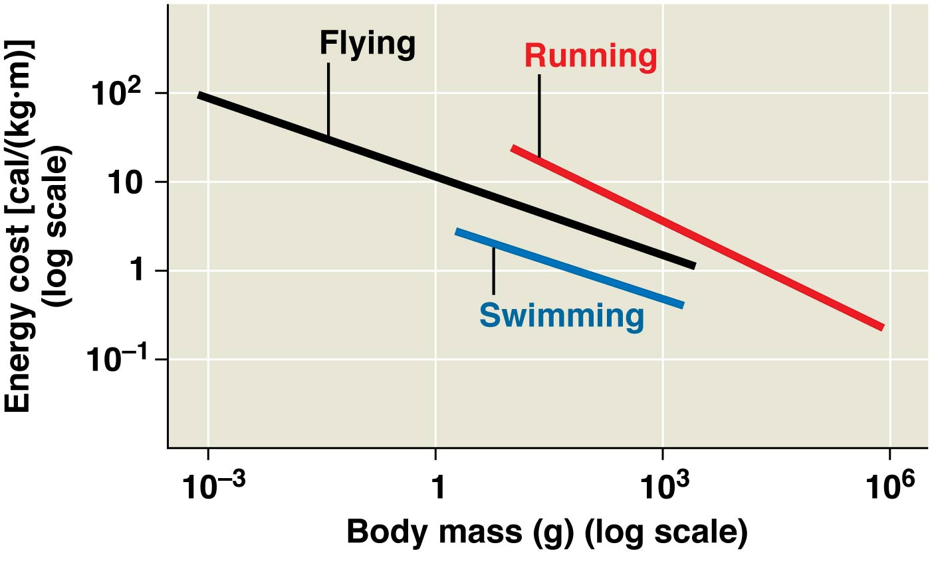
According to the figure, the most energy-efficient locomotion method for a 1-kg animal with the relevant adaptations is
swimming.
flying.
running.
Notes:
10
Answer: A. See the Scientific Skills Exercise in Concept 39.2.

Slide 11
According to the figure, the most energy-efficient locomotion method for a 1-kg animal with the relevant adaptations is
swimming.
flying.
running.
Notes:
11

Slide 12
Which of the following organisms have hydrostatic skeletons?
fish and reptiles
fish and amphibians
cnidarians and flatworms
nematodes and annelids
both C and D
Notes:
Answer: E.

Slide 13
Which of the following organisms have hydrostatic skeletons?
fish and reptiles
fish and amphibians
cnidarians and flatworms
nematodes and annelids
both C and D

Slide 14
Which of the following is not a function of the lateral line system on fish?
monitoring water currents
sensing low-frequency sounds
detecting vibrations from nearby prey
sensing light in the water
Notes:
14
Answer: D. Although the lateral line could sense vibrations from sound in the water, it cannot see anything, as it is not equipped to do so.

Slide 15
Which of the following is not a function of the lateral line system on fish?
monitoring water currents
sensing low-frequency sounds
detecting vibrations from nearby prey
sensing light in the water
Notes:
15

Slide 16
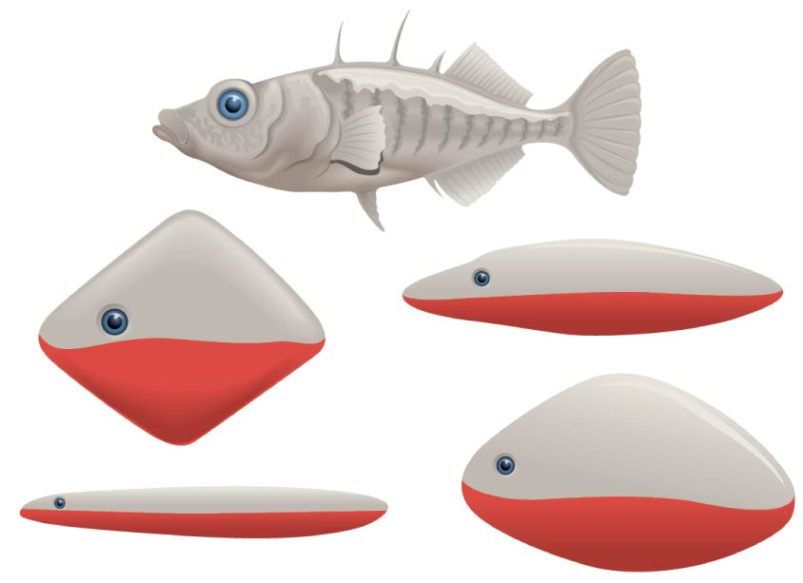
The territorial response in three-spined sticklebacks (Gasterosteus aculeatus) is a fixed action pattern that is triggered by a sign stimulus. What environmental cue did Niko Tinbergen determine was the sign stimulus for aggression in three-spined sticklebacks?
the color red
a torpedo shape
the stickleback spines
a square shape
a swollen belly
Notes:
16
Answer: A. See Concept 39.3.

Slide 17
The territorial response in three-spined sticklebacks (Gasterosteus aculeatus) is a fixed action pattern that is triggered by a sign stimulus. What environmental cue did Niko Tinbergen determine was the sign stimulus for aggression in three-spined sticklebacks?
the color red
a torpedo shape
the stickleback spines
a square shape
a swollen belly
Notes:
17

Slide 18
Which of the following bones in a human skeleton is incorrectly matched with its location?
radius—forearm
hinge joint—hand
tarsals—palm
metacarpals—fingers
Notes:
Answer: C.

Slide 19
Which of the following bones in a human skeleton is incorrectly matched with its location?
radius—forearm
hinge joint—hand
tarsals—palm
metacarpals—fingers

Slide 20
Many distasteful insects are brightly colored. What type of behavior might help explain this?
fixed action pattern
kinesis
associative learning
spatial learning
habituation
Notes:
20
Answer: C. This question is aimed at Concept 39.4 and can be used to begin a discussion of different types of learning.

Slide 21
Many distasteful insects are brightly colored. What type of behavior might help explain this?
fixed action pattern
kinesis
associative learning
spatial learning
habituation
Notes:
21

Slide 22
Which of the following has become an important component of efforts that could save endangered species?
experience of the organisms
behavior of the organisms
nature (genes)
nurture (environment)
imprinting
Notes:
Answer: E.

Slide 23
Which of the following has become an important component of efforts that could save endangered species?
experience of the organisms
behavior of the organisms
nature (genes)
nurture (environment)
imprinting

Slide 24
Every time your dog goes to lie down in her bed, she makes three circles. If you interrupt her, she will start over and do it again. This is an example of
imprinting.
a fixed action pattern.
associative learning.
spatial learning.
Notes:
24
Answer: B. By definition, it is an unlearned behavior that, when initiated, must be completed without interruption.

Slide 25
Every time your dog goes to lie down in her bed, she makes three circles. If you interrupt her, she will start over and do it again. This is an example of
imprinting.
a fixed action pattern.
associative learning.
spatial learning.
Notes:
25

Slide 26
Which of the following is part of the process of cognitive learning?
awareness
reasoning
ability to recollect
judgement
all of the above
Notes:
Answer: E.

Slide 27
Which of the following is part of the process of cognitive learning?
awareness
reasoning
ability to recollect
judgement
all of the above

Slide 28
You come across a pair of birds, one female and the other male, but you cannot tell simply by looking at them. This pair of birds is most likely
monogamous.
polygynous.
polygamous.
hermaphroditic.
Notes:
28
Answer: A. Several monogamous species have no distinguishable differences between males and females, whereas polygamous species tend to have showiness.

Slide 29
You come across a pair of birds, one female and the other male, but you cannot tell simply by looking at them. This pair of birds is most likely
monogamous.
polygynous.
polygamous.
hermaphroditic.
Notes:
29

