Slide 1
9
The Cell Cycle

Slide 2
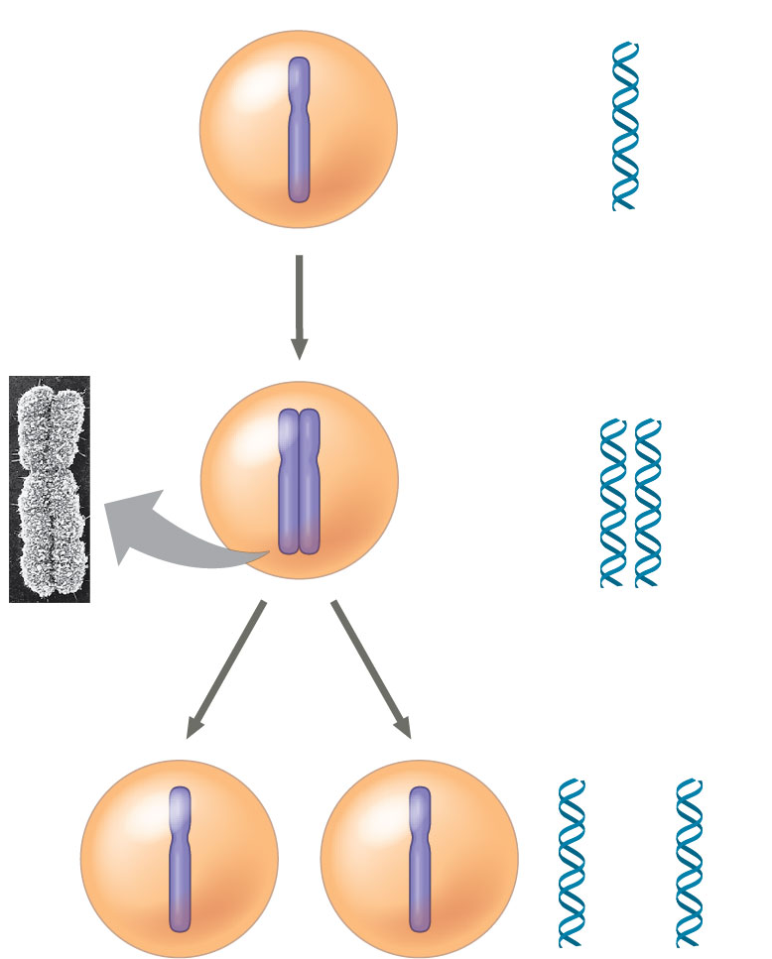
How many chromosomes are in the middle cell?
1
2
4
8
Notes:
Answer: A. There is only one chromosome but two copies in the middle cell. Discuss using a library with multiple copies of the same book as an analogy. See Concept 9.1.

Slide 3
How many chromosomes are in the middle cell?
1
2
4
8
Notes:
3

Slide 4
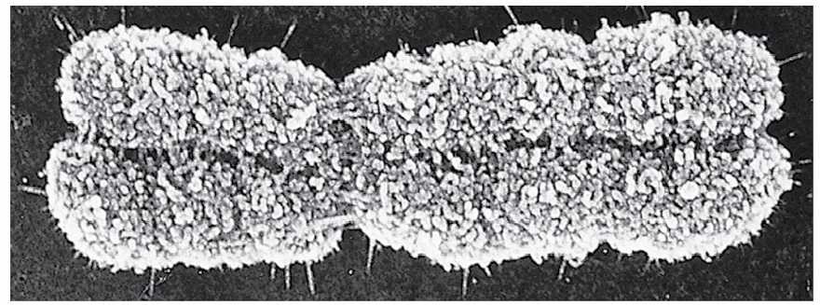
At what part of the cell cycle would you see a chromosome that looks like this? Give your reasons.
G₁
G₂
M
S
Notes:
4
Answer: C. This is a condensed chromosome, ready to be split into separate copies of the same chromosome by mitosis. The chromosome would be decondensed at other times in the cell cycle. See Concepts 9.1 and 9.3.

Slide 5
At what part of the cell cycle would you see a chromosome that looks like this? Give your reasons.
G₁
G₂
M
S
Notes:
5

Slide 6
At what time will the chromosome shown be split into two chromosomes, each the same as the other?
prophase
prometaphase
metaphase
anaphase
telophase
Notes:
6
Answer: D. After lining up on the metaphase plate, the duplicated chromosomes are split, and the daughter copies pulled to opposite poles by the spindle. See Concepts 9.1 and 9.2.

Slide 7
At what time will the chromosome shown be split into two chromosomes, each the same as the other?
prophase
prometaphase
metaphase
anaphase
telophase
Notes:
7

Slide 8
Which of the following best describes the kinetochore?
a structure composed of several proteins that associate with the centromere region of a chromosome and that can bind to spindle microtubules
the centromere region of a metaphase chromosome at which the DNA can bind with spindle proteins
the array of vesicles that will form between two dividing nuclei and give rise to the metaphase plate
the ring of actin microfilaments that will cause the appearance of the cleavage furrow
the core of proteins that forms the cell plate in a dividing plant cell
Notes:
8
Answer: A. See Concept 9.2. Students should be able to differentiate a kinetochore from a centromere. Use the difference between a cell phone and a cell phone case as an analogy.

Slide 9
Which of the following best describes the kinetochore?
a structure composed of several proteins that associate with the centromere region of a chromosome and that can bind to spindle microtubules
the centromere region of a metaphase chromosome at which the DNA can bind with spindle proteins
the array of vesicles that will form between two dividing nuclei and give rise to the metaphase plate
the ring of actin microfilaments that will cause the appearance of the cleavage furrow
the core of proteins that forms the cell plate in a dividing plant cell
Notes:
9

Slide 10
A new cell is found and separation of its chromosomes is examined. How would you interpret this result?
Chromosomes are separated by microfilaments.
Chromosomes are not separated.
Microtubules shorten at the centrosome end.
Microtubules shorten at the chromosome end.
None of the answers is correct.
Notes:
10
Answer: D. See Concept 9.2. The non-movement of the marked part of the microtubules shows that the subunits do not move and that shortening must be occurring at the end of the microtubule that is in contact with the chromosome.

Slide 11
A new cell is found and separation of its chromosomes is examined. How would you interpret this result?
Chromosomes are separated by microfilaments.
Chromosomes are not separated.
Microtubules shorten at the centrosome end.
Microtubules shorten at the chromosome end.
None of the answers is correct.
Notes:
11

Slide 12
Which of the following is a purpose of cell division?
infection
growth
repair
A and B
B and C
Notes:
12
Answer: E. See Concept 9.1. Cells divide to fulfill a range of needs for which extra cells are required.

Slide 13
Which of the following is a purpose of cell division?
infection
growth
repair
A and B
B and C
Notes:
13

Slide 14
If you were counting chromosomes in the gametes and the somatic cells of a giraffe, what should be the ratio of the number in the former to the number in the latter?
1:1
1:2
1:3
1:4
1:8
Notes:
14
Answer: B. See Concept 9.1. Gametes of eukaryotes have half the number of chromosomes as the somatic cells of the same organism.

Slide 15
If you were counting chromosomes in the gametes and the somatic cells of a giraffe, what should be the ratio of the number in the former to the number in the latter?
1:1
1:2
1:3
1:4
1:8
Notes:
15

Slide 16
How does nuclear DNA enter daughter cells?
during replication
as identical copies of the same chromosomes
during G₁
as four copies of each chromosome per daughter cell
attached to all other chromosomes in that cell
Notes:
16
Answer: B. See Concept 9.1. Each daughter cell gets the same chromosomes as the other daughter cell.

Slide 17
How does nuclear DNA enter daughter cells?
during replication
as identical copies of the same chromosomes
during G₁
as four copies of each chromosome per daughter cell
attached to all other chromosomes in that cell
Notes:
17

Slide 18
If you were asked to label a model of a chromosome, the central portion of a replicated chromosome, which looks like the central part of an X, would be labeled
kinetochore.
sister.
arm.
centromere.
Not enough information is provided to decide.
Notes:
18
Answer: D. See Concept 9.1. The centromere is the constricted DNA part of the attachment to the spindle, while the kinetochore is the protein-based part.

Slide 19
If you were asked to label a model of a chromosome, the central portion of a replicated chromosome, which looks like the central part of an X, would be labeled
kinetochore.
sister.
arm.
centromere.
Not enough information is provided to decide.
Notes:
19

Slide 20
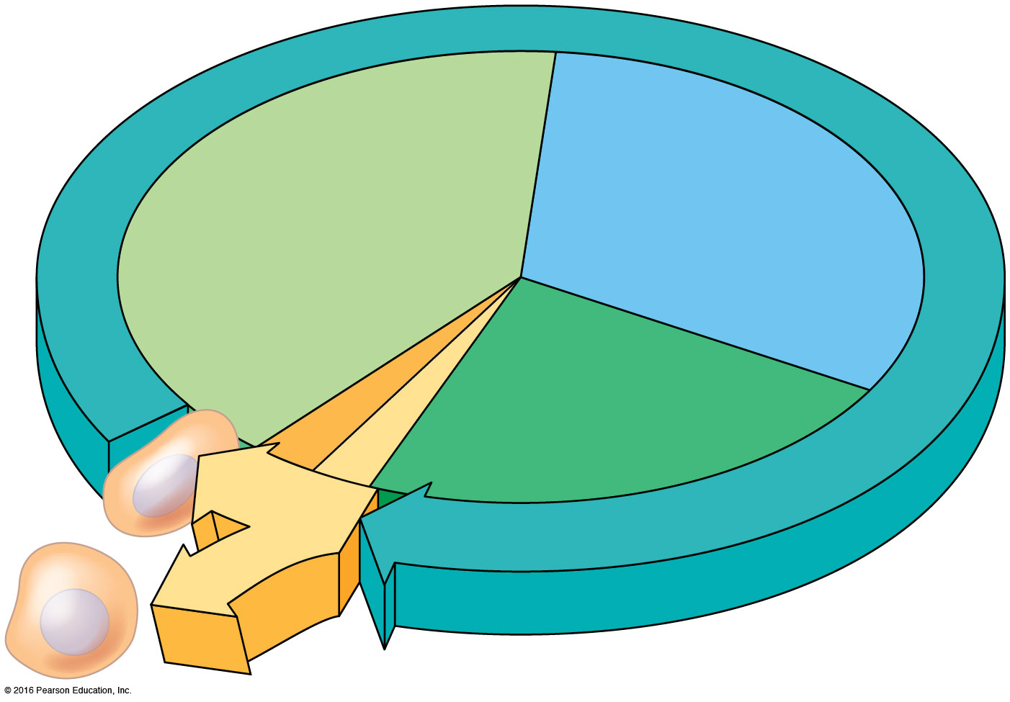
Told to look for a tool in part of a model of the cell cycle during which the cell divides, you would look in the part representing
S phase.
cytokinesis.
G₁ phase.
G₂ phase.
mitosis.
Notes:
20
Answer: B. See Concept 9.2. Cytokinesis the division of the cell into two daughters after the DNA has been divided during mitosis.

Slide 21
Told to look for a tool in part of a model of the cell cycle during which the cell divides, you would look in the part representing
S phase.
cytokinesis.
G₁ phase.
G₂ phase.
mitosis.
Notes:
21

Slide 22
If you saw a cell with condensed chromosomes lined up in the center of the cell, you would know that the cell was in
prophase.
prometaphase.
metaphase.
anaphase.
telophase.
Notes:
22
Answer: C. See Concept 9.2. In metaphase, the chromosomes are lined up in the cell center, pulled equally by microtubules from the two poles.

Slide 23
If you saw a cell with condensed chromosomes lined up in the center of the cell, you would know that the cell was in
prophase.
prometaphase.
metaphase.
anaphase.
telophase.
Notes:
23

Slide 24
If you saw a cell with chromosomes condensing, you would know that the cell was in
prophase.
prometaphase.
metaphase.
anaphase.
telophase.
Notes:
24
Answer: A. See Concept 9.2. In prophase, the chromosomes condense and the spindle starts to form for separating the chromosomes into daughter cells.

Slide 25
If you saw a cell with chromosomes condensing, you would know that the cell was in
prophase.
prometaphase.
metaphase.
anaphase.
telophase.
Notes:
25

Slide 26
If you saw a cell with chromosomes separating but not yet at the poles, you would know that the cell was in
prophase.
prometaphase.
metaphase.
anaphase.
telophase.
Notes:
26
Answer: D. See Concept 9.2. In anaphase, the chromosomes, formerly sister chromatids, are dragged to opposite poles by the microtubules.

Slide 27
If you saw a cell with chromosomes separating but not yet at the poles, you would know that the cell was in
prophase.
prometaphase.
metaphase.
anaphase.
telophase.
Notes:
27

Slide 28
If you saw a cell reversing the changes to chromosomes seen in prophase, you would know that the cell was in
prophase.
prometaphase.
metaphase.
anaphase.
telophase.
Notes:
28
Answer: E. See Concept 9.2. Telophase is the end of mitosis, when chromosomes decondense and the spindle disassembles.

Slide 29
If you saw a cell reversing the changes to chromosomes seen in prophase, you would know that the cell was in
prophase.
prometaphase.
metaphase.
anaphase.
telophase.
Notes:
29

Slide 30
If the nuclear envelope has disappeared but the condensed chromosomes are not yet lined up, the cell is in
prophase.
prometaphase.
metaphase.
anaphase.
telophase.
Notes:
30
Answer: B. See Concept 9.2. Prometaphase immediately precedes metaphase.

Slide 31
If the nuclear envelope has disappeared but the condensed chromosomes are not yet lined up, the cell is in
prophase.
prometaphase.
metaphase.
anaphase.
telophase.
Notes:
31

Slide 32
If asked to guess what part of the cell cycle a eukaryotic cell from an adult organism was in, given no other information, you would be most likely correct if you guessed
prophase.
interphase.
G₁ phase.
anaphase.
S phase.
Notes:
32
Answer: B. See Concept 9.2. Adult organisms perform fewer cell divisions than younger organisms, so most cells would be in interphase, doing various jobs for the body.

Slide 33
If asked to guess what part of the cell cycle a eukaryotic cell from an adult organism was in, given no other information, you would be most likely correct if you guessed
prophase.
interphase.
G₁ phase.
anaphase.
S phase.
Notes:
33

Slide 34
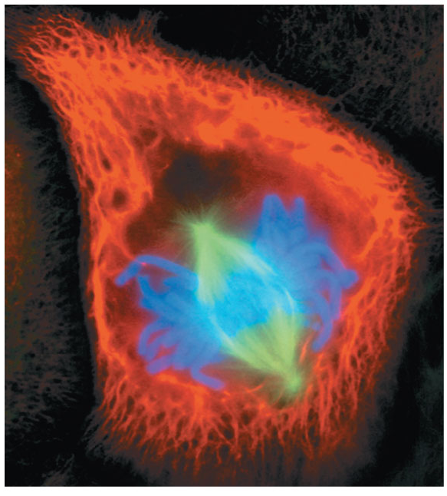
If you wanted to create a drug to stop chromosomes from lining up during mitosis, but otherwise not disturb the overall process, you would want to disrupt
kinetochores.
DNA condensation.
DNA synthesis.
cytokinesis.
arms.
Notes:
34
Answer: A. See Concept 9.2. Kinetochores are the complexes where spindle microtubules attach to chromosomes. Without kinetochores, chromosomes could not be lined up on the metaphase plate.

Slide 35
If you wanted to create a drug to stop chromosomes from lining up during mitosis, but otherwise not disturb the overall process, you would want to disrupt
kinetochores.
DNA condensation.
DNA synthesis.
cytokinesis.
arms.
Notes:
35

Slide 36
What forces the chromosomes to line up at the center of the cell in metaphase?
equal pulling on each kinetochore in a joined pair of sister chromatids
pushing by mitochondria
displacement by the cleavage furrow
repulsion by the spindle
None of the answers is correct.
Notes:
36
Answer: A. See Concept 9.2. Each kinetochore is pulled by a spindle with the same force, with this balanced force making the chromosomes line up in the center of the cell. Use an analogy of a tug-of-war between equally matched teams to explain.

Slide 37
What forces the chromosomes to line up at the center of the cell in metaphase?
equal pulling on each kinetochore in a joined pair of sister chromatids
pushing by mitochondria
displacement by the cleavage furrow
repulsion by the spindle
None of the answers is correct.
Notes:
37

Slide 38
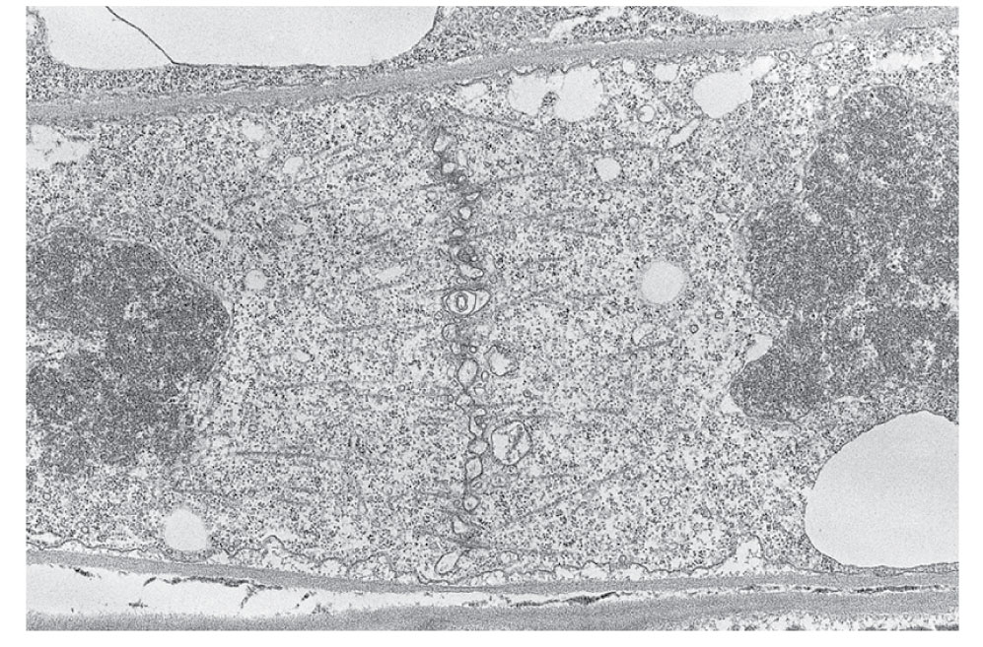
To disrupt cytokinesis in a plant cell, you need to disrupt
all microtubules.
the contractile ring.
microtubules near the cell plate.
all microfilaments.
spindle microtubules.
Notes:
38
Answer: C. See Concept 9.2. Microtubules near the forming cell plate help to build the new wall that divides two daughter cells when a plant cell goes through mitosis.

Slide 39
To disrupt cytokinesis in a plant cell, you need to disrupt
all microtubules.
the contractile ring.
microtubules near the cell plate.
all microfilaments.
spindle microtubules.
Notes:
39

Slide 40
If studying a bacterial cell dividing, you would need to read most about
cytokinesis.
binary fission.
microtubules.
microfilaments.
nuclear envelope.
Notes:
40
Answer: B. See Concept 9.2. Binary fission is the simple form of cell division used by prokaryotes like bacteria. All of the other terms pertain to eukaryotic cell division.

Slide 41
If studying a bacterial cell dividing, you would need to read most about
cytokinesis.
binary fission.
microtubules.
microfilaments.
nuclear envelope.
Notes:
41

Slide 42
If you had a chemical to block ______, cells would stall during the cell cycle and have twice the normal amount of DNA in the presence of this chemical.
the G₁ checkpoint
the M checkpoint
the G₂ checkpoint
A or B
Cells cannot stall in the cell cycle.
Notes:
42
Answer: C. See Concept 9.3. The G₂ checkpoint stops cells from entering mitosis before they are prepared and after DNA has doubled.

Slide 43
If you had a chemical to block ______, cells would stall during the cell cycle and have twice the normal amount of DNA in the presence of this chemical.
the G₁ checkpoint
the M checkpoint
the G₂ checkpoint
A or B
Cells cannot stall in the cell cycle.
Notes:
43

Slide 44
If you had a chemical to block ______, cells would stall during the cell cycle and never synthesize DNA.
the G₁ checkpoint
the M checkpoint
the G₂ checkpoint
A or B
A or C
Notes:
44
Answer: A. See Concept 9.3. The G₁ checkpoint precedes DNA synthesis during the S phase.

Slide 45
If you had a chemical to block ______, cells would stall during the cell cycle and never synthesize DNA.
the G₁ checkpoint
the M checkpoint
the G₂ checkpoint
A or B
A or C
Notes:
45

Slide 46
When observing some fibroblasts in culture, you notice that cell counts stop once the cells reach 100 per square centimeter. You are observing
interphase.
the M checkpoint.
density-dependent inhibition.
prophase.
the action of growth factors.
Notes:
46
Answer: C. See Concept 9.3. Density-dependent inhibition involves cells sensing the number of their kind nearby and stopping cell division once sufficient cells are present.

Slide 47
When observing some fibroblasts in culture, you notice that cell counts stop once the cells reach 100 per square centimeter. You are observing
interphase.
the M checkpoint.
density-dependent inhibition.
prophase.
the action of growth factors.
Notes:
47

Slide 48
A friend claims to have invented a miracle cure that causes wounds to heal more quickly. This might include
products of cytokinesis.
chemicals to halt cells at the M checkpoint.
stimulating interphase cells to divide without DNA synthesis.
microtubules.
growth factors.
Notes:
48
Answer: E. See Concept 9.3. Growth factors stimulate cell division, which is critical in wound healing.

Slide 49
A friend claims to have invented a miracle cure that causes wounds to heal more quickly. This might include
products of cytokinesis.
chemicals to halt cells at the M checkpoint.
stimulating interphase cells to divide without DNA synthesis.
microtubules.
growth factors.
Notes:
49

Slide 50
Without checkpoints during the cell cycle, what might happen?
mitosis before DNA synthesis is done
DNA synthesis without sufficient biochemical preparation
insufficient cells in G₀ for normal functioning
daughter cells with the wrong number of chromosomes
All of the answer choices are correct.
Notes:
50
Answer: E. See Concept 9.3. Checkpoints ensure that the various stages of the cell cycle happen at appropriate times and only when the necessary preceding steps have been completed.

Slide 51
Without checkpoints during the cell cycle, what might happen?
mitosis before DNA synthesis is done
DNA synthesis without sufficient biochemical preparation
insufficient cells in G₀ for normal functioning
daughter cells with the wrong number of chromosomes
All of the answer choices are correct.
Notes:
51

