Slide 1
5
Membrane Transport and
Cell Signaling

Slide 2
Which best describes the structure of a biological membrane?
two layers of phospholipids with proteins embedded between the two layers
a mixture of covalently linked phospholipids and proteins that determines which solutes can cross the membrane and which cannot
two layers of phospholipids with proteins either
crossing the layers or on the surface of the layers
a fluid structure in which phospholipids and proteins move freely between sides of the membrane
two layers of phospholipids (with opposite orientations of the phospholipids in each layer) with each layer covered on the outside with proteins
Notes:
Answer: C. Membrane proteins can either extend from the cytoplasm to outside the plasma membrane or be attached to one side of the plasma membrane. Discuss why a protein that only extended part way into the membrane would not exist. See Concept 5.1.

Slide 3
Which best describes the structure of a biological membrane?
two layers of phospholipids with proteins embedded between the two layers
a mixture of covalently linked phospholipids and proteins that determines which solutes can cross the membrane and which cannot
two layers of phospholipids with proteins either
crossing the layers or on the surface of the layers
a fluid structure in which phospholipids and proteins move freely between sides of the membrane
two layers of phospholipids (with opposite orientations of the phospholipids in each layer) with each layer covered on the outside with proteins
Notes:
3

Slide 4
Which statement about osmosis is correct?
If a cell is placed in an isotonic solution, more water will enter the cell than leaves the cell.
Osmotic movement of water into a cell would likely occur if the cell accumulates water from its environment.
The presence of aquaporins (proteins that form
water channels in the membrane) should speed up
the process of osmosis.
If a solution outside the cell is hypertonic compared to the cytoplasm, water will move into the cell by osmosis.
Osmosis is the diffusion of water from a region of lower water concentration to a region of higher water concentration.
Notes:
4
Answer: C. From Concepts 5.2 and 5.3, since osmosis is passive transport, aquaporins help the water molecules move down their concentration gradient more quickly. Discuss whether ATP would be needed.

Slide 5
Which statement about osmosis is correct?
If a cell is placed in an isotonic solution, more water will enter the cell than leaves the cell.
Osmotic movement of water into a cell would likely occur if the cell accumulates water from its environment.
The presence of aquaporins (proteins that form
water channels in the membrane) should speed up
the process of osmosis.
If a solution outside the cell is hypertonic compared to the cytoplasm, water will move into the cell by osmosis.
Osmosis is the diffusion of water from a region of lower water concentration to a region of higher water concentration.
Notes:
5

Slide 6
Which of the following amino acids would most likely be present in the transmembrane domain of an integral membrane protein?
a charged amino acid like lysine
a polar amino acid like serine
a special amino acid like glycine or proline
a hydrophobic amino acid like valine
any of the above, with no preference
Notes:
6
Answer: D. This question relates to Concept 5.1. Transmembrane domains primarily consist of α helices of hydrophobic amino acids.

Slide 7
Which of the following amino acids would most likely be present in the transmembrane domain of an integral membrane protein?
a charged amino acid like lysine
a polar amino acid like serine
a special amino acid like glycine or proline
a hydrophobic amino acid like valine
any of the above, with no preference
Notes:
7

Slide 8
Which molecule will diffuse most quickly across a lipid bilayer membrane?
H₂O
O₂
H₂PO₄⁻
glucose
Na⁺
Notes:
8
Answer: B. This question relates to Concepts 5.1 and 5.3. Discuss how water and glucose have to be helped by membrane proteins, and the other choices have a strong charge and thus will not diffuse across the center of a bilayer.

Slide 9
Which molecule will diffuse most quickly across a lipid bilayer membrane?
H₂O
O₂
H₂PO₄⁻
glucose
Na⁺
Notes:
9

Slide 10
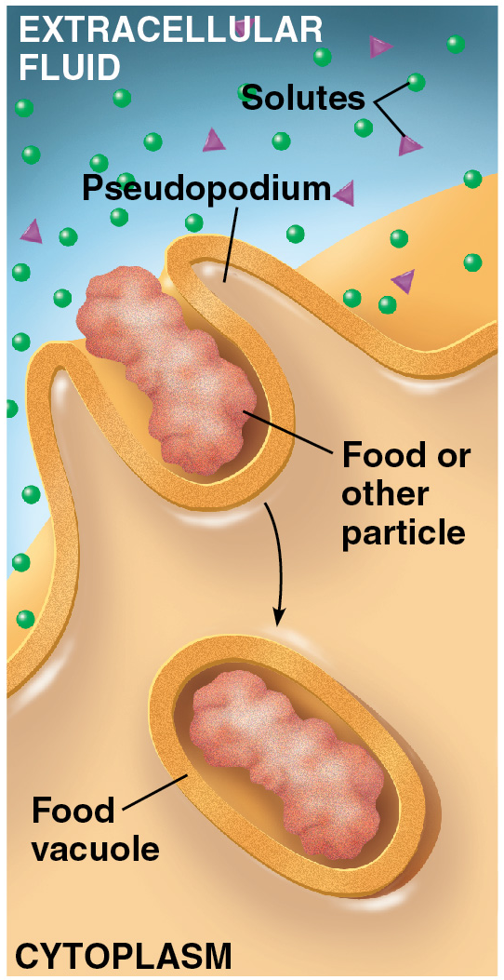
Cells such as bacteria are taken up by other cells such as immune cells by which process?
pinocytosis
exocytosis
receptor-mediated endocytosis
phagocytosis
facilitated diffusion
Notes:
10
Answer: D. From Concept 5.5, discuss the kinds of endocytosis and why the other two kinds would not be used for bacteria.

Slide 11
Cells such as bacteria are taken up by other cells such as immune cells by which process?
pinocytosis
exocytosis
receptor-mediated endocytosis
phagocytosis
facilitated diffusion
Notes:
11

Slide 12
Which of the following best describes a signal transduction pathway?
binding of a signal molecule to a cell protein
catalysis mediated by an enzyme
sequence of changes in a series of molecules
resulting in a response
binding of a ligand on one side of a membrane that results in a change on the other side
the cell’s detection of a chemical or mechanical stimulus
Notes:
12
Answer: C. Please see Concept 5.6. Signal transduction pathways involve a series of stepwise changes that can provide an amplified response. Compare to a cellular phone call with its various steps (nerve impulses, muscular movements, sounds produced, motion of phone receiver, etc.).

Slide 13
Which of the following best describes a signal transduction pathway?
binding of a signal molecule to a cell protein
catalysis mediated by an enzyme
sequence of changes in a series of molecules resulting in a response
binding of a ligand on one side of a membrane that results in a change on the other side
the cell’s detection of a chemical or mechanical stimulus
Notes:
13

Slide 14
Match the receptor with its mechanism.
1. channel receptor
2. G protein-coupled receptor
phosphorylation
binding
ion influx into the cell
dephosphorylation
ATP synthesis
Notes:
14
Answer: 1. C; 2. A. Discuss how receptor proteins work in general, using an analogy with handshakes and other greetings. See Concept 5.6.

Slide 15
Match the receptor with its mechanism.
1. channel receptor
2. G protein-coupled receptor
phosphorylation
binding
ion influx into the cell
dephosphorylation
ATP synthesis
Notes:
15

Slide 16
A steroid hormone binds to an intracellular receptor. When it does, what is the resulting complex able to do?
open channels in the membrane for other substances to enter
open channels in the nuclear envelope for cytoplasmic molecules to enter
mediate the transfer of phosphate groups to/from ATP
change gene expression
make water-soluble molecules able to diffuse across membranes
Notes:
16
Answer: D. By binding to DNA, the steroid-receptor combination can slow or speed the copying of RNA from DNA and thus change the level of gene expression.

Slide 17
A steroid hormone binds to an intracellular receptor. When it does, what is the resulting complex able to do?
open channels in the membrane for other substances to enter
open channels in the nuclear envelope for cytoplasmic molecules to enter
mediate the transfer of phosphate groups to/from ATP
change gene expression
make water-soluble molecules able to diffuse across membranes
Notes:
17

Slide 18
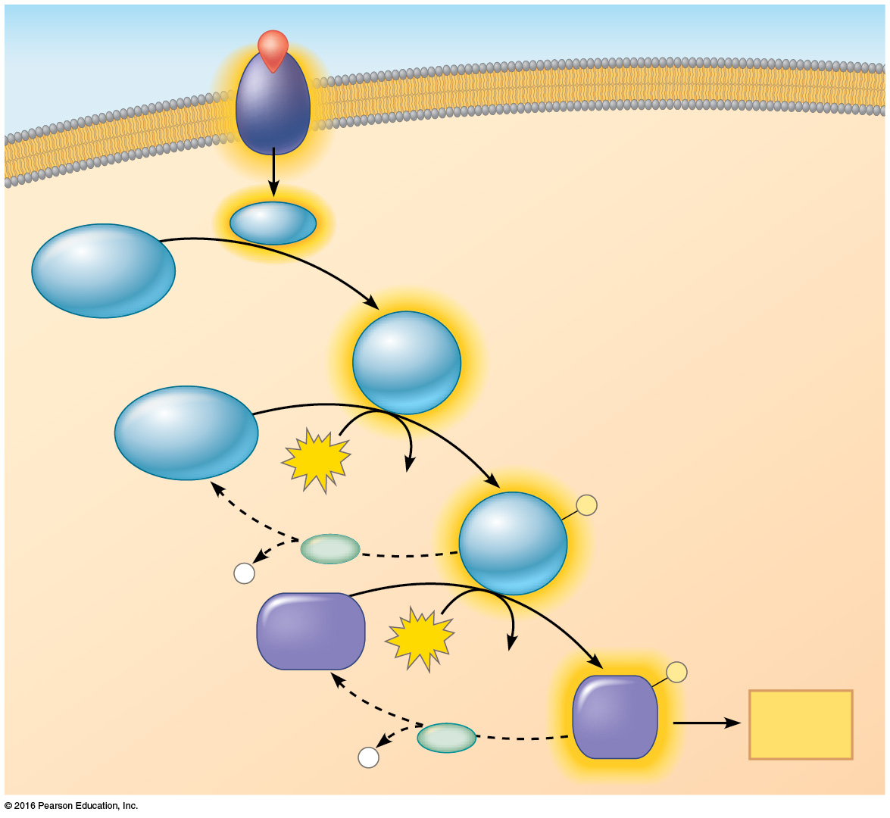
Weak ionic bonds formed between the negative phosphate functional group and partially or fully positive amino acids of proteins in a phosphorylation cascade do which of the following?
make functional ATP
change the shape of a protein from its inactive to its active form
change the shape of a protein from its active to its inactive form
alter the permeability of the cell’s membranes
produce an increase in the cell’s store of inorganic phosphates
Notes:
18
Answer: B. Please see Concept 5.6. Phosphate, being large and negatively charged, changes the shape of a protein and thus its function.

Slide 19
Weak ionic bonds formed between the negative phosphate functional group and partially or fully positive amino acids of proteins in a phosphorylation cascade do which of the following?
make functional ATP
change the shape of a protein from its inactive to its active form
change the shape of a protein from its active to its inactive form
alter the permeability of the cell’s membranes
produce an increase in the cell’s store of inorganic phosphates
Notes:
19

Slide 20
Which of the following is an example of signal amplification?
production of many molecules by many signal molecules
activation of 100 molecules by a single signal binding event
activation of a specific gene by a transcription factor
activation of an enzyme molecule
activation of a receptor by a hormone
Notes:
20
Answer: B. See Concept 5.6. Discuss how a message can be amplified by being spread from one person to two, and then from two to four, and so on.

Slide 21
Which of the following is an example of signal amplification?
production of many molecules by many signal molecules
activation of 100 molecules by a single signal binding event
activation of a specific gene by a transcription factor
activation of an enzyme molecule
activation of a receptor by a hormone
Notes:
21

Slide 22
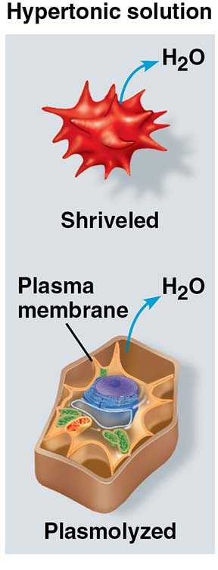
Movement of water out of a cell that has been placed in a hypertonic solution is
active transport.
passive transport.
diffusion.
B and C.
A and C.
Notes:
22
Answer: D. Osmosis is an example of passive transport, in which water diffuses out of a cell, either through the plasma membrane directly or via aquaporins. See Concept 5.3.

Slide 23
Movement of water out of a cell that has been placed in a hypertonic solution is
active transport.
passive transport.
diffusion.
B and C.
A and C.
Notes:
23

Slide 24
If you placed an algal cell that had been living in a marine aquarium with oceanic fish into a glass of pure water, what would happen?
The cell would take up water.
The cell would turn on cell signaling.
Water would bind to receptors.
The cell would lose water.
none of the above
Notes:
24
Answer: A. See Concept 5.3. A cell from a marine habitat would contain high concentrations of solutes, so it would absorb water from the salt-free pure water.

Slide 25
If you placed an algal cell that had been living in a marine aquarium with oceanic fish into a glass of pure water, what would happen?
The cell would take up water.
The cell would turn on cell signaling.
Water would bind to receptors.
The cell would lose water.
none of the above
Notes:
25

Slide 26
You are observing a newly discovered form of protist, and you see an organelle suddenly decrease in volume. What has happened?
The cell was osmoregulating.
The cell used its contractile vacuole.
The cell was counteracting osmosis.
The cell was avoiding bursting.
All of the choices are correct.
Notes:
26
Answer: E. See Concept 5.3. This sounds like a Paramecium, which uses its contractile vacuole to expel excess water obtained by osmosis and by endocyotosis.

Slide 27
You are observing a newly discovered form of protist, and you see an organelle suddenly decrease in volume. What has happened?
The cell was osmoregulating.
The cell used its contractile vacuole.
The cell was counteracting osmosis.
The cell was avoiding bursting.
All of the choices are correct.
Notes:
27

Slide 28
If you were studying a cell undergoing lots of active transport, which nucleotide would you expect to find in greatest abundance?
GTP
UTP
TTP
ATP
CTP
Notes:
28
Answer: D. As discussed in Concept 5.4, ATP is used to power active transport, while GTP has a role in cell signaling, and all five choices are used in making DNA or RNA.

Slide 29
If you were studying a cell undergoing lots of active transport, which nucleotide would you expect to find in greatest abundance?
GTP
UTP
TTP
ATP
CTP
Notes:
29

Slide 30
A living cell has a gradient across its membrane that is which of the following?
electrical
physical
light-driven
chemical
A and D
Notes:
30
Answer: E. As discussed in Concept 5.4, because living cells contain different amounts of ions than their surrounding, they have differences from their surroundings in terms of both charge and chemical concentration.

Slide 31
A living cell has a gradient across its membrane that is which of the following?
electrical
physical
light-driven
chemical
A and D
Notes:
31

Slide 32
If you place a culture of animal cells (called fibroblasts) into a container filled with molecules of red dye that have a strong negative charge, and the dye ends up inside the cell, what is the most likely explanation for the uptake?
osmosis
phagocytosis
pinocytosis
active transport
None of the answers is correct.
Notes:
32
Answer: C. As discussed in Concept 5.1, membranes have a hydrophobic center that cannot be crossed by charged molecules, and from Concept 5.5, dissolved molecules are continually taken up by pinocytosis. D is possible, but why the cell would expend energy to take up a dye is not obvious.

Slide 33
If you place a culture of animal cells (called fibroblasts) into a container filled with molecules of red dye that have a strong negative charge, and the dye ends up inside the cell, what is the most likely explanation for the uptake?
osmosis
phagocytosis
pinocytosis
active transport
None of the answers is correct.
Notes:
33

Slide 34
If you were asked to figure out what a newly discovered receptor was used for, what function(s) might you consider?
binding a steroid hormone
specialized endocytosis
activating a G protein
serving as an ion channel
All of the answers are correct.
Notes:
34
Answer: E. Receptors serve a wide range of roles, as described in Concepts 5.5 and 5.6. Discuss how each of these functions relies on a receptor.

Slide 35
If you were asked to figure out what a newly discovered receptor was used for, what function(s) might you consider?
binding a steroid hormone
specialized endocytosis
activating a G protein
serving as an ion channel
All of the answers are correct.
Notes:
35

Slide 36
If a cell membrane were hydrophilic, with pores larger than most proteins, could it be selectively permeable in a living system?
Yes; this is a typical cell membrane.
No; any substances could pass through.
Yes; it would keep other large cells out.
No; proteins need to diffuse unto cells.
Yes; proteins are the main thing kept outside a cell by membranes.
Notes:
36
Answer: B. As discussed in Concept 5.2, selectively permeable membranes act as a barrier to diffusion of molecules into and out of the cell, especially hydrophilic ones.

Slide 37
If a cell membrane were hydrophilic, with pores larger than most proteins, could it be selectively permeable in a living system?
Yes; this is a typical cell membrane.
No; any substances could pass through.
Yes; it would keep other large cells out.
No; proteins need to diffuse unto cells.
Yes; proteins are the main thing kept outside a cell by membranes.
Notes:
37

Slide 38
If a sugar needed by a cell was found at higher concentration inside the cell than outside, what would the cell need to do?
open ion channels
dissolve its plasma membrane
perform active transport
perform phagocytosis
lower its membrane potential
Notes:
38
Answer: B. To transport against a gradient, energy must be put into the process. See Concept 5.4. Discuss macroscopic examples of working against a gradient, such as walking uphill.

Slide 39
If a sugar needed by a cell was found at higher concentration inside the cell than outside, what would the cell need to do?
open ion channels
dissolve its plasma membrane
perform active transport
perform phagocytosis
lower its membrane potential
Notes:
39

Slide 40
Which would be the most surprising function of an integral membrane protein in the plasma membrane?
connect to cytoskeleton
connect to extracellular matrix
serve as a motor protein in the cytoskeleton
act as a receptor
allow ions to pass through the membrane
Notes:
40
Answer: C. Motor proteins are usually peripheral membrane proteins or free in the cytoplasm. Discuss why the incorrect options are part of normal membrane function, as shown in Concept 5.1.

Slide 41
Which would be the most surprising function of an integral membrane protein in the plasma membrane?
connect to cytoskeleton
connect to extracellular matrix
serve as a motor protein in the cytoskeleton
act as a receptor
allow ions to pass through the membrane
Notes:
41

Slide 42
Chemical analysis of a cellular membrane would normally reveal the presence of
sugars.
proteins.
lipids.
nucleic acids.
A–C.
Notes:
42
Answer: E. Glycolipids and glycoproteins are found in membranes, but usually nucleic acids are not, as shown in Concept 5.1.

Slide 43
Chemical analysis of a cellular membrane would normally reveal the presence of
sugars.
proteins.
lipids.
nucleic acids.
A–C.
Notes:
43

Slide 44
A stain that revealed the location of glycoproteins would stain what?
plasma membrane
some vesicles
ER
Golgi body
all of the above
Notes:
44
Answer: E. Glycoproteins are made in the ER and sorted through the Golgi and out to the plasma membrane via vesicles, as shown in Concept 5.1.

Slide 45
A stain that revealed the location of glycoproteins would stain what?
plasma membrane
some vesicles
ER
Golgi body
all of the above
Notes:
45

Slide 46
What do transport proteins do for cells?
speed up transport
increase the kinds of molecules entering cells
act as enzymes
A and B
B and C
Notes:
46
Answer: D. As discussed in Concept 5.2, the various transport proteins let many things into cells more quickly than would happen otherwise. Discuss analogies such as elevators and doors in buildings.

Slide 47
What do transport proteins do for cells?
speed up transport
increase the kinds of molecules entering cells
act as enzymes
A and B
B and C
Notes:
47

Slide 48
In which case would osmosis occur?
a red blood cell in an isotonic solution
a beaker of water with salt dissolved and evenly mixed in it
a cell coated with an impermeable plastic coating
a skin cell in a hypotonic solution
none of the above
Notes:
48
Answer: D. Concept 5.3 shows that a gradient is needed to drive osmosis, diffusion of water across a selectively permeable membrane. Discuss how each incorrect choice does not fit this definition.

Slide 49
In which case would osmosis occur?
a red blood cell in an isotonic solution
a beaker of water with salt dissolved and evenly mixed in it
a cell coated with an impermeable plastic coating
a skin cell in a hypotonic solution
none of the above
Notes:
49

Slide 50
In which case would active transport be needed?
uptake of potassium from a solution rich in sodium by a cell rich in potassium
release of sodium from a cell that stores it
uptake of a hydrophobic dye that was newly placed in a solution
release of dye from a crystal placed in solution
none of the above
Notes:
50
Answer: A. Concept 5.4 discusses how active transport is needed for uptake against a gradient. Cover how movement would be spontaneous in the other cases.

Slide 51
In which case would active transport be needed?
uptake of potassium from a solution rich in sodium by a cell rich in potassium
release of sodium from a cell that stores it
uptake of a hydrophobic dye that was newly placed in a solution
release of dye from a crystal placed in solution
none of the above
Notes:
51

