Slide 1
14
Gene Expression: From Gene to Protein

Slide 2
Which of the following is the best example of gene expression?
A frog adapts to variation in its environmental temperature.
Mouse fur color results from pigment formed by gene-encoded enzymes.
DNA is replicated during the S phase of the cell cycle.
The percent of A versus a alleles in a population is altered by natural selection.
Mutation alters the sequence of a region of DNA.
Notes:
2
Answer: B. Gene expression is the first concept of Chapter 14 (albino deer example); also see Concept 14.1.

Slide 3
Which of the following is the best example of gene expression?
A frog adapts to variation in its environmental temperature.
Mouse fur color results from pigment formed by gene-encoded enzymes.
DNA is replicated during the S phase of the cell cycle.
The percent of A versus a alleles in a population is altered by natural selection.
Mutation alters the sequence of a region of DNA.
Notes:
3

Slide 4
Consider the diagram below, in which red strands are DNA and orange strands are potential RNA transcripts. Which letter(s) could represent proper transcripts?
W
X
X and Y
W and Z
W
Y
3′
5′
5′
3′
X
Z
Notes:
Answer: C. Transcripts must be synthesized 5′ to 3′ in antiparallel fashion relative to the template DNA. No promoter orientation is given, so both X and Y could be correct.

Slide 5
Consider the diagram below, in which red strands are DNA and orange strands are potential RNA transcripts. Which letter(s) could represent proper transcripts?
W
X
X and Y
W and Z
W
Y
3′
5′
5′
3′
X
Z

Slide 6
Consider the diagram below, in which red strands are DNA and orange strands are potential RNA transcripts. Noting the orientation of the promoter, which letter(s) could represent proper transcripts?
promoter
W
Y
Z
Y and Z
W
Y
3′
5′
5′
3′
X
Z
promoter
Notes:
Answer: B. The promoter orientation, combined with 5′ to 3′ rules, specifies that strand Y is the only proper transcript. This question is also good for illustrating that there is no universal “template” or “coding” strand. It all depends on the orientation of the promoter.

Slide 7
Consider the diagram below, in which red strands are DNA and orange strands are potential RNA transcripts. Noting the orientation of the promoter, which letter(s) could represent proper transcripts?
promoter
W
Y
Z
Y and Z
W
Y
3′
5′
5′
3′
X
Z
promoter

Slide 8
The nontemplate strand of a portion of a gene reads
5′ ACTGGTTCA. What will be the sequence of the resulting transcript for this portion?
5′ UGACCAAGU
5′ ACUGGUUCA
5′ UGAACCAGU
5′ ACUUGGUCA
Notes:
Answer: B. The transcript should have the same 5′ to 3′ sequence with U’s substituted for T’s. This is a good question for reinforcing the 5′ to 3′ rule.

Slide 9
The nontemplate strand of a portion of a gene reads
5′ ACTGGTTCA. What will be the sequence of the resulting transcript for this portion?
5′ UGACCAAGU
5′ ACUGGUUCA
5′ UGAACCAGU
5′ ACUUGGUCA

Slide 10
What kind of molecules are transcription factors?
DNA
RNA
proteins
lipids
Notes:
Answer: C.

Slide 11
What kind of molecules are transcription factors?
DNA
RNA
proteins
lipids

Slide 12
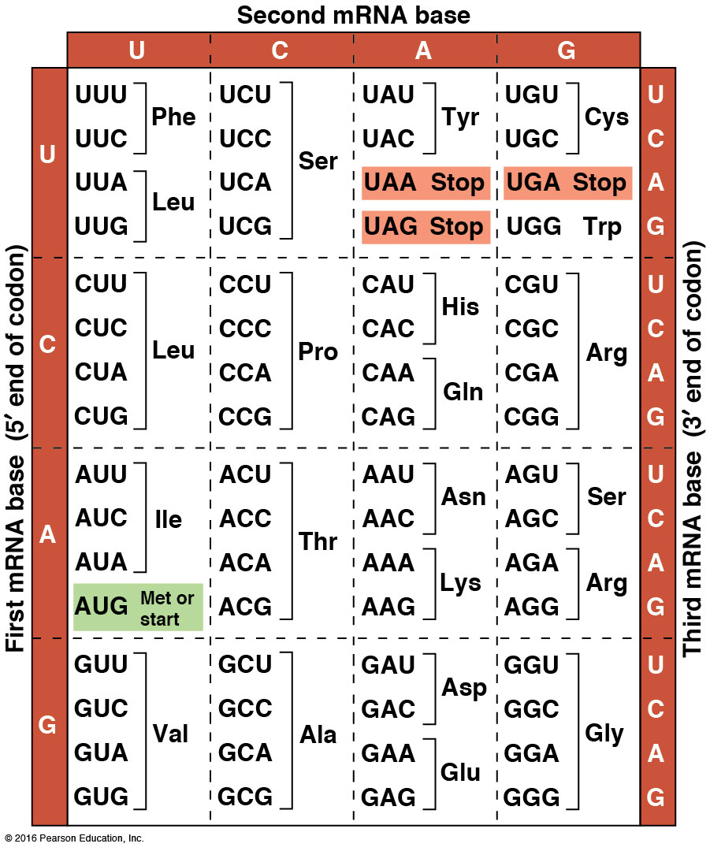
What is the 5′→ 3′ sequence on the anticodon of the methionine (Met) tRNA?
AUG
GUA
UAC
CAU
Notes:
Answer: D. The anticodon is antiparallel. This is a great question for reinforcing this concept.

Slide 13
What is the 5′→ 3′ sequence on the anticodon of the methionine (Met) tRNA?
AUG
GUA
UAC
CAU

Slide 14
In a long random sequence of A, C, G, or U, how often should a stop codon appear?
almost never
1/3
1/64
3/64
Notes:
Answer: D. This is a simple question to help students connect probabilities with the codon table. It is also very useful for introducing the concept of the open reading frame (most proteins are much longer than 20 (~3/64) amino acids), so it is clear they are not encoded by chance!

Slide 15
In a long random sequence of A, C, G, or U, how often should a stop codon appear?
almost never
1/3
1/64
3/64

Slide 16
How many amino acyl tRNA synthetases should there be?
64
61
20
3
Notes:
Answer: C. There should be one per amino acid, even though most amino acid codons are redundant.

Slide 17
How many amino acyl tRNA synthetases should there be?
64
61
20
3

Slide 18
During a normal translation cycle, where would you expect to find a polypeptide on a ribosome?
on a tRNA attached to the E site
on a tRNA attached to the P site
on a tRNA attached to the A site
alternating between tRNAs attached to the P site and tRNAs attached to the A site
Notes:
Answer: D.

Slide 19
During a normal translation cycle, where would you expect to find a polypeptide on a ribosome?
on a tRNA attached to the E site
on a tRNA attached to the P site
on a tRNA attached to the A site
alternating between tRNAs attached to the P site and tRNAs attached to the A site

Slide 20
Tetracycline antibiotics bind to the A site on the bacterial ribosome and prevent further translation. Where would you expect polypeptides to accumulate on tetracycline-inhibited ribosomes?
on a tRNA attached to the E site
on a tRNA attached to the P site
on a tRNA attached to the A site
alternating between tRNAs attached to the P site and tRNAs attached to the A site
Notes:
Answer: B.

Slide 21
Tetracycline antibiotics bind to the A site on the bacterial ribosome and prevent further translation. Where would you expect polypeptides to accumulate on tetracycline-inhibited ribosomes?
on a tRNA attached to the E site
on a tRNA attached to the P site
on a tRNA attached to the A site
alternating between tRNAs attached to the P site and tRNAs attached to the A site

Slide 22
In which group(s) of organisms would you expect to see coupled transcription and translation?
prokaryotes
eukaryotes
both
neither
Notes:
Answer: A.

Slide 23
In which group(s) of organisms would you expect to see coupled transcription and translation?
prokaryotes
eukaryotes
both
neither

Slide 24
In which group(s) of organisms would you expect to see polyribosomes?
prokaryotes
eukaryotes
both
neither
Notes:
Answer: C.

Slide 25
In which group(s) of organisms would you expect to see polyribosomes?
prokaryotes
eukaryotes
both
neither

Slide 26
Which of the following is a (are) normal feature(s) of eukaryotic mRNA?
5′ cap
poly-A tail
5′ UTR
3′ UTR
all of the above
Notes:
Answer: E.

Slide 27
Which of the following is a (are) normal feature(s) of eukaryotic mRNA?
5′ cap
poly-A tail
5′ UTR
3′ UTR
all of the above

Slide 28
When a mutation caused by a nucleotide pair substitution occurs in a protein coding region, which of the following effects can not occur?
silent
frameshift
missense
nonsense
All are possible.
Notes:
Answer: B. Substitutions should not alter the reading frame.

Slide 29
When a mutation caused by a nucleotide pair substitution occurs in a protein coding region, which of the following effects can not occur?
silent
frameshift
missense
nonsense
All are possible.

Slide 30
When a mutation caused by a nucleotide pair insertion occurs in a protein coding region, which of the following effects can not occur?
silent
frameshift
missense
nonsense
All are possible.
Notes:
Answer: A. Insertions must alter the reading frame, and thus must alter the amino acid sequence.

Slide 31
When a mutation caused by a nucleotide pair insertion occurs in a protein coding region, which of the following effects can not occur?
silent
frameshift
missense
nonsense
All are possible.

